Slide 1
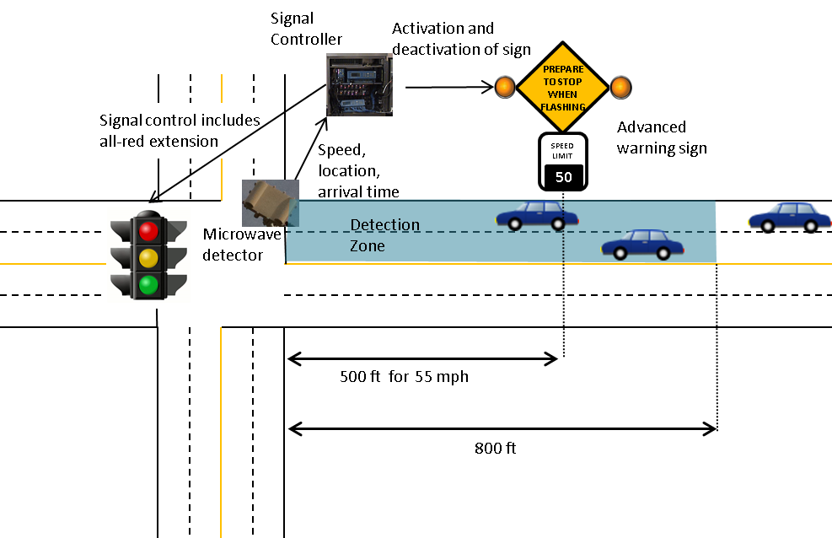
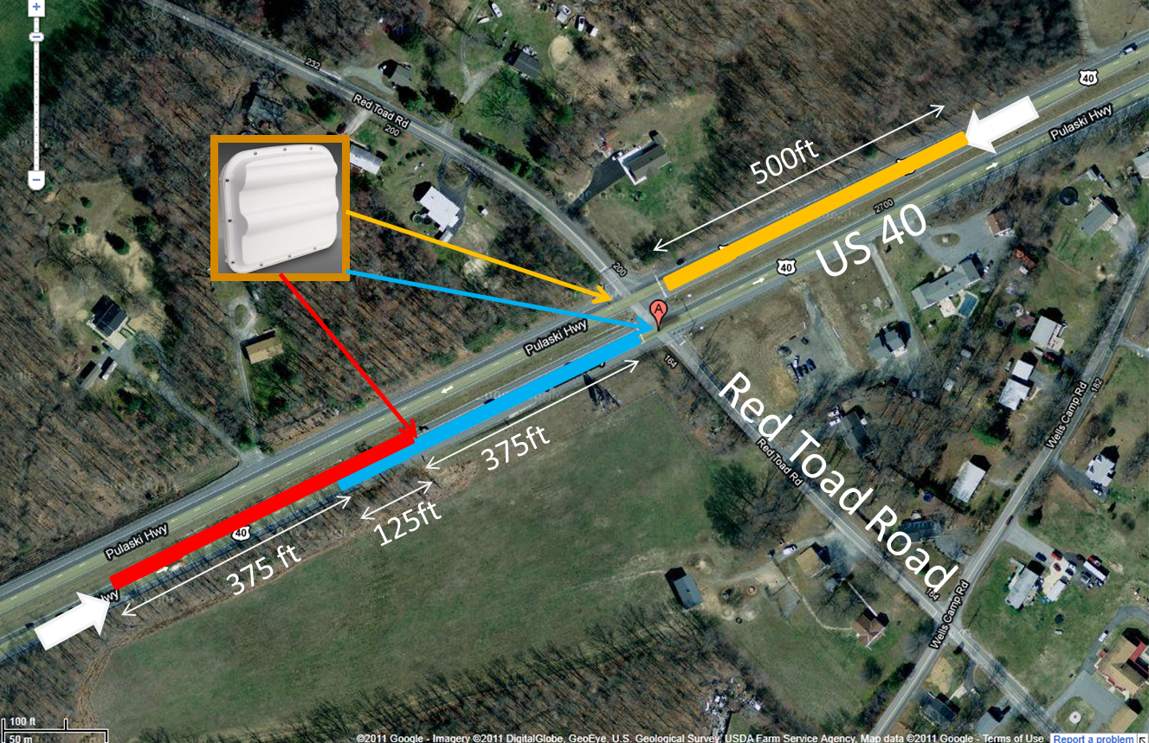
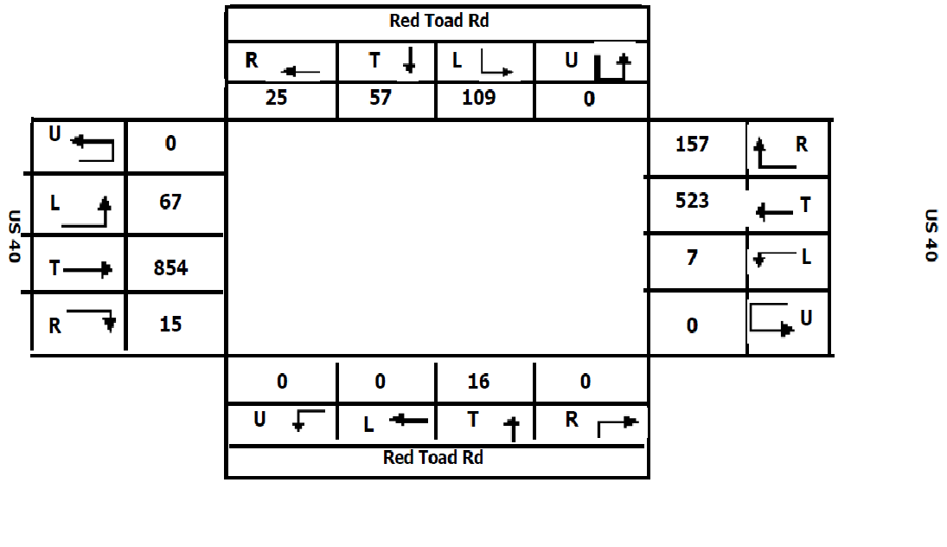
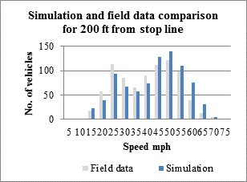
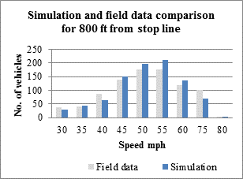
Design and Evaluation of An Advanced Dilemma Zone Protection System: Advanced Warning Sign and All-Red Extension
by Sung Yoon Park, Liu Xu, Gang-Len Chang
University of Maryland, College Park
Abstract
Proposed System
Speed mph | Location of vehicle from stop line onset of yellow
 | 0 - 100 ft |  |  | 100 - 200 ft |  |  | 200 - 300 ft |  |  | 300 - 400 ft |  |  | 400 - 500 ft
 | Field | Initial | Final | Field | Initial | Final | Field | Initial | Final | Field | Initial | Final | Field | Initial | Final
30 - 40 | 100% | 100% | 100% | 86% | 100% | 59% | 21% | 100% | 48% | 2% | 89% | 18% | 0% | 18% | 0%
40 - 50 | 100% | 100% | 100% | 100% | 100% | 100% | 74% | 100% | 56% | 50% | 100% | 64% | 20% | 100% | 8%
50 - 60 | 100% | 100% | 100% | 100% | 100% | 100% | 88% | 100% | 80% | 50% | 100% | 71% | 0% | 100% | 0%
Field: percentage of driver taking the “Pass” decision from field observations Initial: percentage of driver taking the “Pass” decision fromVISSIM with initial coefficients Final: percentage of driver taking the “Pass” decision from VISSIM after re-calibration.
Sensitivity Analysis
This paper proposes an advanced intelligent dilemma zone protection system that integrates advanced warning signs with all-red extension strategies to reduce the number of red-light running vehicles and also to provide extra time to clear the intersection.
A behavioral model for drivers’ response on yellow has been rigorously developed ,calibrated with field data and then been incorporated into VISSIM for extensive simulation experiments.
Results indicates that the proposed system can offer best protection on safety measures.
Locations of AWS on Drivers’ Responses to the Yellow Phase
Note that in the range between 300 to 500ft, the total number of red-light running vehicles decrease with the AWS’s distance increases, but reach an approximately stable level if AWS is placed over 500 feet.
The Impact of Traffic Volume on Driver Behavior
Number of red-light running vehicles increases with the volume. However, the rate of red-light running vehicles remains around ten vehicles per 1000 vehicles, indicating that volume is not a major contributing factor for red light running vehicles.
After adjusting parameters, $α=0.798,β_{1}=−0.35,β_{2}=0.455$ were chosen for the minimized total difference as shown in following table.
Locations of AWS(ft) | Total number of red-light runners | Average remaining All-red time (sec)
300 | 167 | 2.5
400 | 157 | 2.3
500 | 138 | 2.1
600 | 139 | 1.8
700 | 134 | 1.8
Target intersection
Turning Movements
Volume level | Total number of red-light running vehicle | Average remaining All-red interval for red-light running vehicles (sec) | Average number of run on red vehicles per 1000 vehicles
Low (500 veh/hr/ln) | 138 | 2.3 | 10.35
Medium (750 veh/hr/ln) | 202 | 1.9 | 10.05
High (1000 veh/hr/ln) | 263 | 1.7 | 9.75
Design of proposed dilemma zone protection system
Research Background
Drivers’ Behavior Model
Speed distributions from field and simulation for 200 feet and 800 feet from the stop line
Research Motivation
According to a report from the 2009 National Highway Traffic Safety Administration, approximately, 165,000 people were injured annually by the neglect of red-light instruction .
The existence of dilemma zones at signalized intersections is one of the main contributors to the high frequency of accidents.
Research Objective
This research is to investigate the compound effectiveness of integrating the advanced warning sign with the all-red phase extension on minimizing the dilemma zone caused accidents.
Empirical observations of responses of driver during the yellow phase at six intersections are used to calibrate a driver’s behavior model, and use as the basis for conducting laboratory experiments and performance evaluation.
Calibration of Drivers’ Responses on Yellow Model
Step 1: : Identifying Contributing Factors.
Step 2: Calibration of VISSIM’s Embodied “Reaction to Amber” Model with Field Data.
$$P_{stop}=\frac{1}{1+e^{−α−β_{1}v−β_{2}d_{x}}}$$
The initially estimated values of those key parameters are: $α=0.798,β_{1}=−0.288,β_{2}=0.043$ from field data.
Step 3: Comparison of Simulated Drivers’ Responses in VISSIM with the Field Data
With the initial calibrated parameters ($α=0.798,{ β}_{1}=−0.288, β_{2}=0.043$) seem do not offer the promise for laboratory experiments.
Results Analysis
Conclusions
VARIABLES | Coeff. | P-Value
Initial_Speed | 0.043 | 0
Initial_Position | -0.271 | 0
Age[Middle] | 1.577 | 0.008
Age[Senior] | 4.811 | 0
Phone[not on = 0] | -2.774 | 0
Passenger[ None = 0] | -2.152 | 0
Costant | -1.529 | 0.59
Comparison scenarios
Base Scenario: actuated control without any protection.
Scenario 1: actuated control with all-red extension only.
Scenario 2: actuated control with advanced warning sign only.
Scenario 3: actuated control with all-red extension and advanced warning sign.
This study has employed simulation experiments to evaluate a proposed dilemma zone protection system that uses advanced warning to advise drivers and exerts the all-red extension to prevent those non-compliance drivers from causing accidents.
To reflect the actual drivers’ responses to the yellow phase, the simulation system developed with VISSIM has been incorporated with a driver behavior model which is calibrated with the field data of 1123 drivers from six locations.
The results of simulated experiments confirm an expectation that the integration of advance warning system with all-red extension can better protect drivers and improve traffic safety.
 | Base Scenario | Scenario 1 | Scenario 2 | Scenario 3
Total number of vehicles run on red | 175 | 141 | 151 | 138
Vehicle running on red rate (per 1000 veh) | 10.8 | 8.7 | 9.3 | 8.5
Average remaining all-red time (sec) | 1.47 | 2.08 | 1.4 | 2.13
Total number of vehicles | 16206 | 16206 | 16206 | 16206
Simulation durations (hr) | 10 | 10 | 10 | 10
% of changes in number of vehicles running on red (%) from Base line Scenario* | - | -19% | -14% | -21%
Additional remaining all-red time from Base line Scenario (sec) ** | - | 0.61 | -0.07 | 0.66
* (total number of vehicles run on red from scenario each - total number of vehicles run base scenario)/total number of vehicles run base scenario ** average remaining all-red time from base scenario - average remaining all-red from each scenario

