Slide 1

Dilemma Zone Protection System
ATTAP
Traffic Safety and Operations Lab
University of Maryland

Slide 2
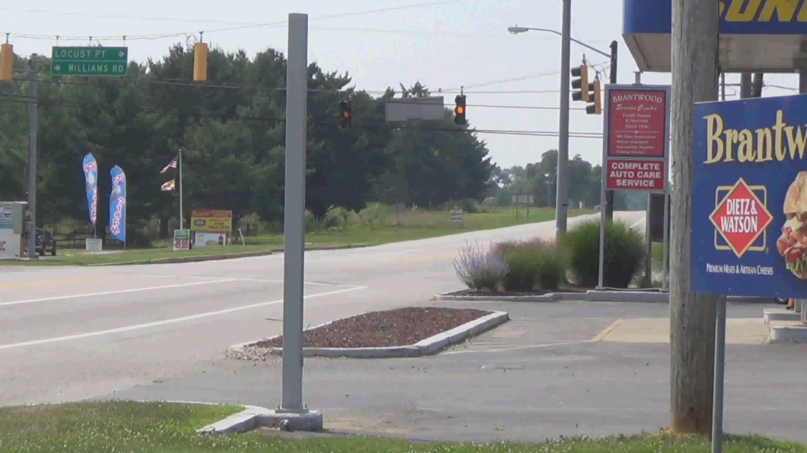
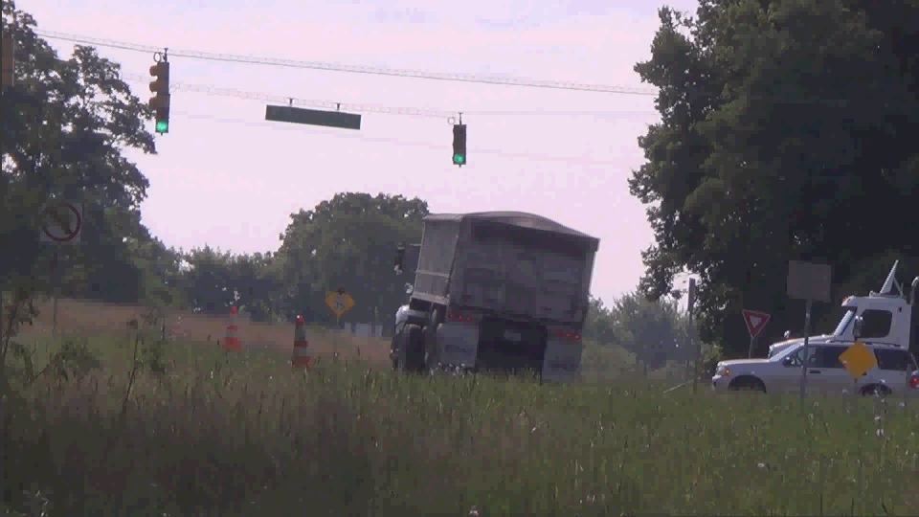
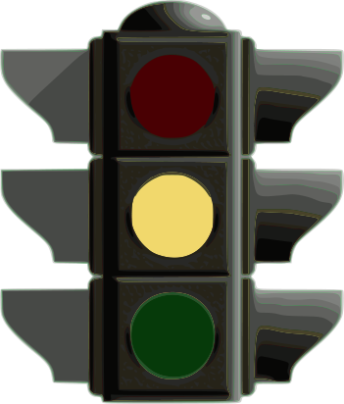
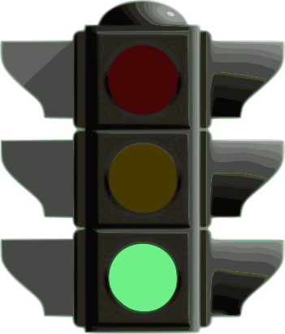
When signal changeS to yellow,
What is your decision?
STOP? Or Pass?
STOP
????
Pass
Notes:
Cars on wrong side
“awkward silence” during second video

Slide 3
It’s called THE Dilemma Zone
Cannot Stop
Dilemma Zone
Cannot Pass
Where a driver cannot stop comfortably and cannot pass the intersection
Notes:
Cars on wrong side
“DZ”

Slide 4
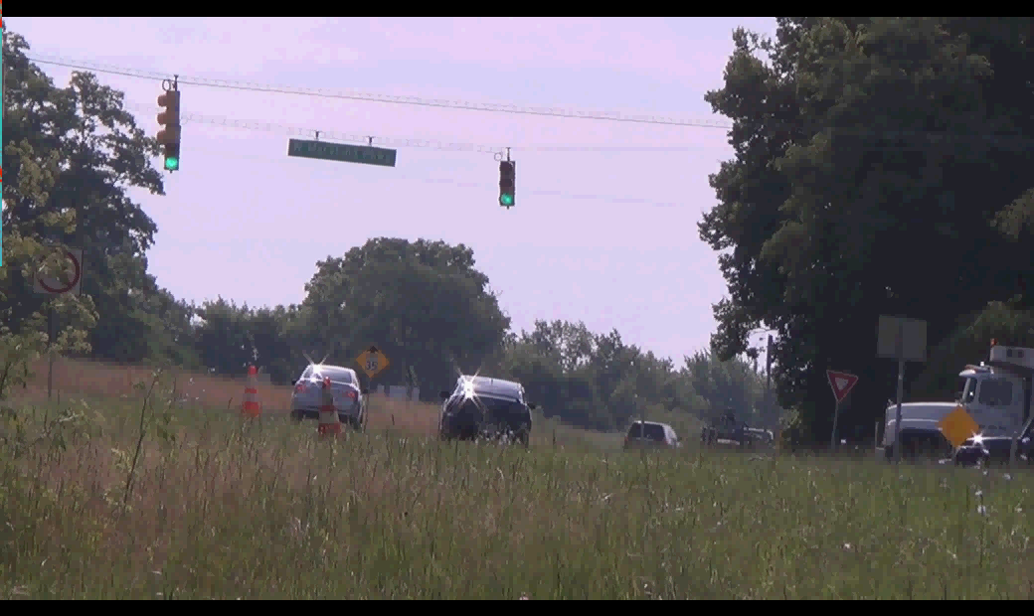
Without DZ Protection
Cause accidents

Slide 5
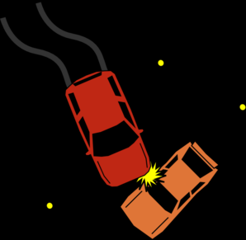
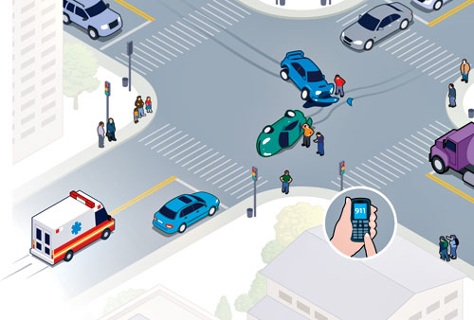
Some statistics about DZ
165,000 people injured related to red-light running
20% of total accidents on the intersection are related red-light-running in Maryland
Notes:
Change to figure

Slide 6
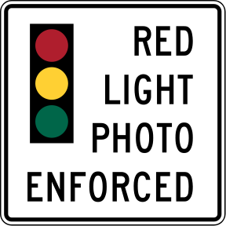

How to prevent?
Traffic Engineering
Education
Enforcement
Notes:
Make font larger or change color

Slide 7
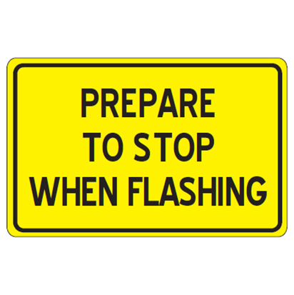

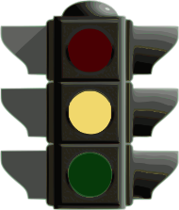
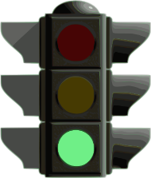
As traffic engineerS, what can we do?
Advanced Warning Sign
  Provide warning in advance
  30-40% reduction in red-light running
PREPARE TO STOP WHEN FLASHING
Notes:
Make sure this slide clearly explains what the All red extension, holds the traffic on the side street

Slide 8
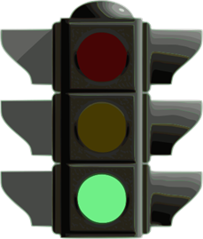
As traffic engineerS, what can we do?
Green Truncation
  Find best time to change signal
  Based on number of vehicles in the DZ
No Protection
Dilemma Zone
Protection
Dilemma Zone

Slide 9
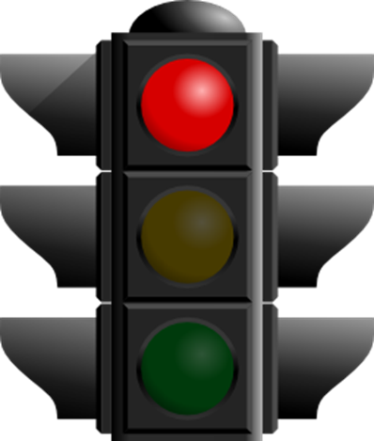
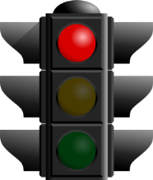
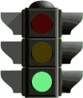

As traffic engineerS, what can we do?
All-Red Extension
  Prevent potential accidents
  Provide additional clearance time
No Protection
Protection

Slide 10
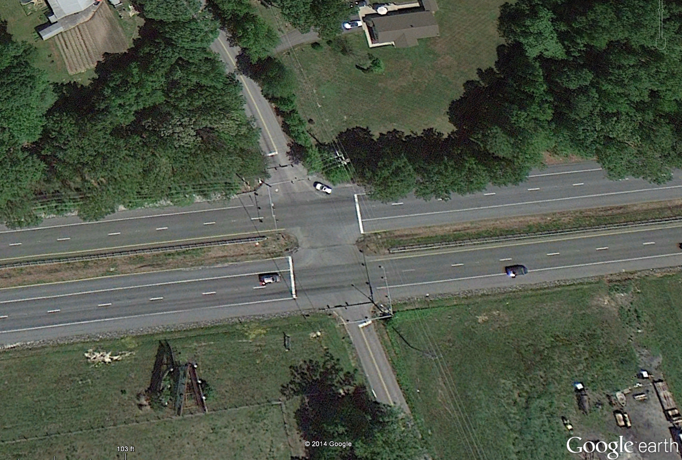
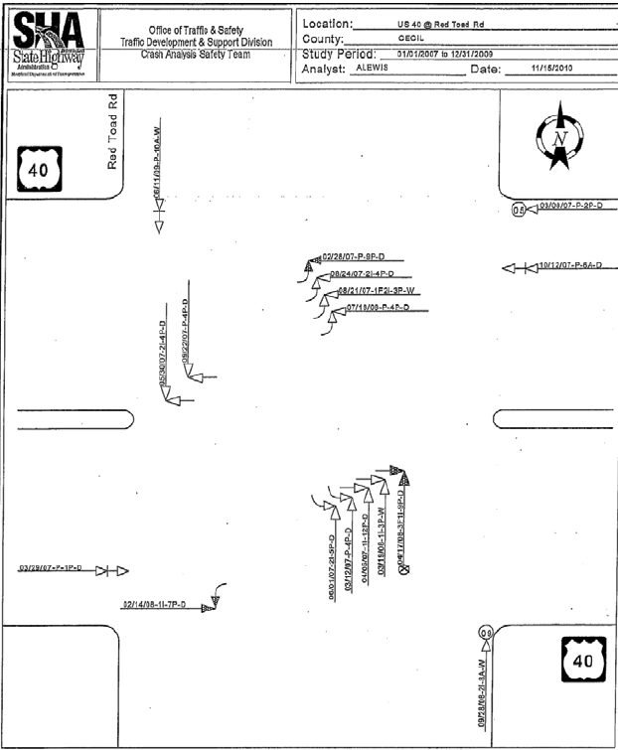
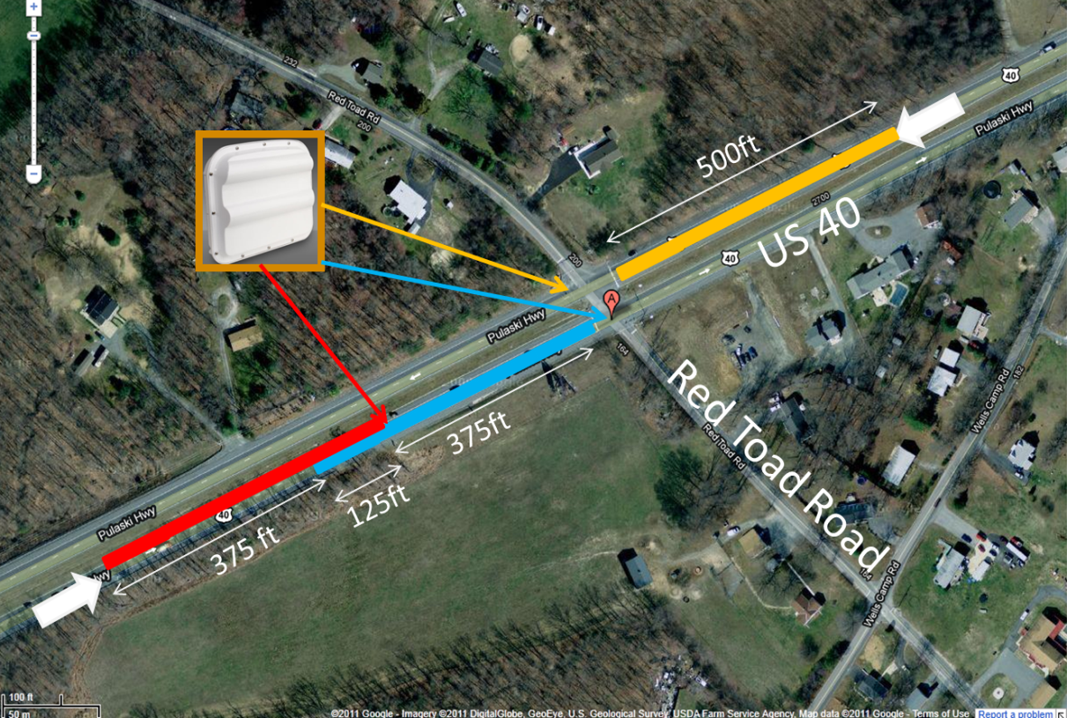
Field deployment on
All-Red Extension protection system
US 40 @ Red Toad Road
US 40
40 angled accidents
Red Toad Road
Notes:
This white picture is too technical

Slide 11
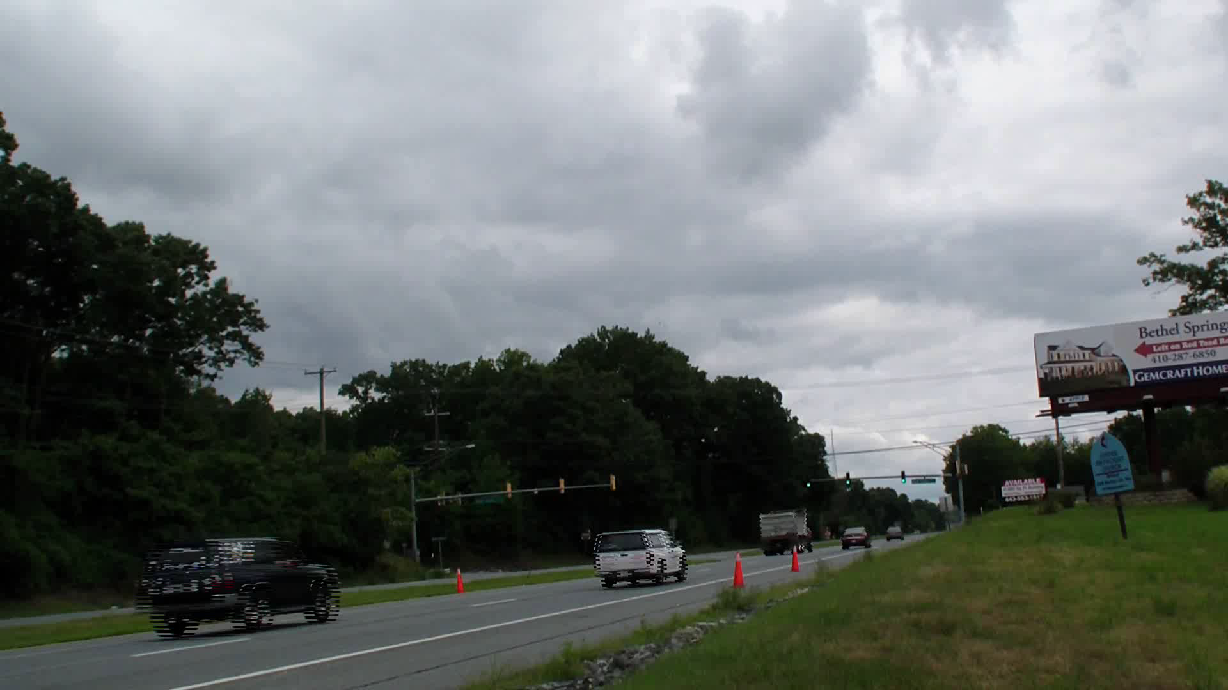
From the protection
Benefits
  Reduce number of red light running vehicles
  Provide extra clearance time

Slide 12
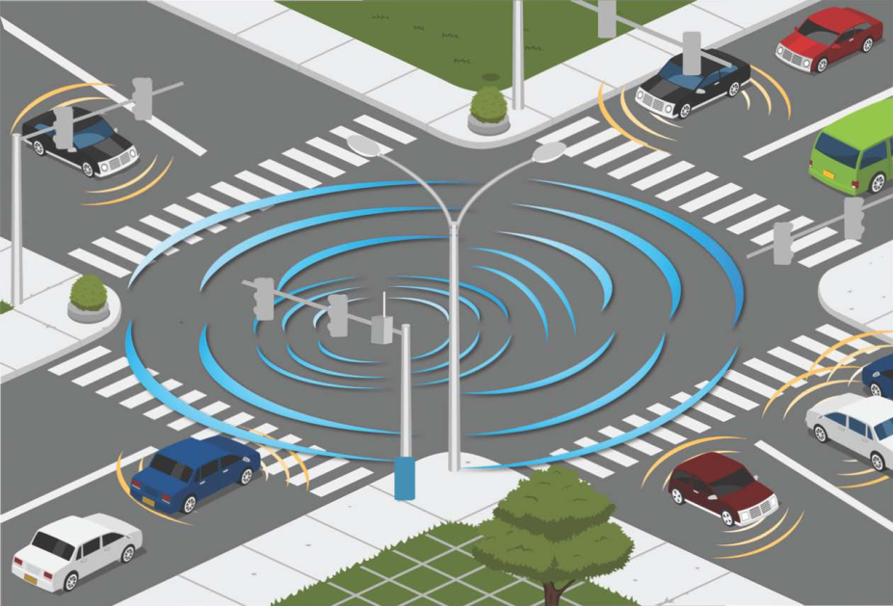
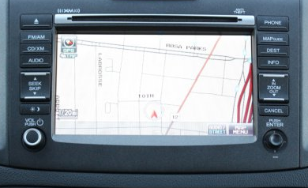
Ongoing Studies
Connected vehicles
  Intersection provide when the signal will be change
  On board system will provide warning sign to drivers
Prepare to STOP at Baltimore Ave @ Campus Dr
Source: Florida DOT

Slide 13
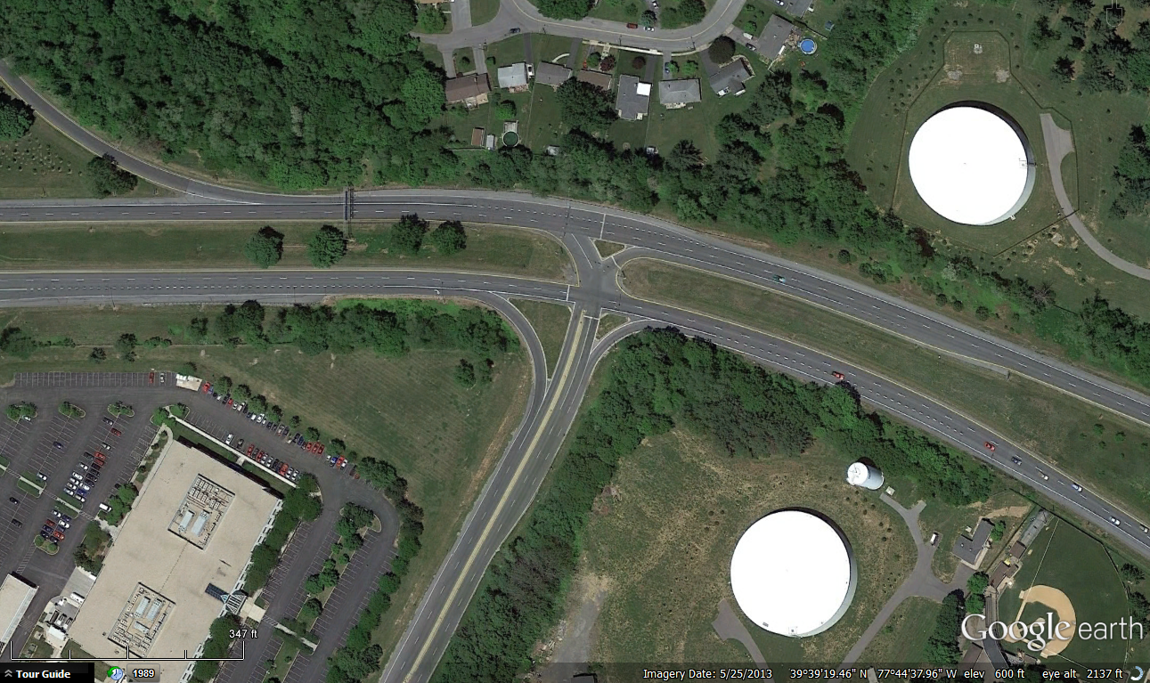
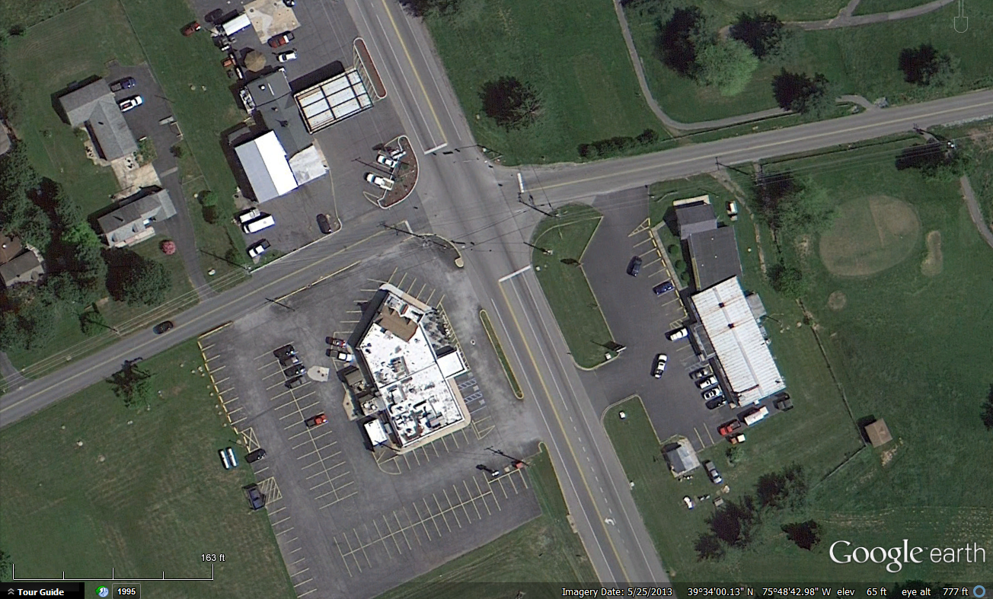
Ongoing Studies
Field deployment
  Advanced Warning Sign
  All-Red Extension
12 accidents related to DZ
2 severe accidents related to DZ
US 40 @ Western Maryland Parkway
MD 213 @ Locust Point Road/William Street

Slide 14
Thank you
Sung Yoon Park
alza102@gmail.com
Ph.D. Candidate
University of Maryland

