Slide 1
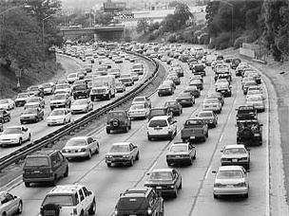
An Integrated Traffic Control System for Urban Freeway Corridors under Non-recurrent Congestion

Slide 2
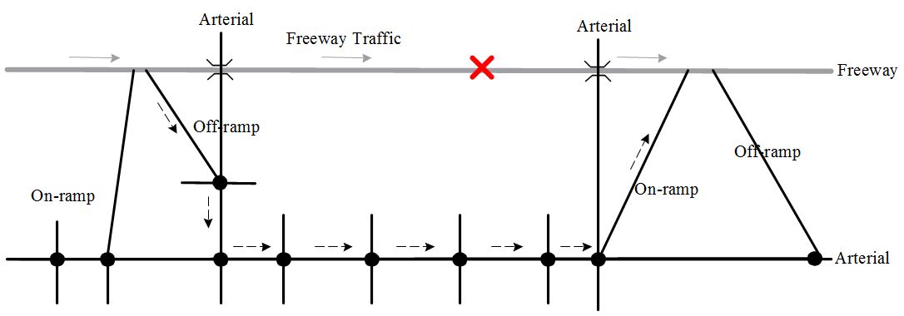
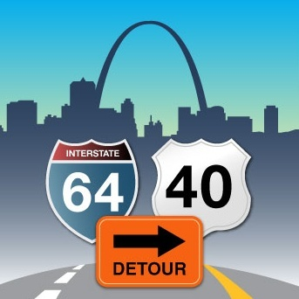
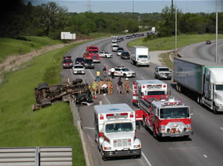
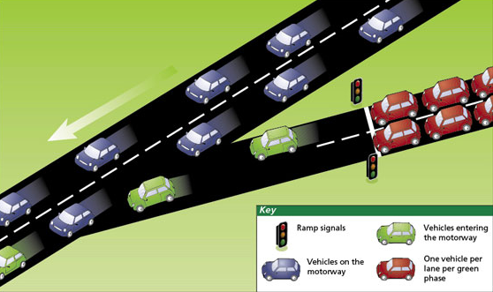
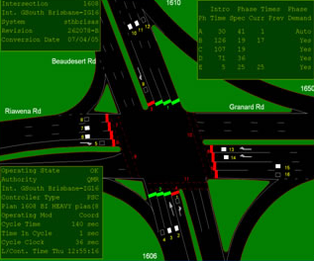
Non-recurrent Congestion & Potential Solutions
A Urban Freeway Corridor System
Non-recurrent Congestion
Potential Solutions I – Detour Operations
Potential Solutions II – Ramp Metering
Potential Solutions III – Arterial Signal Optimization
Undermine capacity
Decrease efficiency
Up to 60% freeway delay (Zhang, 1997)
Utilize available parallel arterial capacity
Relieve freeway congestion
Control the access to freeway mainline
High speeds and throughput on freeway
Reduce stops, delays, and queuing
Improve Level of Service at Intersections

Slide 3
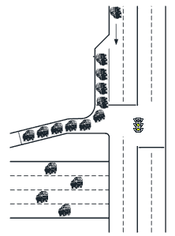
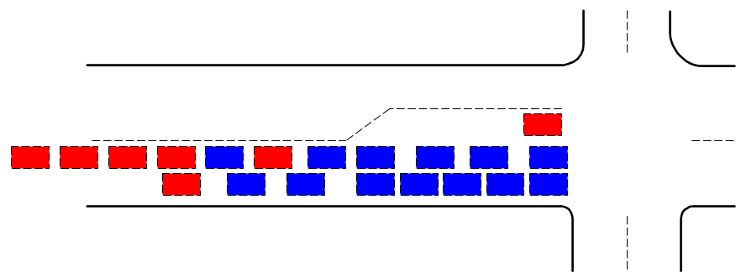
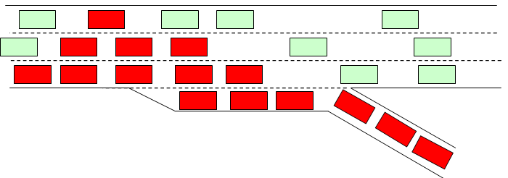
New Problems Arising !
A shift of congestion between arterials and freeways
Even worse traffic conditions than the incident impact
C. Arterial Spillback and Blockages
Integrated control strategies need to be developed
B. Off-ramp Congestion
A. On-ramp Spillback

Slide 4
Outline
Critical issues in developing an integrated traffic control system for non-recurrent congestion management
Findings of Literature Review
Primary Research Tasks and Modelling Framework
Model Development
Summary and Future Research

Slide 5
Outline
Critical issues in developing an integrated traffic control system for non-recurrent congestion management
Findings of Literature Review
Primary Research Tasks and Modelling Framework
Model Development
Summary and Future Research

Slide 6
Critical Issues of the Integrated Control
I – How to choose proper control boundaries?
II – How to model dynamic traffic flow evolutions along the corridor network?
III – How to capture the interaction between freeway and arterial?
I – How to choose proper control boundaries?
II – How to model dynamic traffic flow evolutions along the corridor network?
III – How to capture the interaction between freeway and arterial?
IV – How to design diversion control strategies in response to time-varying traffic conditions?
V – How to update ramp metering and signal timing plans to prevent the formation of local bottlenecks?
VI – How to solve the optimization model efficiently for real-time operations?
IV – How to design diversion control strategies in response to time-varying traffic conditions?
V – How to update ramp metering and signal timing plans to prevent the formation of local bottlenecks?
VI – How to solve the optimization model efficiently for real-time operations?

Slide 7
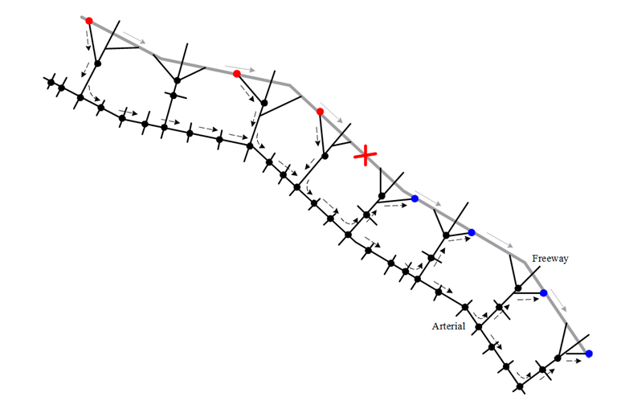
Critical Issues of the Integrated Control
I – How to choose proper control boundaries?
Incident nature, available corridor capacity
Trade-off between freeway and arterial system
II – How to model dynamic traffic flow evolutions along the corridor network?
III – How to capture the interaction between freeway and arterial?
IV – How to design diversion control strategies in response to time-varying traffic conditions?
V – How to update ramp metering and signal timing plans to prevent the formation of local bottlenecks?
VI – How to solve the optimization model efficiently for real-time operations?

Slide 8
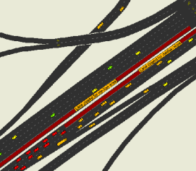
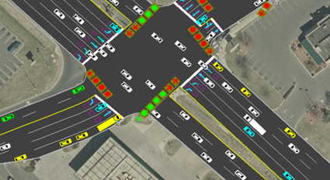
Critical Issues of the Integrated Control
I – How to choose proper control boundaries?
Interaction with Control Variables
Traffic State Prediction and Estimation (constraints)
System Performance (objective function)
II – How to model dynamic traffic flow evolutions along the corridor network?
III – How to capture the interaction between freeway and arterial?
IV – How to design diversion control strategies in response to time-varying traffic conditions?
V – How to update ramp metering and signal timing plans to prevent the formation of local bottlenecks?
VI – How to solve the optimization model efficiently for real-time operations?

Slide 9
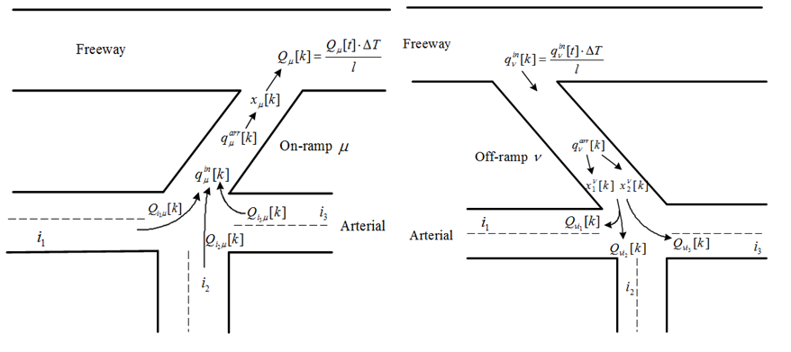
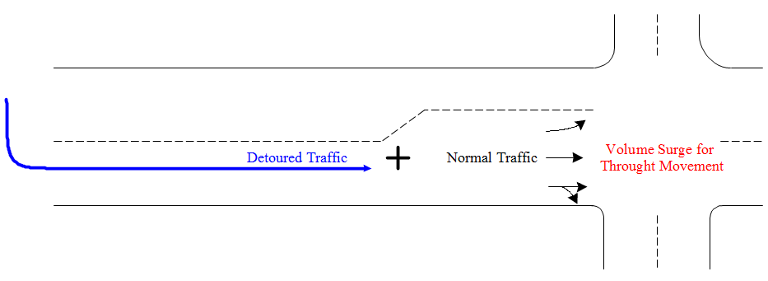
Critical Issues of the Integrated Control
I – How to choose proper control boundaries?
II – How to model dynamic traffic flow evolutions along the corridor network?
III – How to capture the interaction between freeway and arterial?
Flow exchange at on-ramps and off-ramps
Project the time-varying impact of detoured traffic on existing traffic patterns
IV – How to design diversion control strategies in response to time-varying traffic conditions?
V – How to update ramp metering and signal timing plans to prevent the formation of local bottlenecks?
VI – How to solve the optimization model efficiently for real-time operations?

Slide 10
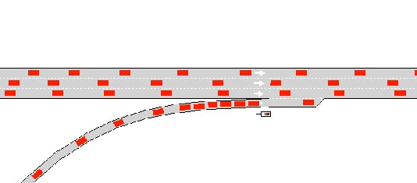
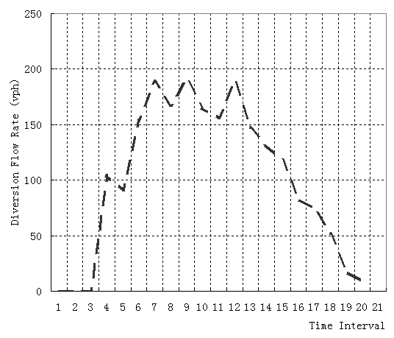
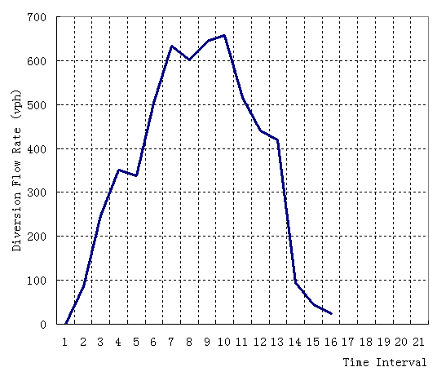
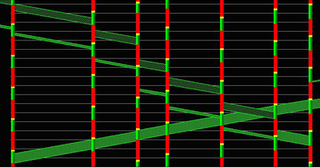
Critical Issues of the Integrated Control
I – How to choose proper control boundaries?
II – How to model dynamic traffic flow evolutions along the corridor network?
III – How to capture the interaction between freeway and arterial?
IV – How to design diversion control strategies in response to time-varying traffic conditions?
V – How to update ramp metering and signal timing plans to prevent the formation of local bottlenecks?
VI – How to solve the optimization model efficiently for real-time operations?

Slide 11
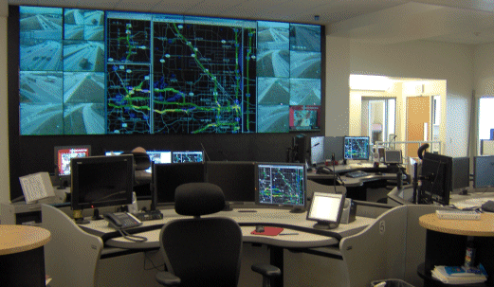
Critical Issues of the Integrated Control
I – How to choose proper control boundaries?
II – How to model dynamic traffic flow evolutions along the corridor network?
III – How to capture the interaction between freeway and arterial?
IV – How to design diversion control strategies in response to time-varying traffic conditions?
V – How to update ramp metering and signal timing plans to prevent the formation of local bottlenecks?
VI – How to solve the optimization model efficiently for real-time operations?

Slide 12
Outline
Critical issues in developing an integrated traffic control system for non-recurrent congestion management
Findings of Literature Review
Primary Research Tasks and Modelling Framework
Model Development
Summary and Future Research

Slide 13
Findings of Literature Review
Limited research has been done regarding determining the control boundaries for integrated corridor control
Simplified network flow formulations
Queue arrival and departure with respect to different types of intersection lane channelization
Intersection signal timing – oversimplified, multiple phases, synchronization
Interactions between the freeway and arterial
Flow exchanges at on-off ramps
The dynamic impact of detoured traffic on existing demand patterns
Lack of consideration on local bottlenecks during severe congestion (e.g. turning bay spillback and blockages)
The multi-objective nature of the integrated control has not been fully addressed

Slide 14
Outline
Critical issues in developing an integrated traffic control system for non-recurrent congestion management
Findings of Literature Review
Primary Research Tasks and Modelling Framework
Model Development
Summary and Future Research

Slide 15
Primary Research Tasks and Modeling Framework
Part II - Integrated Control Strategies
Modeling Framework
Base Model: Single Segment Corridor Control
Network Flow Formulations
Extended Model: Multi-segment Corridor Control
Part I - Arterial Signal Optimization
considering Spillback and Lane Blockage
Enhanced Signal Timing Optimization
Enhanced Network Formulations Accounting for Local Bottlenecks
Part III - Model Solution and Real-time Application
Solution Algorithms
A Successive Optimization Framework

Slide 16
Outline
Critical issues in developing an integrated traffic control system for non-recurrent congestion management
Findings of Literature Review
Primary Research Tasks and Modelling Framework
Model Development
Summary and Future Research

Slide 17
Part I - An Enhanced Arterial Signal Optimization Model
Task 1
An Arterial Network Flow Model to account for Local Bottlenecks (Spillback and Lane Blockage)
Task 2
Traffic Signal Timing Enhancement for Local Bottleneck Management

Slide 18
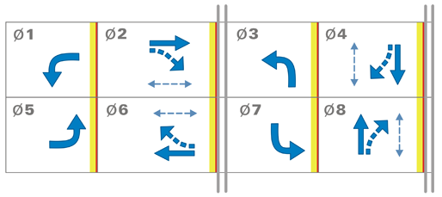
Task 1: Arterial Network Flow Formulations
A link-based model
  Arrival flows
  Departure flows
  Link-based queue
Basic Concept
?
Discrete Time Steps
Dynamic State Equations
Queue Evolution
Limitation: Not compatible with multiple phase

Slide 19
Task 1: Arterial Network Flow Formulations
A movement-based model
  Arrival flows
  Departure flows
  Movement-based queues
?
  Shared Lane Problem
Limitation: Inaccurate modeling of traffic flow discharge process at shared lanes

Slide 20
Task 1: Arterial Network Flow Formulations
Is it possible to use a single formulation to address all above issues?

Slide 21
Task 1: Arterial Network Flow Formulations
The proposed solution:
A lane-group-based model
I
II
III
Key Features
  Integrate the link-based model and movement-based model into a single formulation
  Capture the evolution of physical queues with respect to the signal status, arrivals, and departures
  Provide better accuracy for modeling arrival and departure process at shared approach lanes
  Arrival flows
  Arrival flows
  Arrival flows
  Departure flows
  Departure flows
  Departure flows
  3 lane groups
  1 lane group
  2 lane groups

Slide 22
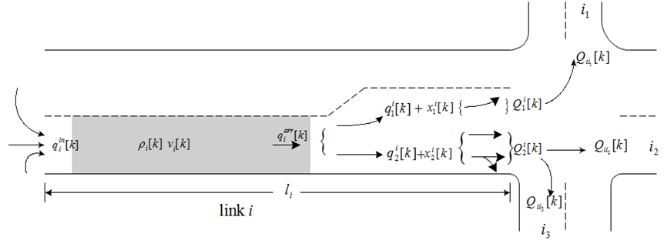
Task 1: Arterial Network Flow Formulations
Model Development
Demand Origins
Upstream Arrivals
Approach the End of Queue
Merge into Lane Groups
Departure
Flow Conservation

Slide 23
Task 1: Arterial Network Flow Formulations
Key Formulations
Demand Origins
Departure Process
Upstream Arrivals
Approach the End of Queue
Flow Conservation
Merge into Lane Groups

Slide 24
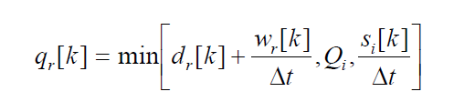
Task 1: Arterial Network Flow Formulations
Demand Origins
Flow rate entering downstream link i from demand entry r
Demand flow rate at entry r
Existing queued vehicles ( in the unit of veh/h) at entry r
Discharge capacity of link i
Available space of link i (in the unit of veh/h)

Slide 25

Task 1: Arterial Network Flow Formulations
Demand Origins
Queue waiting at entry r at step k+1 (vehs)
Queue waiting at entry r at step k (vehs)
Demand flow rate at entry r at step k
(veh/h)
Flow rate entering downstream link i from demand entry r
(veh/h)

Slide 26
Task 1: Arterial Network Flow Formulations
Key Formulations
Demand Origins
Departure Process
Upstream Arrivals
Approach the End of Queue
Flow Conservation
Merge into Lane Groups

Slide 27

Task 1: Arterial Network Flow Formulations
Upstream Arrivals
For Internal Links
Upstream inflow of link i at step k (vehs)
Set of upstream links of link i
Flow actually depart from link j to link i at step k (vehs)

Slide 28

Task 1: Arterial Network Flow Formulations
Upstream Arrivals
For source Links
Upstream inflow of link i at step k (vehs)
Flow rate entering downstream link i from demand entry r at step k (veh/h)

Slide 29
Task 1: Arterial Network Flow Formulations
Key Formulations
Demand Origins
Departure Process
Upstream Arrivals
Approach the End of Queue
Flow Conservation
Merge into Lane Groups

Slide 30
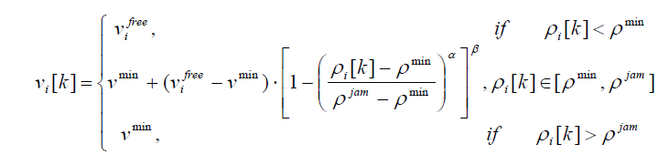
Task 1: Arterial Network Flow Formulations
Approach the End of Queue
Approaching speed from upstream to the end of queue at link i at step k
Density from upstream to the end of queue at link i at step k
Free-flow speed of link i
Minimum density
Minimum speed
Jam density

Slide 31
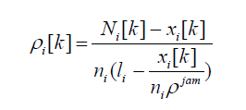
Task 1: Arterial Network Flow Formulations
Approach the End of Queue
Density from upstream to the end of queue at link i at step k (veh/mile/lane)
Total number of vehicles in queue of link i at step k
Number of vehicles at link i at step k
Number of lanes of link i
Length of link i

Slide 32

Task 1: Arterial Network Flow Formulations
Approach the End of Queue
Flows arriving at the end of queue of link i at step k (vehs)
Flows potentially arriving at the end of queue at step k (vehs)
Maximum number of vehicles that can arrive at the end of queue at step k (vehs)

Slide 33
Task 1: Arterial Network Flow Formulations
Key Formulations
Demand Origins
Departure Process
Upstream Arrivals
Approach the End of Queue
Flow Conservation
Merge into Lane Groups

Slide 34

Task 1: Arterial Network Flow Formulations
Merge into Lane Groups
Flows joining lane group m of link i at step k (vehs)
Set of downstream links of link i
Flows arriving at the end of queue of link i at step k (vehs)
Turning proportion from link i to j
Binary variable indicating whether movement from link i to j uses lane group m

Slide 35
Task 1: Arterial Network Flow Formulations
Key Formulations
Demand Origins
Departure Process
Upstream Arrivals
Approach the End of Queue
Flow Conservation
Merge into Lane Groups

Slide 36

Task 1: Arterial Network Flow Formulations
Departure Process
Flows potentially depart from link i to j at step k (vehs)
Flows joining the queue of lane group m of link i at step k (vehs)
Queues of lane group m of link i at step k (vehs)
Discharging capacity of lane group m at link i (vehs)
Binary value indicating whether signal phase p of intersection n is set to green at step k
Percentage of traffic in lane group m going from link i to j

Slide 37
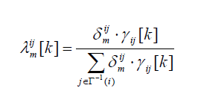
Task 1: Arterial Network Flow Formulations
Departure Process
Percentage of traffic in lane group m going from link i to j
Binary variable indicating whether movement from link i to j uses lane group m
Turning proportion from link i to j at step k

Slide 38
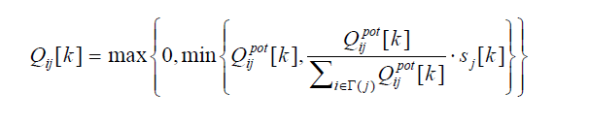
Task 1: Arterial Network Flow Formulations
Departure Process
Flows actually depart from link i to j at step k (vehs)
Flows potentially depart from link i to j at step k (vehs)
Available downstream capacity allocated for flows from link i

Slide 39

Task 1: Arterial Network Flow Formulations
Departure Process
Flows actually depart from lane group m of link i at step k (vehs)
Flows actually depart from link i to j at step k (vehs)
Binary variable indicating whether movement from link i to j uses lane group m

Slide 40
Task 1: Arterial Network Flow Formulations
Key Formulations
Demand Origins
Departure Process
Upstream Arrivals
Approach the End of Queue
Flow Conservation
Merge into Lane Groups

Slide 41

Task 1: Arterial Network Flow Formulations
Flow Conservation
Queues of lane group m of link i at step k+1 (vehs)
Queues of lane group m of link i at step k (vehs)
Flows joining the queue of lane group m of link i at step k (vehs)
Flows actually depart from lane group m of link i at step k (vehs)

Slide 42

Task 1: Arterial Network Flow Formulations
Flow Conservation
Total number of vehicles queued at link i at step k+1 (vehs)
Queues of lane group m of link i at step k+1 (vehs)

Slide 43

Task 1: Arterial Network Flow Formulations
Flow Conservation
Total number of vehicles at link i at step k+1 (vehs)
Total number of vehicles at link i at step k (vehs)
Flows actually depart from upstream to link i at step k (vehs)
Flows actually depart from link i to downstream at step k (vehs)

Slide 44

Task 1: Arterial Network Flow Formulations
Flow Conservation
Available space of link i at step k+1 (vehs)
Storage space of link i (vehs)
Total number of vehicles at link i at step k+1 (vehs)

Slide 45
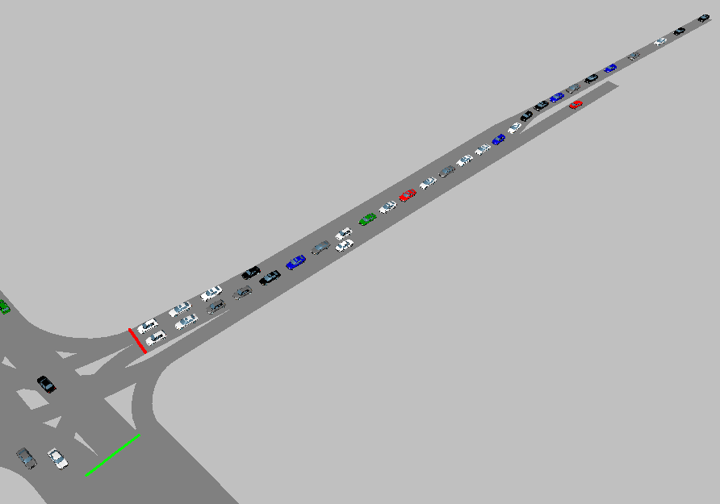
Capturing Local Bottlenecks
Why?
    The storage capacity of the intersection approach lane
    Lane group queue interaction
Blockage
Right-through lane group
Further Enhancement
to account for queue interaction
Left turn lane group

Slide 46
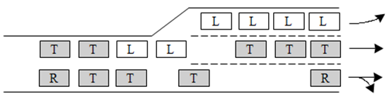
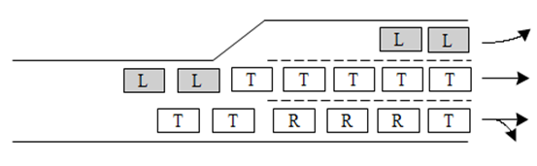
Capturing Local Bottlenecks
Spillback
Partial
Blockage
Complete
Blockage
Spillback
Propose the concept of “Blocking Matrix” to model the dynamic interaction between various lane group queues

Slide 47
Capturing Local Bottlenecks
Spillback
Partial
Blockage
Complete
Blockage
Spillback
A value between 0 and 1

Slide 48
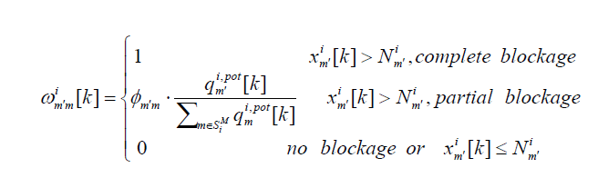
Capturing Local Bottlenecks
Constant parameter related to driver’s response to lane blockage and geometry features
Approximates the fraction of merging lanes occupied by the overflowed traffic from lane group m’
Potential flows may merge into group m at link i at step k (vehs)
The percentage of merging capacity reduction for lane group m due to the queue spillback at lane group m’ at step k

Slide 49

Capturing Local Bottlenecks
Potential flows may merge into group m at link i at step k (vehs)
Number of vehicles bound to lane group m but queued outside at link i due to blockage at step k
Flows arriving at the end of queue of link i at step k (vehs)
Turning proportion from link i to j
Binary variable indicating whether movement from link i to j uses lane group m

Slide 50
Capturing Local Bottlenecks
Key Enhancement
Demand Origins
Departure Process
Upstream Arrivals
Enhanced Formulations
Approach the End of Queue
Flow Conservation
Merge into Lane Groups

Slide 51
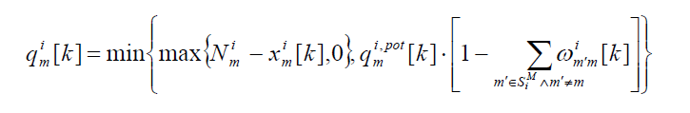
Capturing Local Bottlenecks
Key Enhancement
Number of vehicles allowed to merge into group m at link i at step k (vehs)
Available storage capacity of lane group m at step k
Number of vehicles allowed to merge into group m at link i at step k considering the blockage effect (vehs)

Slide 52
Part I - An Enhanced Arterial Signal Optimization Model
Task 1
Network Enhancement Approach to account for Local Bottlenecks (Queue Interactions and Blockages)
Task 2
Traffic Signal Timing Enhancement for Local Bottleneck Management

Slide 53
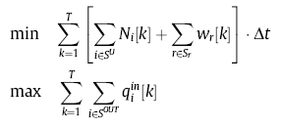
Task 2: An Enhanced Signal Optimization Model
Task 2
Traffic Signal Timing Enhancement for Local Bottleneck Management
Control Objectives
  Minimize total travel time and queue time – under saturated conditions
  Maximize total throughput – oversaturated conditions

Slide 54
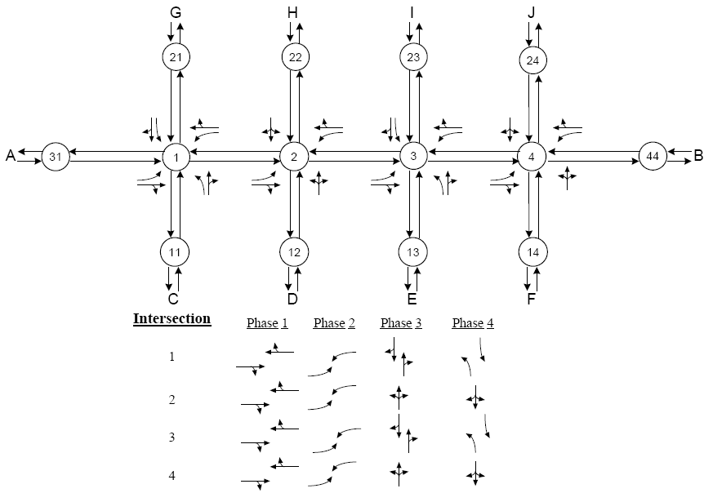
Task 2: An Enhanced Signal Optimization Model
Task 2
Traffic Signal Timing Enhancement for Local Bottleneck Management
Experimental Design
  1. A hypothetical arterial
  2. Three traffic demand levels
  3. Comparison with TRANSYT-7F with the turning bay spillover factor set

Slide 55
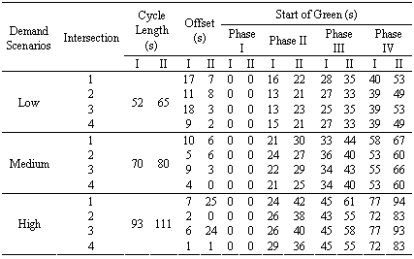
Task 2: An Enhanced Signal Optimization Model
Task 2
Traffic Signal Timing Enhancement for Local Bottleneck Management
The proposed model
TRANSYT-7F
Control Plans
  The proposed model tends to select shorter cycle length to reduce the chance of blockages

Slide 56
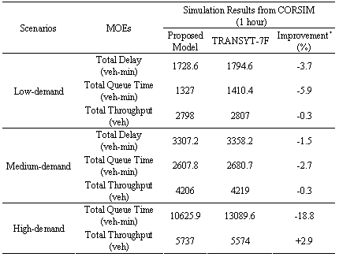
Task 2: An Enhanced Signal Optimization Model
Task 2
Traffic Signal Timing Enhancement for Local Bottleneck Management
Control Performance
  1. Low- and medium demand scenario: less total delay and total queue time but less total throughput
  2. High-demand scenario: less total queue time and more total throughput

Slide 57
Summary
The proposed model outperforms TRANSYT-7F in terms of total system queue time for all experimental demand scenarios
For oversaturated traffic conditions, in terms of the total system queue time and total system throughput, the proposed model can mitigate the congestion and blockage more effectively than TRANSYT-7F due to the use of enhanced network flow formulations.

Slide 58
Part II – The Integrated Corridor Control Model
The Arterial Model
The Freeway Model
Interaction between freeway and arterial
Overall Corridor Model

Slide 59
Part II – The Integrated Corridor Control Model
The Arterial Model
(done)
The Freeway Model
Interaction between freeway and arterial
Overall Corridor Model

Slide 60
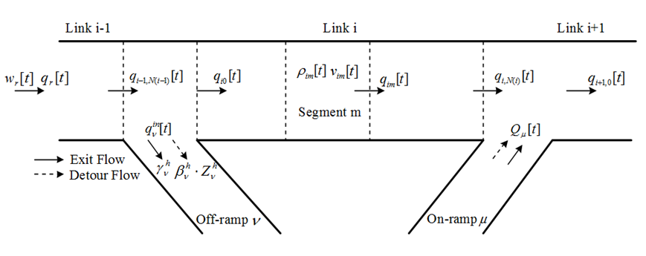
The Freeway Model
METANET Model
(Messmer and Papageorgiou, 1990)
The Freeway Model
Basic Concept
Discrete Time Steps
Dynamic State Equations
Sub-sections of freeway mainline
Extension
Sections near the off-ramp and on-ramp

Slide 61
The Freeway Model
Actual entering flow rate into off-ramp at time t
Sections near the off-ramp and on-ramp
Density at time t
Speed at
time t
Number of lanes
Actual flow rate leaving from the freeway link right before the off-ramp at time t
Normal exit rate for off-ramp during interval h
Driver compliance rate to the detour operation
Diversion rate for off-ramp during interval h

Slide 62
The Freeway Model
METANET Model
(Messmer and Papageorgiou, 1990)
The Freeway Model
Basic Concept
Discrete Time Steps
Dynamic State Equations
Sub-sections of freeway mainline
Extension
Sections near the off-ramp and on-ramp

Slide 63
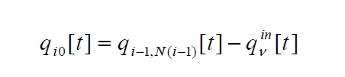
The Freeway Model
Sections near the off-ramp and on-ramp
Actual flow rate entering the freeway link right after the off-ramp at time t
Actual flow rate leaving from the freeway link right before the off-ramp at time t
Actual entering flow rate into off-ramp at time t

Slide 64
The Freeway Model
METANET Model
(Messmer and Papageorgiou, 1990)
The Freeway Model
Basic Concept
Discrete Time Steps
Dynamic State Equations
Sub-sections of freeway mainline
Extension
Sections near the off-ramp and on-ramp

Slide 65

The Freeway Model
Sections near the off-ramp and on-ramp
Actual flow rate entering the freeway link right after the on-ramp at time t
Actual flow rate leaving from the freeway link right before the on-ramp at time t
Actual merging flow rate into freeway from on-ramp at time t

Slide 66
Part II – The Integrated Corridor Control Model
A. On-off Ramps
The Arterial Model
The Freeway Model
B. The impact of detour traffic
Interaction between freeway and arterial
Overall Corridor Model

Slide 67
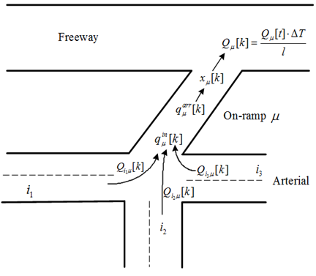
The On-ramp Model
A. On-off Ramps (On-ramp)
Interaction between freeway and arterial
Revised departure process
Basic Concept
Model ramps as simplified arterial links with the lane-group concept
Modify departure process for on-ramp
Modify arrival process for off-ramp

Slide 68
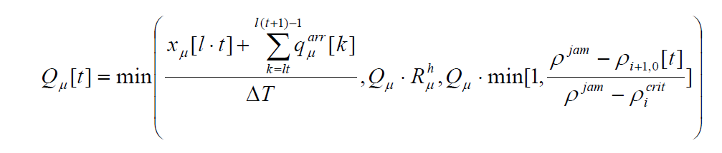
The On-ramp Model
A. On-off Ramps (On-ramp)
Actual flow rate allowed to merge into freeway from on-ramp
Potential number of vehicles to merge into freeways (waiting+arrival)
Discharging capacity under the ramp metering
Available downstream freeway capacity (veh/h)

Slide 69
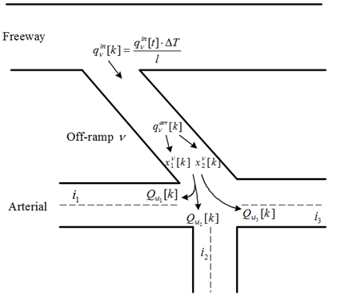
The Off-ramp Model
A. On-off Ramps (Off-ramp)
Interaction between freeway and arterial
Revised arrival process
Basic Concept
Model ramps as simplified arterial links with the lane-group concept
Modify departure process for on-ramp
Modify arrival process for off-ramp

Slide 70
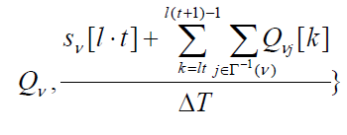
The Off-ramp Model
A. On-off Ramps (Off-ramp)
Actual flow rate entered the off-ramp
Potential flow rate to enter the off-ramp (normal+detour)
Off-ramp capacity (veh/h)
Available space at the off-ramp (veh/h)

Slide 71
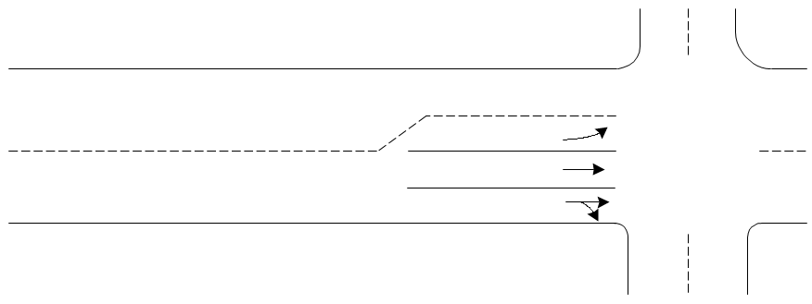
The Impact of Detour Traffic
B. The impact of detour traffic
Interaction between freeway and arterial
Revised arrival process
Detour Traffic
Arterial Traffic
Basic Concept
Integrate the “sub-flow” concept with the lane-group-based arterial model

Slide 72
The Impact of Detour Traffic
B. The impact of detour traffic
Interaction between freeway and arterial
Departure Process
Model Extensions
Upstream Arrivals
Approach the End of Queue
Flow Conservation
Merge into Lane Groups

Slide 73
The Overall Corridor Model
The Arterial Model
The Freeway Model
On-off Ramps
The impact of detour traffic
Interaction between freeway and arterial
Overall Corridor Model

Slide 74
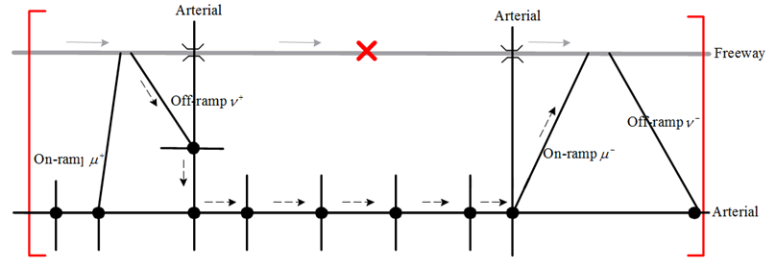
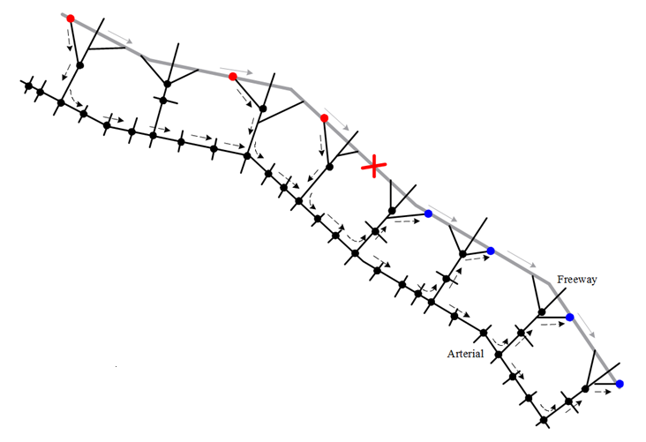
Part II – The Integrated Corridor Control Model
Step 1
Base Model - Integrated Control of a Single Corridor Segment
Step 2
Extended Model - Integrated Control of a Multi-segment Corridor

Slide 75
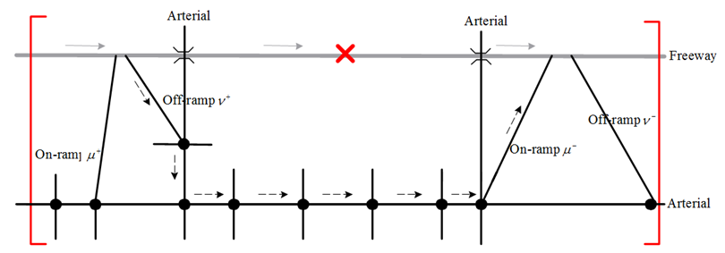
Part II – The Integrated Corridor Control Model
Step 1
Base Model - Integrated Control of a Single Corridor Segment
Expected Output:
    Diversion rates at the off-ramp
    Arterial signal timings: cycle length, offsets, and splits
    Incident upstream on-ramp metering rates

Slide 76
Part II – The Integrated Corridor Control Model
Key Formulations
Step 1
Base Model - Integrated Control of a Single Corridor Segment
  Max. Total Corridor Throughput
  Min. Total Spent Time by Detour Traffic
Operational Constraints
Network Flow Constraints

Slide 77
Part II – The Integrated Corridor Control Model
Operational Constraints
Cycle length constraint
Green time constraint
The sum of green times and clearance times
should be equal to cycle length.
Offset constraint
Metering rate constraint
Diversion rate constraint

Slide 78
Part II – The Integrated Corridor Control Model
Step 1
Base Model - Integrated Control of a Single Corridor Segment
Step 2
Extended Model - Integrated Control of a Multi-segment Corridor

Slide 79
Part II – The Integrated Corridor Control Model
Step 2
Extended Model - Integrated Control of a Multi-segment Corridor
Expected Output:
    Control boundaries for detour operations
    Detour plans
    Diversion rates at each off-ramp
    Arterial signal timings: cycle length, offsets, and splits
    Incident upstream on-ramp metering rates

Slide 80
Part II – The Integrated Corridor Control Model
Formulations
Step 2
Extended Model - Integrated Control of a Multi-segment Corridor
  Additional set of decision variables for detour route choice
Enhanced Network Flow Constraints

Slide 81
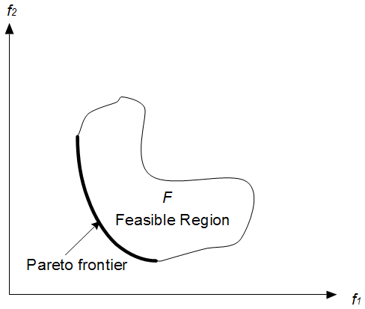
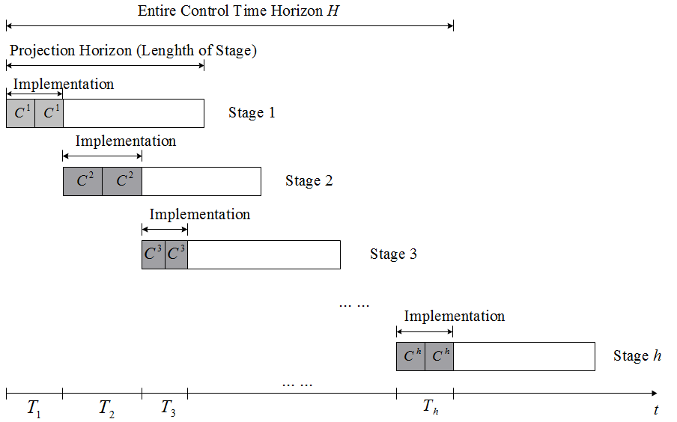
Part III – Solution Algorithms for Integrated Control
Module I: A compromised GA to solve the proposed bi-objective model (Gen and Cheng, 1998)
Module II: A successive optimization framework for real-time application with variable rolling time window
Difficulties
    Dynamic, discrete-time and complex system
    Non-linear constraints
    Time-consuming process to obtain the Pareto solution set
    Large-scale
    Dramatic traffic pattern changes
Ideally best point
Solution

Slide 82
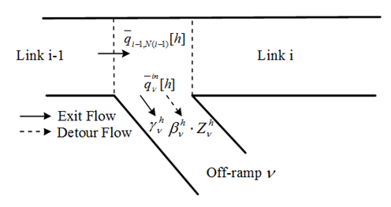
On-line Estimation of Diversion Compliance Rates
Estimation of compliance rate
Measurement of flow rate at the off-ramp
Measurement of flow rate at the freeway upstream
Normal exit rate
Applied diversion rate

Slide 83
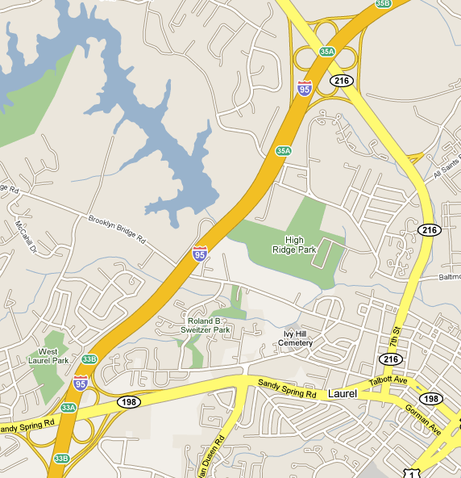
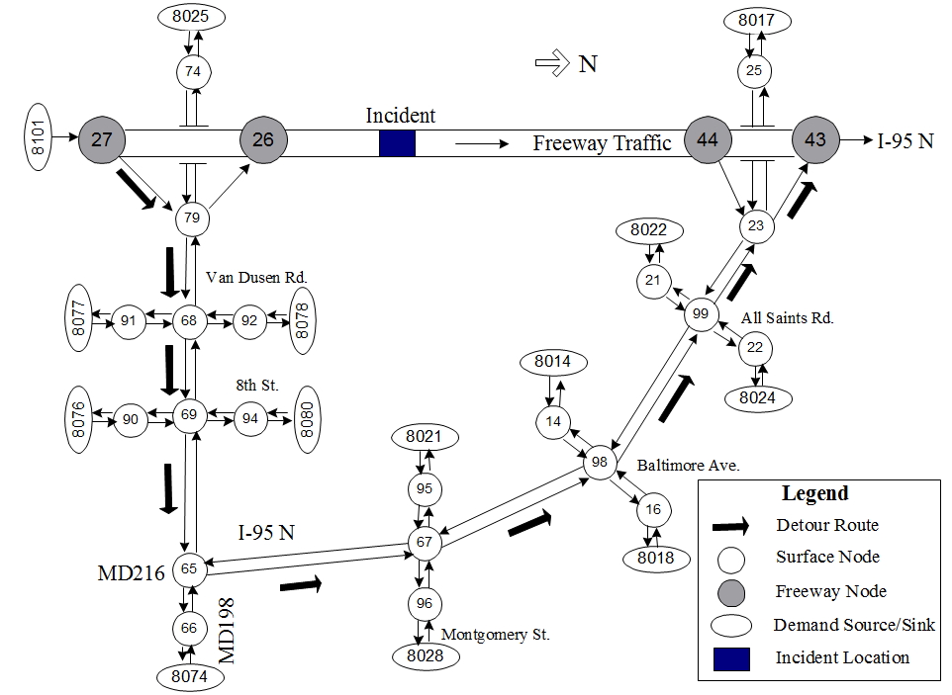
Case Studies – The Base Model
Experiment Design
    I-95 corridor northbound
    MD198 and MD216
    6 arterial intersections
    2 traffic demand levels
    2 levels of incident effect
    35-min control period
I. Off-peak hour (low traffic demand level)
II. Peak hour (high demand level)
I. 1 lane blocked due to incident
II. 2 lanes blocked due to incident
  5-min normal operation
  20-min incident period
  10-min incident recovery
Plan C
4 test scenarios
  Scenario 1: Off-peak with 1 lane blocked
  Scenario 2: Off-peak with 2 lanes blocked
  Scenario 3: Peak with 1 lane blocked
  Scenario 4: Peak with 2 lanes blocked

Slide 84



Case Studies – The Base Model
Step- 1:
Evaluate the performance of the proposed model with systematically varied weights to provide operational guidelines for decision makers in best weighting importance between both control objectives under a given scenario
Step- 2:
With a set of properly selected weights from Step - 1, compare the model performance with other two strategies
Efficiency
Equity

Slide 85
Case Studies – The Base Model
Step- 1:
Evaluate the performance of the proposed model with systematically varied weights to provide operational guidelines for decision makers in best weighting importance between both control objectives under a given scenario
Step- 2:
With a set of properly selected weights from Step - 1, compare the model performance with other two strategies
Efficiency
Equity

Slide 86
Case Studies – The Base Model
Step- 1: Objective function values under different weight assignment (w1/w2)
  Scenario 1: Off-peak with 1 lane blocked
  Scenario 2: Off-peak with 2 lanes blocked
  Scenario 3: Peak with 1 lane blocked
  Scenario 4: Peak with 2 lanes blocked

Slide 87
Case Studies – The Base Model
Step- 1: Travel Time (Detour Route v.s. Freeway Mainline)
Scenario 2

Slide 88
Case Studies – The Base Model
Step- 1: Travel Time (Detour Route v.s. Freeway Mainline)
Scenario 3

Slide 89
Case Studies – The Base Model
Step- 1: Travel Time (Detour Route v.s. Freeway Mainline)
Scenario 4

Slide 90
Single control objective may effectively maximize the utilization of corridor capacity under light traffic and incident conditions, however it may cause unbalanced traffic conditions under over-saturated conditions which will degrade the diversion compliance rates
Traffic operators need to properly select the weighting factors between two control objectives to achieve the best operational efficiency while balancing the traffic conditions

Slide 91
Case Studies – The Base Model
Step- 1:
Evaluate the performance of the proposed model with systematically varied weights to provide operational guidelines for decision makers in best weighting importance between both control objectives under a given scenario
Step- 2:
With a set of properly selected weights from Step - 1, compare the model performance with other two strategies
Efficiency
Equity

Slide 92
Case Studies – The Base Model
Step- 2: Comparison with other strategies
Plan A
  No Control – base line
Plan B
4 test scenarios
  Local Responsive Control
  Detour – Static User Equilibrium (UE)
  On-ramp metering – ALINEA
  Arterial signal timing – TRANSYT-7F
  Scenario 1: Off-peak with 1 lane blocked
  Scenario 2: Off-peak with 2 lanes blocked
  Scenario 3: Peak with 1 lane blocked
  Scenario 4: Peak with 2 lanes blocked
Plan C
  The Proposed control model

Slide 93
Case Studies – The Base Model
MOE -1. Accumulated Total Travel Time Savings
Scenario 1
w1/w2=10/0
Scenario 2
w1/w2=10/0
Scenario 3
w1/w2=6/4
Scenario 4
w1/w2=5/5

Slide 94
Case Studies – The Base Model
MOE-2. Accumulated Total Corridor Throughput Increases
Scenario 1
w1/w2=10/0
Scenario 2
w1/w2=10/0
The proposed integrated control model outperforms other control strategies under all experimental scenarios
Scenario 3
w1/w2=6/4
Scenario 4
w1/w2=5/5

Slide 95

Case Studies – The Extended Model
Experiment Design: A 12-mile hypothetical corridor with 12 exits and 36 arterial intersections

Slide 96

Case Studies – The Extended Model
Step- 1:
Investigate the control area variation with respect to different weight assignment settings, and its impact on the system MOEs
Step- 2:
Compare the performance of the extended model with the base model under the same incident scenario and the same control objective

Slide 97
Case Studies – The Extended Model
Step- 1:
Investigate the control area variation with respect to different weight assignment settings, and its impact on the system MOEs
Step- 2:
Compare the performance of the extended model with the base model under the same incident scenario and the same control objective

Slide 98










Case Studies – The Extended Model
Step- 1: The variation of control boundaries
Preliminary Findings:
The control boundaries shrink with the weight assignment between two control objectives varying from 10/0 to 0/10
There exists a critical control area beyond which the total corridor throughput no longer increases.
The number of incident downstream on-ramps used to divert traffic back to the freeway is less than that of incident upstream off-ramps.
  w1/w2=5/5, 4/6, and 3/7
  w1/w2=8/2, 7/3, and 6/4
  w1/w2=10/0 and 9/1
  w1/w2=2/8 and 1/9
  w1/w2=0/10

Slide 99


Case Studies – The Extended Model
Step- 1: Determine the proper control boundaries
  w1/w2=10/0
  w1/w2=8/2
  Total corridor throughput decreases only 3.2%
  Total spent time by detour traffic decreases 19.8%

Slide 100
Case Studies – The Extended Model
Step- 1: Distribution of diversion flows
  w1/w2=10/0 and 9/1
  w1/w2=8/2, 7/3, 6/4
The diversion flows are not evenly distributed over the upstream off-ramps. An off-ramp closer to the incident location has carried more diversion flows
The most upstream off-ramps only carry a small percent of diversion traffic but significantly increase the total time spent

Slide 101
Case Studies – The Extended Model
Step- 1:
Investigate the control area variation with respect to different weight assignment settings, and its impact on the system MOEs
Step- 2:
Compare the performance of the extended model with the base model under the same incident scenario and the same control objective

Slide 102

Case Studies – The Extended Model
Step- 2: Comparison with the base model under the same incident scenario and the same control objective
  The same control objective: Maximizing the total corridor throughput
The extended model outperforms the base model in terms of the total corridor throughput
The extended model can also significantly decrease the average total queue time on detour links and at the side street links
  The control boundaries of the base model
  Model 1
  The control boundaries of the extended model
  Model 2

Slide 103
Outline
Critical issues in developing an integrated traffic control system for non-recurrent congestion management
Findings of Literature Review
Primary Research Tasks and Modelling Framework
Model Development
Summary and Future Research

Slide 104
Summary of Contributions
Develop an effective operational framework to integrate different control strategies for incident management
Integrated Level
Base Model: Single Segment Corridor Control
Network Flow Formulations
Extended Model: Multi-segment Corridor Control
Local Level
Enhanced Signal Timing Optimization
Enhanced Network Formulations Accounting for Local Bottlenecks

Slide 105
Summary of Contributions
Develop an enhanced arterial signal optimization model to produce control strategies that can effectively prevent the formation of local bottlenecks

Slide 106
Summary of Contributions
Construct an overall corridor model that can capture network flow evolution in a dynamic control environment
The Overall Corridor Model

Slide 107



Summary of Contributions
Formulate a set of mathematical models solved by an efficient algorithm for design of integrated corridor control strategies in real time
A Multi-objective Framework
Base Model
Extended Model
GA-based Heuristic
+
A successive optimization framework
  Substantially improved operational performance with balanced traffic conditions between the freeway and detour routes
  Less negative impact on the local arterial and better system performance compared with the base model

Slide 108

Future Research
Development of efficient solution algorithms for large-scale network-wide control
Development of robust solution algorithms for the proposed models when available control inputs are missing or contain some errors
Development of an intelligent interface with advanced surveillance systems

Slide 109
Thanks for your attention!
Q & C?

Slide 110
Computational Performance
The Base Model
The Extended Model
Projection Stage
4-min
10-min
Update Interval
1 cycle length
2 cycle length
Convergence Failure
<3%
<10%

Slide 111













System Application
Intelligent On-line Traffic Management System
    Assist transportation agencies to deal with recurrent or non-recurrent congestion
    Improve the operational efficiency for the urban traffic corridor system

