Slide 1
A Summary of
Drone Applications
Yen-Yu Chen
2016/02/12

Slide 2
Drone Applications
Traffic Surveillance
Traffic Simulation
Monitoring of Structures
Safety Inspection on Construction Sites
Detect and track roadway assets

Slide 3
Traffic Surveillance
Freeway/Arterial conditions
  Observing flows, speeds, densities, off-ramp weaving, and vehicle trajectories
Intersection movements / Evaluate the performance of an intersection
  Observing flows, turning movements, queue lengths, delay, headway and saturation flow rates.
Network paths
  Observing path flows, speeds, densities, queue lengths, and vehicle trajectories
Parking lot monitoring
  assessing utilization of parking lots
Visualization and parameter estimation of traffic flows

Slide 4
Traffic Surveillance (Cont.)
Monitor roadway incident
  UAVs can also be used for crash scene documentation. This information was made available to the incident command center as soon as the hexacopter landed.
[Source: Lee, Zhong, Kim, Dimitrijevic, Du, and Gutesa (2015).]

Slide 5
Traffic Simulation
Traffic simulation models rely on routinely collected data in real-time and process such data to determine origin-destination flows and to evaluate traffic patterns for emergency response.(Irizarry, J. , and Johnson, E. N., 2014)
Puri et al. (2007) adopts UAVs to collect real-time traffic data and these data are used to calculate simulation models.

Slide 6
Monitoring of Structures
Bridge Asset Management and Condition Assessment
  Structure from Motion (SfM) techniques were employed to create 3D models and fused with thermal data for a complete evaluation of bridge condition through automated detections of surface and sub-surface defects.
Inspecting and monitoring infrastructures such as roads, pipelines, aqueducts, rivers, and canals
  Zhang and Elaksher (2012) introduced an innovative UAV-based digital imaging system for aerial assessment of surface condition data over rural roads.

Slide 7

Safety Inspection on Construction Sites
An aerial drone quadrotor helicopter (AR.Drone quadricopter) is flied all around the construction jobsite and provide the safety managers with real time information about what is happening on the construction site.(Irizarry et al., 2012)
Confined Space Inspection
  Micro-UAVs with camera and sensor attachments can be flown in confined spaces, such as pump stations and culverts, to determine if they are safe enough to send a person into.
[Source: http://www.mtri.org/mdot_uav.html]

Slide 8
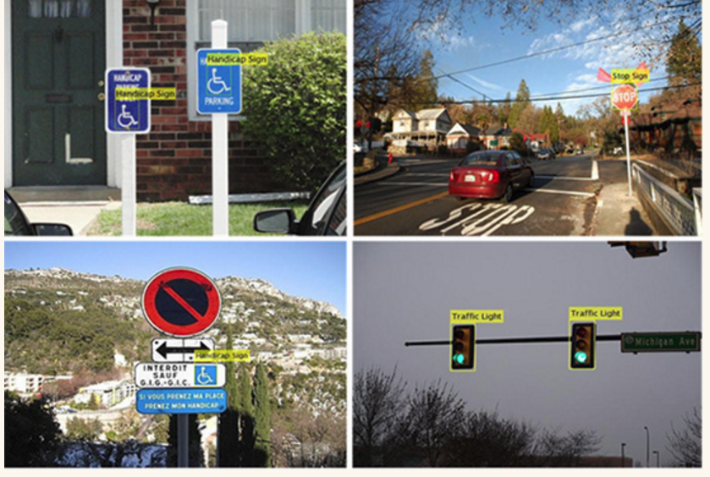
Detect and track roadway assets
From the UAV imagery, feature based algorithms and classifiers can be “trained” to detect and track roadway assets. The tracker is generalized such that any type of roadway assets could be detected and tracked; e.g., different types of signs and indicators, guard rails, and lamps.
[Source: http://www.mtri.org/mdot_uav.html]

Slide 9
Reference
C.Brooks, R.Dobson, D.Banach, D. Dean, T.Oommen, R.Wolf, T.Havens, T. Ahlborn, B.Hart and Michigan (2015). “Evaluating the Use of Unmanned Aerial Vehicles for Transportation Purposes.” Technological University and the Michigan Department of Transportation.
Coifman, B. , McCord, M. , Mishalani, M. , and Redmill, K. (2004). “Surface transportation surveillance from unmanned aerial vehicles.” Proc. of 83rd Annual Meeting of the Transportation Research Board.
Irizarry, J. , and Johnson, E. N. (2014). ”Feasibility study to determine the economic and operational benefits of utilizing unmanned aerial vehicles (UAVs).” Georgia Institute of Technology, Atlanta.
Lee, Joyoung, Zhong, Zijia, Kim, Kitae, Dimitrijevic, Branislav, Du, Bo, Gutesa, Slobodan (2015). “Examining the Applicability of Small Quadcopter Drone for Traffic Surveillance and Roadway Incident Monitoring.” Proc. of 94th Annual Meeting of the Transportation Research Board
Puri, A., Valavanis, K., and Kontitsis, M. (2007). "Generating traffic statistical profiles using unmanned helicopter-based video data." International Conference on Robotics and Automation., IEEE, Roma, Italy, 870-876.
Zhang, C., and Elaksher, A. (2012). "An Unmanned Aerial Vehicle‐Based Imaging System for 3D Measurement of Unpaved Road Surface Distresses1." Computer‐Aided Civil and Infrastructure Engineering, 27(2), 118-129.

