Slide 1
AN INTEGRATED BUS-BASED PROGRESSION SYSTEM FOR ARTERIALS HAVING HEAVY TRANSIT FLOWS
Thesis Defense for the Degree of Master of Science
Yao Cheng
11/25/2014

Slide 2
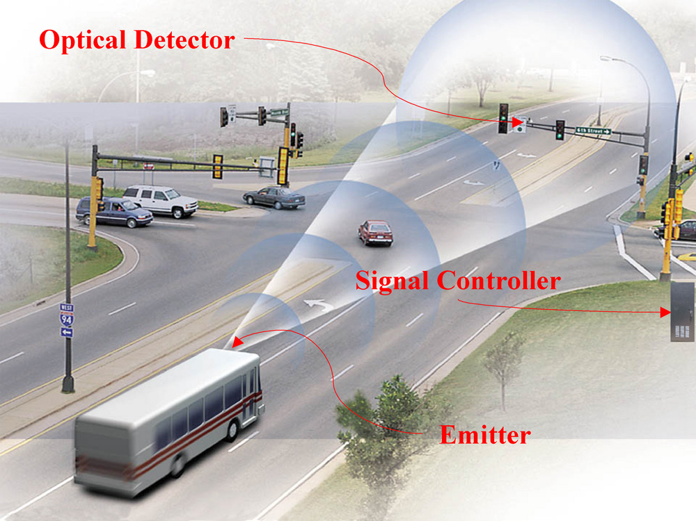



Transit Signal Priority (TSP)
Transit system
Active control strategies
Bus-based progression
Bus operational features
Source: Sustainable Transportation in the Netherlands

Slide 3
Outline
Literature Review
Problem Nature and Modelling Framework
Methodology
Case Study
Conclusions and Future Study

Slide 4
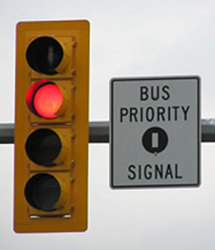
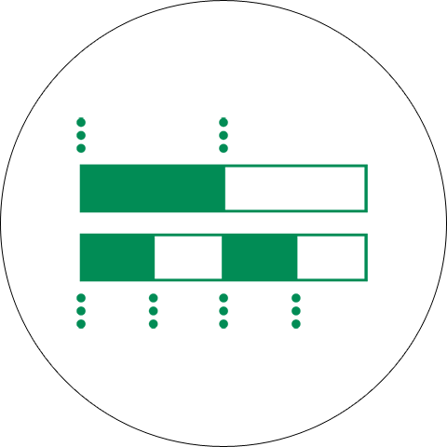
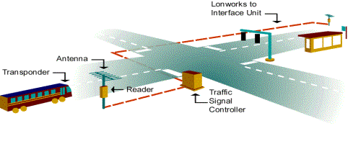
Literature Review
The concept of TSP has been developed since late 1960s (Smith, 1968).
    Active strategies detect the arrival of buses and grant a priority to them. (Ludwick & John, 1974; Dion & Hesham, 2005)
  Passive strategies do not recognize the presence of buses, but predetermine the signal timings to facilitate bus movements. (Urbanik, 1977)
Limitations of TSP strategies
  Significant negative impact to cross-street traffic if the target arterials experience heavy bus volumes
  May interrupt the conventional signal progression design

Slide 5
Literature Review
Signal progression, first presented by Morgan and Little (1964), is studied mainly for passenger cars.
  Allow some vehicles to pass consecutive intersections without encountering red phases.
  Reduce accidents
  MAXBAND (Little et al., 1981)
  MULTIBAND (Gartner et al., 1990)
Bus progression is a promising passive strategy to improve the operational efficiency of transit system with
  minimized negative impact to cross-street traffic
  benefits to transit vehicles on an arterial
outbound
inbound

Slide 6
Outline
Literature Review
Problem Nature and Modelling Framework
Methodology
Case Study
Conclusions and Future Study

Slide 7
Critical issues
Dwell time at bus stops
Dwell time uncertainty
Bus stop capacity
Competition between buses and PCs

Slide 8


Critical issues
Dwell time at bus stops
Dwell time uncertainty
Bus stop capacity
Competition between buses and PCs
Transit vehicles, impacted by the dwell time at stops, may not stay in the green band designed for passenger cars.

Slide 9
Critical issues
Deterministic dwell time VS. Stochastic dwell time
Dwell time at bus stops
Dwell time uncertainty
Bus stop capacity
Competition between buses and PCs
The stochastic nature of bus dwell time should be considered when studying bus progression.

Slide 10
Critical issues
Is the wider band always better?
Dwell time at bus stops
Dwell time uncertainty
Bus stop capacity
Competition between buses and PCs
The number of buses in a band shall not exceed the capacity of the bus stop to prevent the formation of bus queues.

Slide 11
Critical issues
Dwell time at bus stops
Dwell time uncertainty
Bus stop capacity
Competition between buses and PCs
The bus band and passenger-car band may need to be optimized concurrently.

Slide 12
Critical issues
Modelling Framework
Following the concept of MAXBAND, a Mixed-Integer Linear Programming model is developed .
Dwell time at bus stops
Dwell time uncertainty
Bus stop capacity
Competition between buses and PCs
A deterministic model
An enhanced deterministic model
Integrating passenger car’s benefits
An evaluation module
Taking advantage of the results produced from the deterministic model, an evaluation module is developed to fully account for the stochastic nature of bus dwell time.
An enhanced evaluation module
A progression model for buses
A integrated model for both buses and PC s

Slide 13
Outline
Literature Review
Problem Nature and Modelling Framework
Methodology
Case Study
Conclusions and Future Study
A deterministic model
An integrated model
An evaluation module

Slide 14
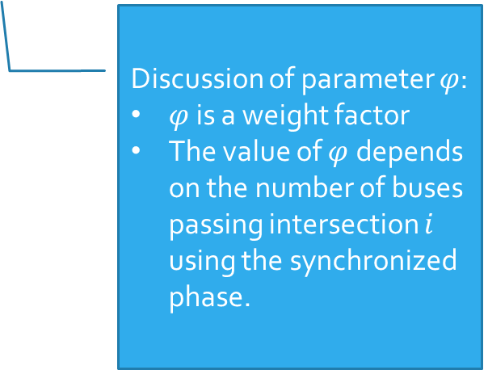
Methodology
Taking each bus stop as a control point
Mixed Integer Linear Programming
Objective function
Constraints
  Interference constraints
A deterministic model
Discussion of parameter $φ$:
$φ$ is a weight factor
The value of $φ$depends on the number of buses passing intersection $i$ using the synchronized phase.

Slide 15
Methodology
A deterministic model
Constraints
  Progression constraints
    For links with bus stops
      Outbound
      Inbound
    For other intersections
      Outbound
      Inbound
Average dwell time
Dwell time at bus stops

Slide 16
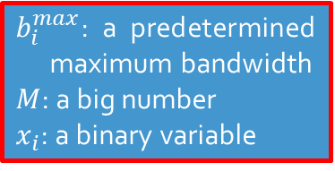
Methodology
$b_{i}^{max}$: a predetermined maximum bandwidth
$M$: a big number
$x_{i}$: a binary variable
A deterministic model
Constraints (bus stop capacity)
  Bandwidth limit
    Outbound
    Inbound
    These constraints are only for upstream intersections of bus stops
Bus stop capacity
The center of a band
should be either close to the start of green
or close to the end of green
to make sure that the potential band is realistic.

Slide 17
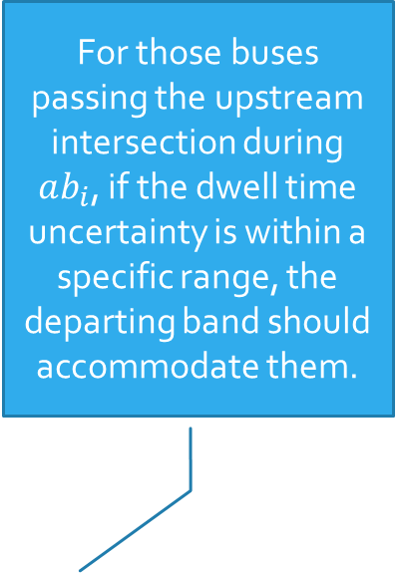
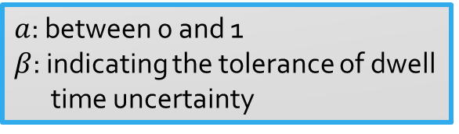
Methodology
A deterministic model
For those buses passing the upstream intersection during $ab_{i}$, if the dwell time uncertainty is within a specific range, the departing band should accommodate them.
Other Constraints
  Bandwidth equality
    For links without bus stops
  Dwell time uncertainty
    For links with bus stops
$a$: between 0 and 1
$β$: indicating the tolerance of dwell time uncertainty

Slide 18
Methodology
A deterministic model
Objective Function
Constraints
Interference constraints
For adjacent intersections between which that a stop is located
Progression constraints
Bandwidth constraints
Dwell time uncertainty
For other intersections
Progression constraints
Bandwidth equality

Slide 19
Methodology
A deterministic model
An enhanced deterministic model
Integrating passenger car’s benefits
An evaluation module
An enhanced evaluation module
A progression model for buses
A integrated model for both buses and PC s

Slide 20
Methodology
Downstream
An evaluation module
Upstream
By adjusting parameters in this critical constraint, one may have multiple sub-optimal solutions.
They will be evaluated and ranked, fully taking the stochastic nature of bus dwell time into consideration.

Slide 21
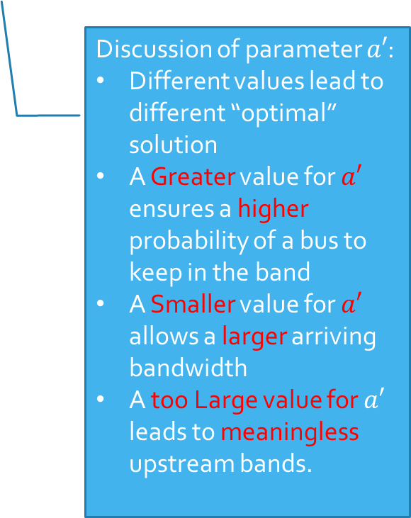
Methodology
An evaluation module
Discussion of parameter $a′$:
Different values lead to different “optimal” solution
A Greater value for $a′$ ensures a higher probability of a bus to keep in the band
A Smaller value for $a′$ allows a larger arriving bandwidth
A too Large value for $a′$ leads to meaningless upstream bands.
Computational complexity
Still describing the relation between the arriving bandwidth and the departing bandwidth
Still ensuring a relatively large departing bandwidth based on its arriving bandwidth
Although the dwell time variance is no longer considered in the constraints, the analysis to sub-optimal solutions applies a more rigorous method to assess the impact of dwell time variance

Slide 22
Methodology
An evaluation module
How effective a signal plan is highly depends on the relation between each pair of bands arriving to and departing from a bus stop.
To evaluate the sub-optimal solutions, this module computes the expectation of the fraction of the arriving bandwidth which can be effectively utilized.
This expectation is called “effective bandwidth”.

Slide 23
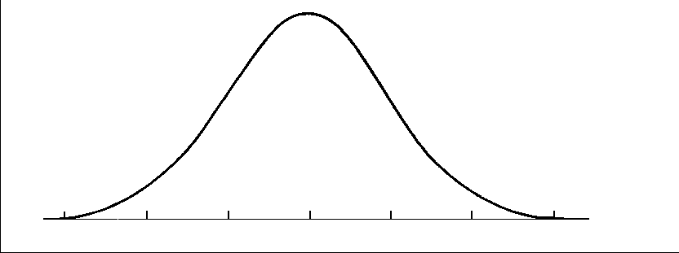
Methodology
An evaluation module
In order to compute the effective bandwidths, one first needs to calculate the probability of a bus to keep in the band.

Slide 24
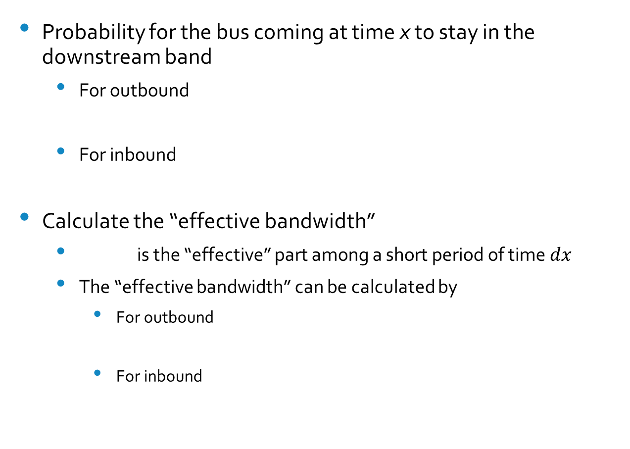
Methodology
An evaluation module
Probability for the bus coming at time x to stay in the downstream band
  For outbound
  For inbound
Calculate the “effective bandwidth”
  is the “effective” part among a short period of time $dx$
  The “effective bandwidth” can be calculated by
    For outbound
    For inbound
Dwell time uncertainty
For an intersection that is not at upstream of a bus stop:

Slide 25
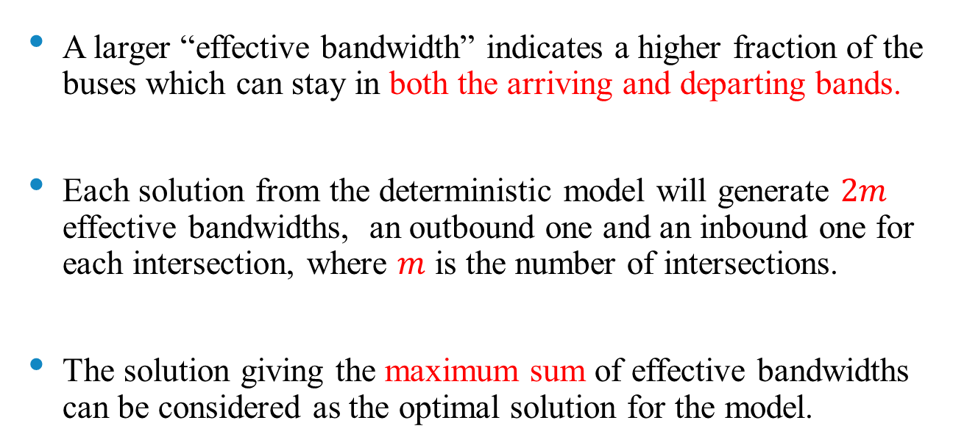
Methodology
An evaluation module
A larger “effective bandwidth” indicates a higher fraction of the buses which can stay in both the arriving and departing bands.
Each solution from the deterministic model will generate $2m$ effective bandwidths, an outbound one and an inbound one for each intersection, where $m$ is the number of intersections.
The solution giving the maximum sum of effective bandwidths can be considered as the optimal solution for the model.

Slide 26
Methodology
An evaluation module
Cycle length, green split, travel time, estimated bus dwell time….
Each solution has a set of bandwidths and offsets
Find the solution with the maximum total effective bandwidths

Slide 27
Methodology
A deterministic model
An enhanced deterministic model
Integrating passenger car’s benefits
An evaluation module
An enhanced evaluation module
A progression model for buses
A integrated model for both buses and PC s

Slide 28
Methodology
An integrated model
Designing bus bands causes potential interruption for passenger car movements.
Even with the same bus bands, the benefit for passenger cars can be different among signal plans.

Slide 29
Methodology
An integrated model
Therefore, the bus bands and the passenger car bands need to be optimized concurrently.
An enhanced deterministic model
An enhanced evaluation module
Revising the objective function to include bands for both types of vehicles.
Revising the constraints to express passenger car bands.
When comparing the sub-optimal solutions, both effective bandwidths for buses and passenger car bandwidths are considered.

Slide 30
Methodology
An integrated model
Ratio between numbers of passengers on two types of vehicles
Competition between buses and PCs
Objective function
Additional constraints
  To balance the bus bands and the passenger-car bands and avoid one dominating the other,
  Constraints to express passenger-car bands
An enhanced deterministic model
k<1: Passengers on PCs are less
k>1: Passengers on buses are less

Slide 31
Methodology
An integrated model
An enhanced evaluation module
Enhancement to the stochastic analysis
  The ranking index of a sub-optimal solution includes both effective bandwidth of bus bands and passenger-car bands
Total effective bandwidths
Total passenger-car bandwidths

Slide 32
Methodology
An integrated model
Cycle length, green split, travel time, estimated bus dwell time….
Each solution has a set of bandwidths and offsets
Find the solution with the maximum ranking index

Slide 33
Methodology
Dwell time at bus stops
Bus stop capacity
A deterministic model
Following the concept of MAXBAND, a Mixed-Integer Linear Programming model is developed .
An enhanced deterministic model
Integrating passenger car’s benefits
By adjusting a parameter in the MILP, multiple sub-optimal solutions will be produced and evaluated, accounting for the stochastic nature of bus dwell time.
An evaluation module
Dwell time uncertainty
An enhanced evaluation module
A progression model for buses
Competition between buses and PCs
A integrated model for both buses and PC s
Benefits of both buses and passenger cars are considered.

Slide 34
Outline
Literature Review
Problem Nature and Modelling Framework
Methodology
Case Study
Conclusions and Future Study

Slide 35
Case Study
Case Design
Link | Link length (ft) | travel time | With bus stop?
I↔II | 906 | 20 | Yes
II↔III | 948 | 21 | No
III↔IV | 1250 | 28 | Yes
IV↔V | 725 | 16 | Yes
Cycle length is 150 seconds;
Green times at intersections are 99 , 77 , 66, 75, and 60 seconds, respectively;
The dwell time: bus stop 1: N(30,9); bus stop 2: N(27,7); bus stop 3: (24,9);
The bus stop capacity is 2 buses at each direction, and the confidence parameter p equals 0.95; then the maximal bus bandwidth could be computed as 50 seconds
For each direction along the arterial, the bus volume is 60 veh/h, with an average headway of 1.0 minute and the passenger car volume is 750 veh/h;

Slide 36
Case Study
Models to be evaluated
  Model-1: MAXBAND with fixed phase sequences
  Model-2: A direct extension of MAXBAND by adding the average bus dwell time to the travel time on the links having a bus stop.
  Model-3: The proposed deterministic model
  Model-4: The proposed deterministic model with the evaluation module
  Model-5: The proposed integrated model
The MILP is solved with LINGO. The evaluation module is conducted with R studio.

Slide 37
Case Study
Task 1: Bandwidths and performance measures generated by bus progression models will first be compared to verify the necessity of the evaluation module.
Task 2: Then the signal plans generated by all Models will be applied in the simulation software, VISSIM, and will be evaluated based on the average delays and number of stops.
Task 3: Sensitivity Analysis will then be conducted with respect to the number of passengers on buses to assess the stability of the proposed integrated model.

Slide 38
Case Study
Fixed bandwidths
Varying bandwidths
Bandwidths limited by the capacity constraints
MAXBAND with extension
The deterministic model
The deterministic model + the evaluation stage

Slide 39
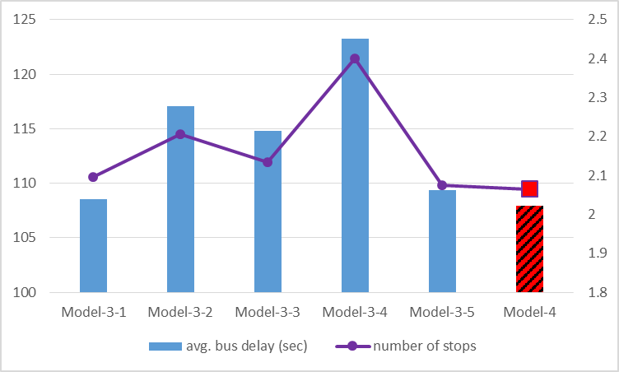
Case Study
To verify the necessity of the evaluation module, several sets of parameters for Model-3 are tested.
 |  |  | Offsets (s) at Intersection No.
 | α | β | 1 | 2 | 3 | 4 | 5
Model-3-1 | 0.3 | 1 | 0 | 102 | 101 | 40 | 38
Model-3-2 | 0.3 | 2 | 0 | 107 | 104 | 38 | 43
Model-3-3 | 0.5 | 1 | 0 | 105 | 98 | 37 | 41
Model-3-4 | 0 | 1 | 0 | 99 | 104 | 25 | 35
Model-3-5 | 0.1 | 2 | 0 | 104 | 99 | 41 | 40
The deterministic model + the evaluation stage

Slide 40
Case study
The models which take bus progression into consideration, are able to offer operational benefits to bus vehicles on the target arterial, evidenced by reduction in the average bus delay.
Model-2 may yield a slight reduction in bus delay. This is due to that Model-2 has ignored the stochastic nature of bus dwell time at bus stops.
  Model-1: MAXBAND with fixed phase sequences
  Model-2: A direct extension of MAXBAND
  Model-4: The proposed deterministic model with the evaluation ranking stage
  Model-5: The proposed integrated model
Model-2 and 4 outperform Model-1, and Model-5 outperforms both Model-2 and Model-4

Slide 41
Case Study
It can be expected that the integrated model should be only applied when the difference between numbers passengers on two types of vehicles is small
When the number of passengers on buses dominates that on passenger cars, bus progression model may be preferred, and vice versa.
The system performance is quite sensitivity to the preference factor k
Loading factor on buses | Passenger ratio k
12 | 0.8
18 | 1.2
30 | 2
7.5 | 0.5

Slide 42
Case Study
Model-5, an integrated progression model that accounts for both buses and passenger cars, performs better when the ratio between passengers on the two types of vehicles is close to 1, as expected.
This may be because the constraints in the integrated guarantee both bus bands and passenger car bands which is unnecessary and may limit the bandwidth for the type of vehicle with significantly higher volume.

Slide 43
Outline
Literature Review
Problem Nature and Modelling Framework
Methodology
Case Study
Conclusions and Future Study

Slide 44
Conclusions
Due to the limited functions of the active transit signal priority control and the strengths of arterial signal progression, this study has developed a bus progression system to facilitate bus movements on an arterial.
The key features of the developed model include:
  1) the impact of bus dwell time at a bus stop between intersections on the progression design;
  2) the stochastic nature of bus dwell time;
  3) the capacity of bus stops; and
  4) the competition on the green band between buses and passenger cars
The simulation results demonstrate that the proposed model can reduce both bus passenger delays and average person delays for vehicles in the entire network, compared to the conventional progression models.

Slide 45
Future Research
Developing a set of rigorous criteria that can compute the trade-off between bus based and passenger-car-based progression models and select the proper one in real time based on the detected traffic conditions
An extensive sensitivity analysis with field data and simulation experiments

Slide 46
Thank you
Questions and Comments

Slide 47
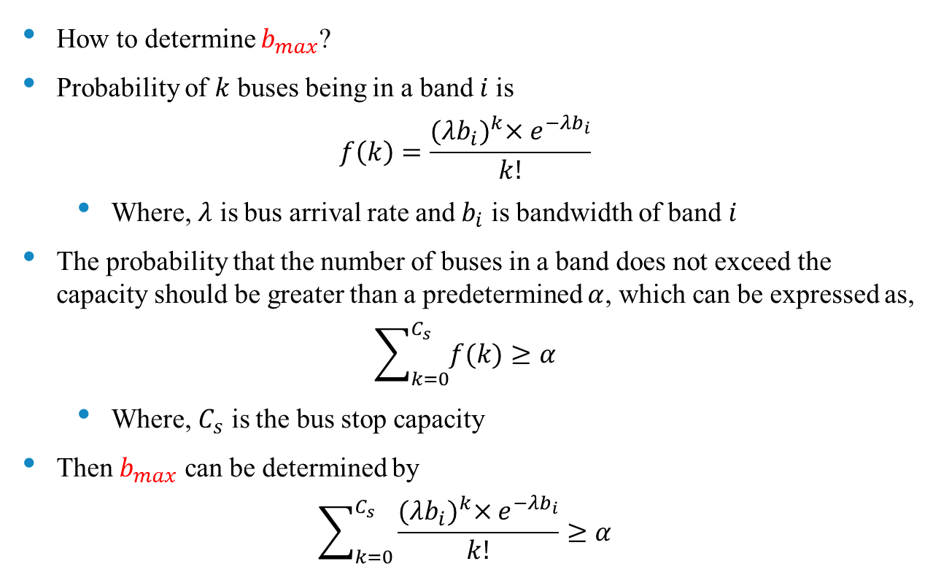
Methodology
A deterministic model
How to determine $b_{max}$?
Probability of $k$ buses being in a band $i$is
$$f\left(k\right)=\frac{{(λb_{i})}^{k}×e^{−λb_{i}}}{k!}$$
  Where, $λ$ is bus arrival rate and $b_{i}$ is bandwidth of band $i$
The probability that the number of buses in a band does not exceed the capacity should be greater than a predetermined $α$, which can be expressed as,
$$\sum_{k=0}^{C_{s}}{f(k)}≥α$$
  Where, $C_{s}$ is the bus stop capacity
Then $b_{max}$ can be determined by
$$\sum_{k=0}^{C_{s}}{\frac{{(λb_{i})}^{k}×e^{−λb_{i}}}{k!}}≥α$$

Slide 48
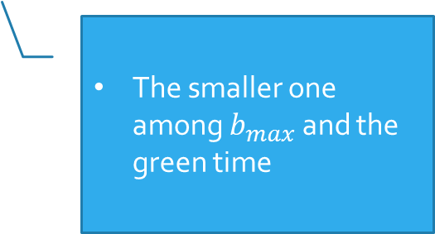

Methodology
An evaluation module
How to determine $a$?
1) set a minimum band $b_{min}$ and $b_{max,k}$
2)
3)
4)
5) the number of different values of $a$ is $\frac{a^{u}−a^{l}}{a^{′min}}$
A band smaller than that is meaningless operationally.
The smaller one among $b_{max}$ and the green time
upper bound
lower bound
Based on the bandwidth resolution of 1 second
Minimum interval

