Slide 1








An Integrated Multi-modal Emergency Evacuation System for the Baltimore Metropolitan Area
Traffic Safety and Operation Lab
University of Maryland
Maryland State Highway
Administration

Slide 2
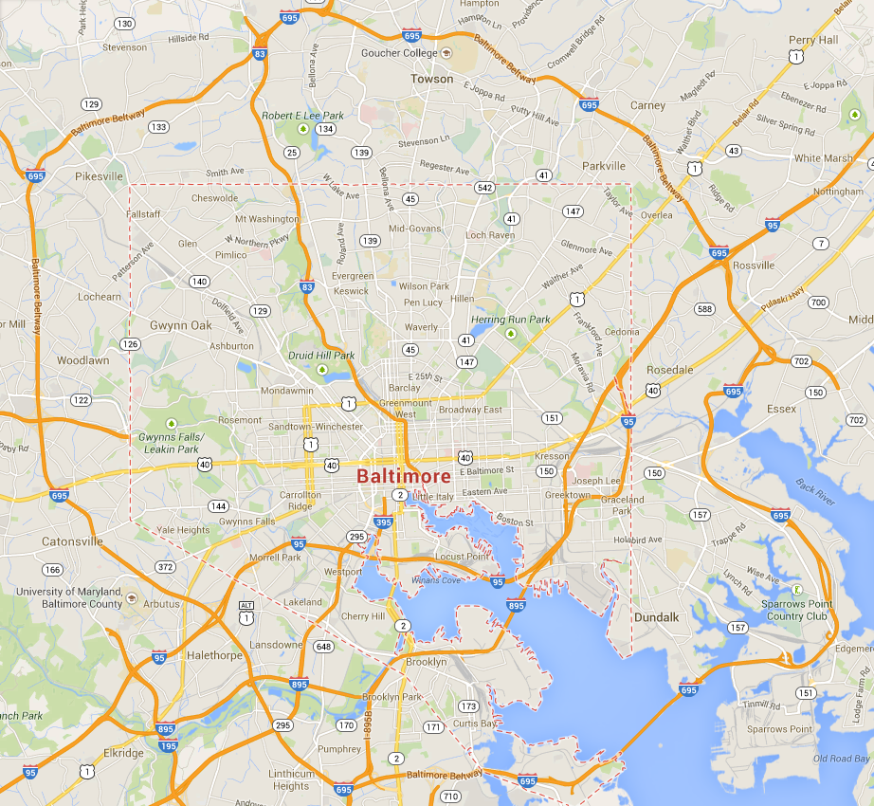
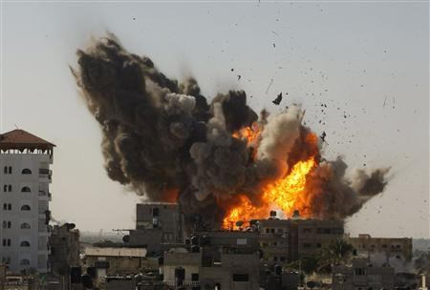
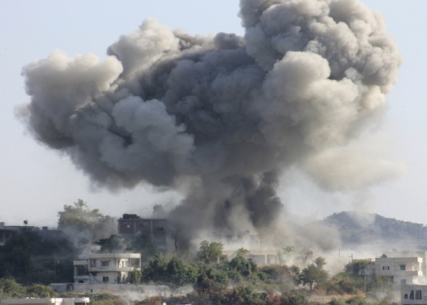

Emergencies in Urban Area
Bomb Attack
Emergency
Chemical Attack
Hurricane

Slide 3
A Typical Evacuation Procedure
Incident detected
Evacuation activated
Modal input
Impact zone: Multi-mode
Network-wide
Single-mode
Step 1
Step 2
Step 3
Step 4
Step 5
Mixed flow
pedestrians, transit system and vehicles
Single mode

Slide 4
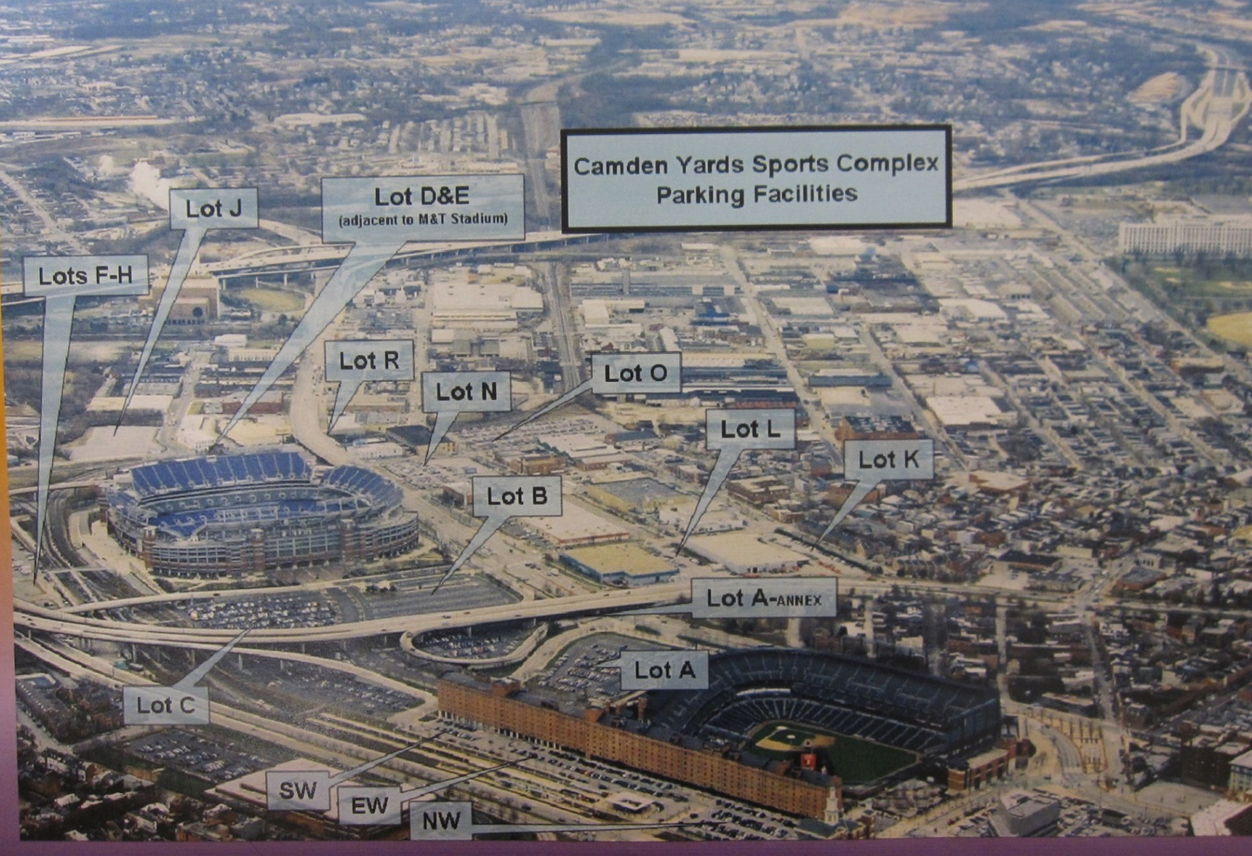
Field Site Demonstration

Slide 5
Drop off
Pedestrian flow
Mixed flow
Vehicular flow
Mixed flow intersection
Bus routing

Slide 6
Two-stage Evacuation Process
Stage 1 – Impact zone
(Pedestrian module + Bus module)
Stage 2 – Network wide
(Passenger cars module)

Slide 7
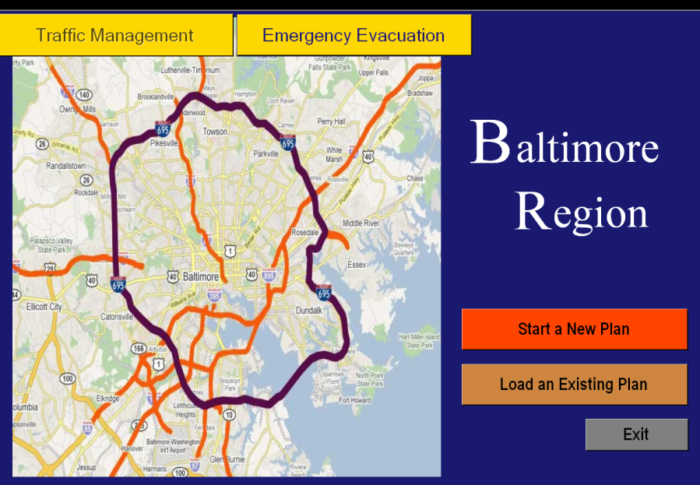
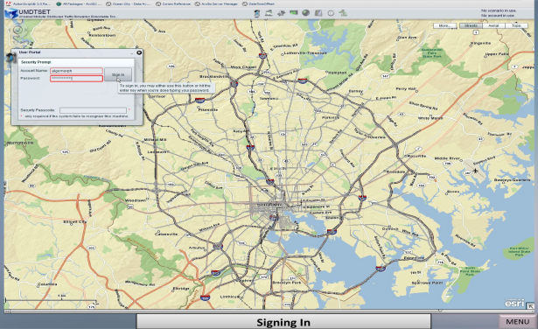
Off-line Evacuation
System
On-line Evacuation

Slide 8
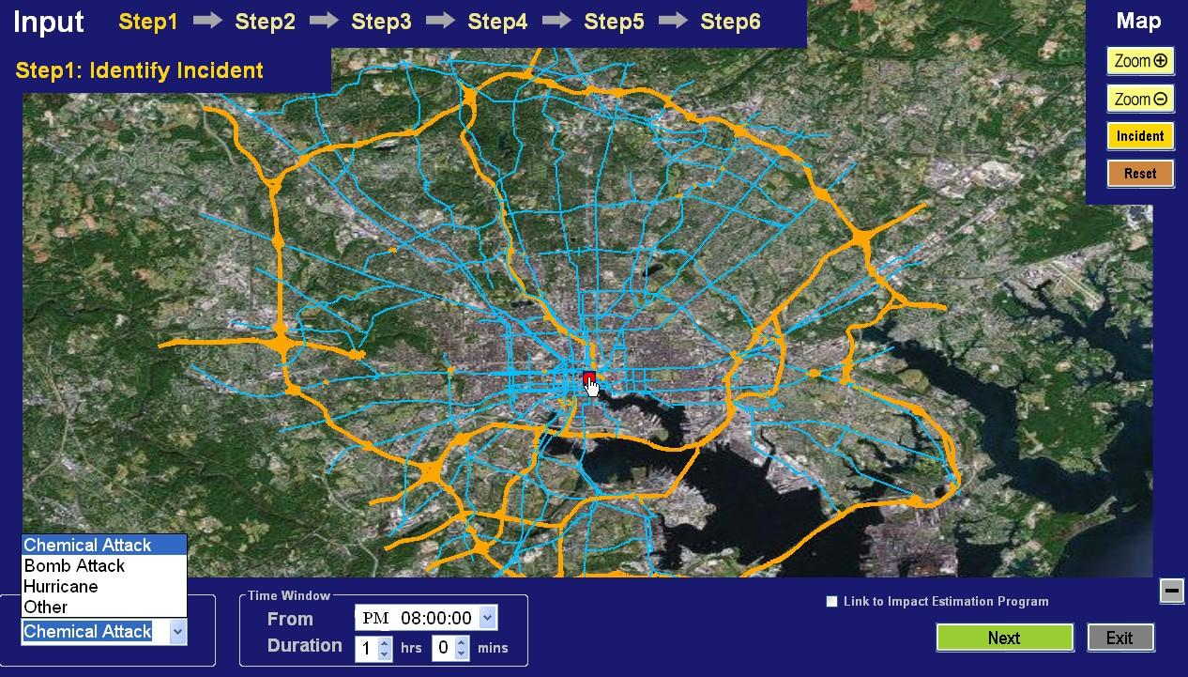
Off-line Evacuation System

Slide 9
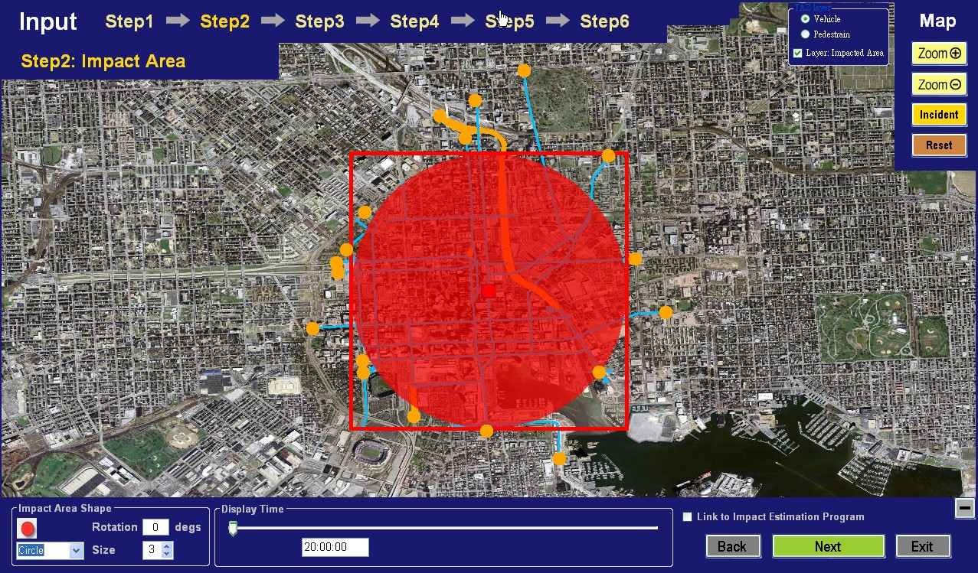
Off-line Evacuation System

Slide 10
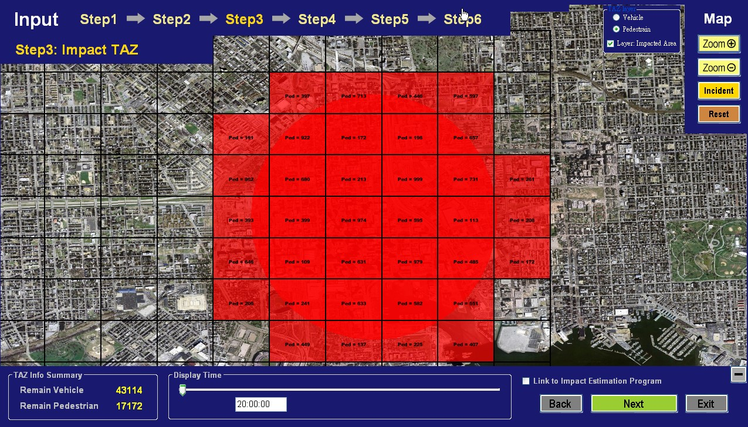
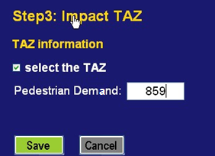

Off-line Evacuation System

Slide 11
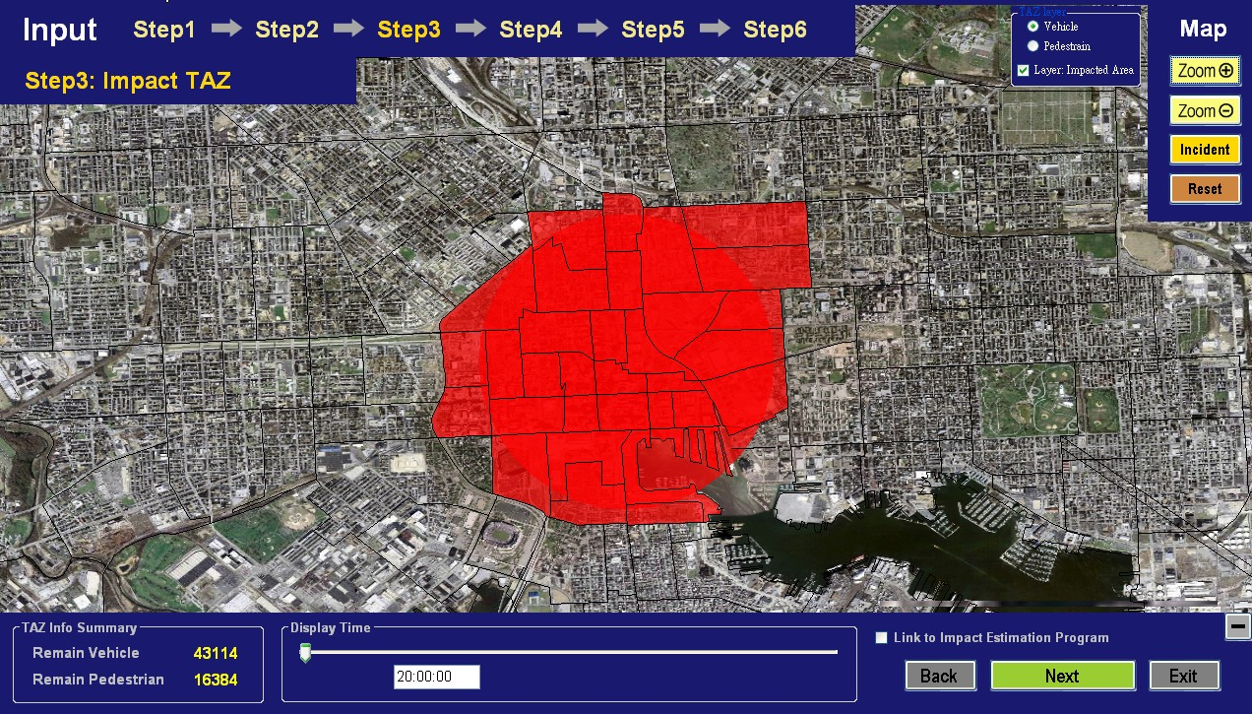
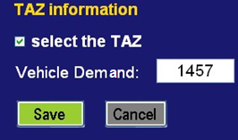
Off-line Evacuation System

Slide 12
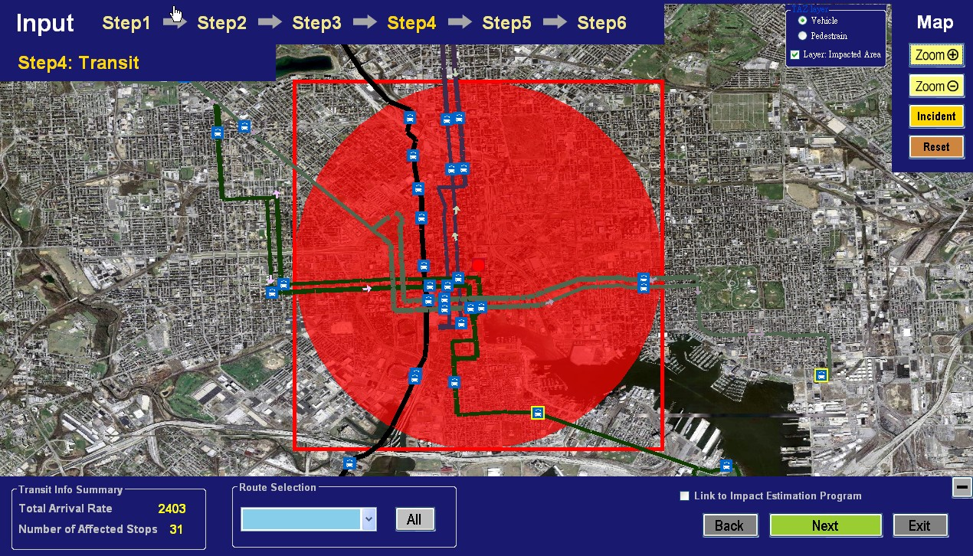
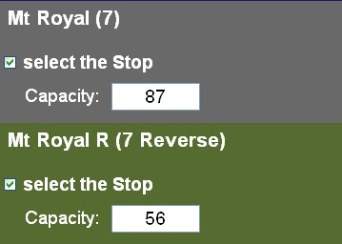
Off-line Evacuation System

Slide 13
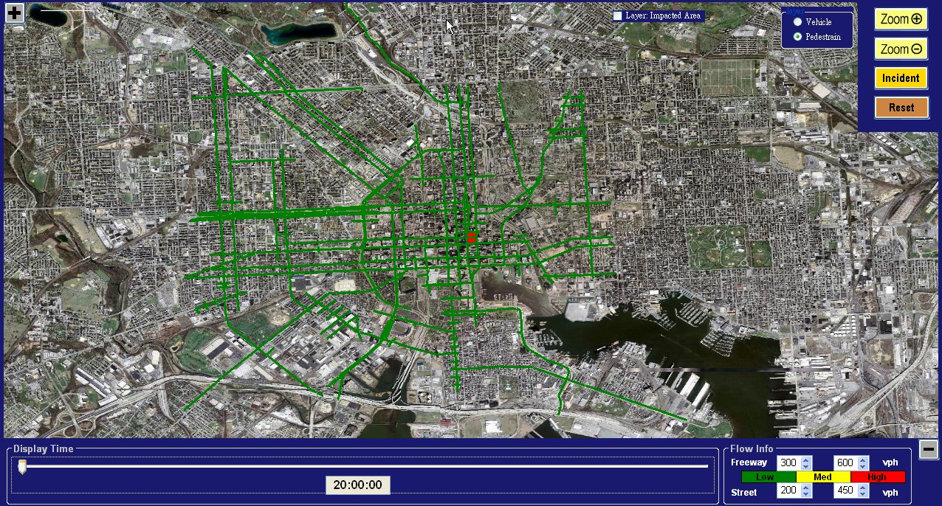
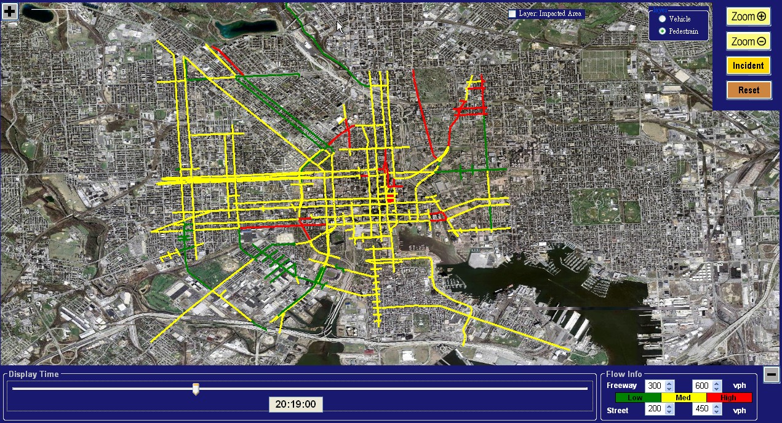
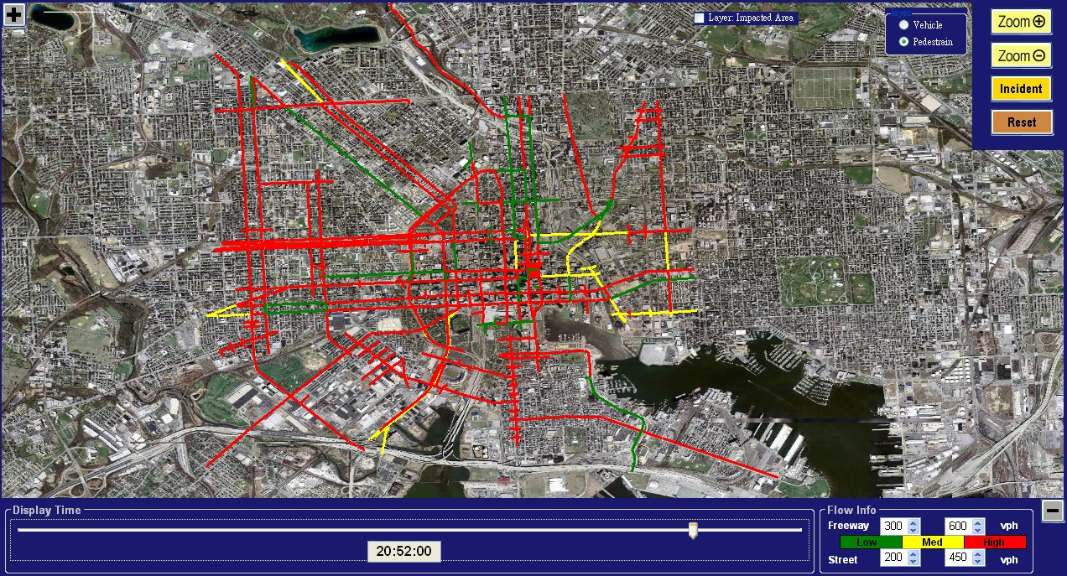
Network performance within the impact zones (Pedestrian)

Slide 14
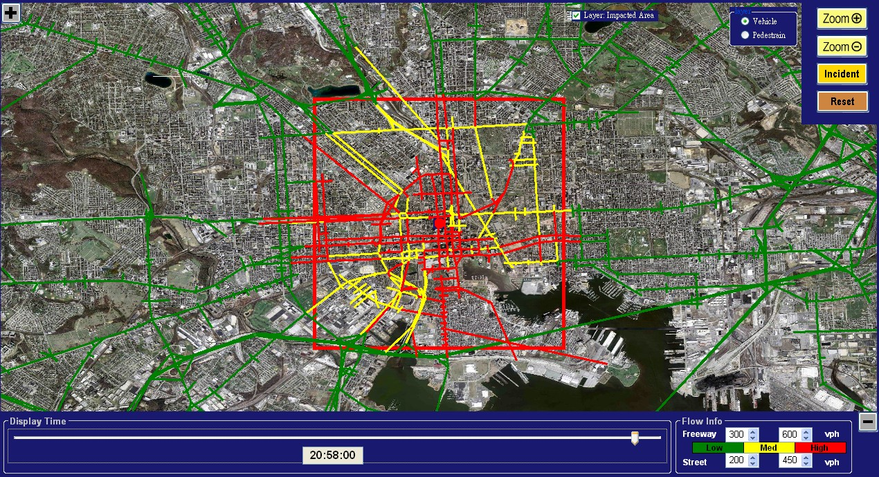
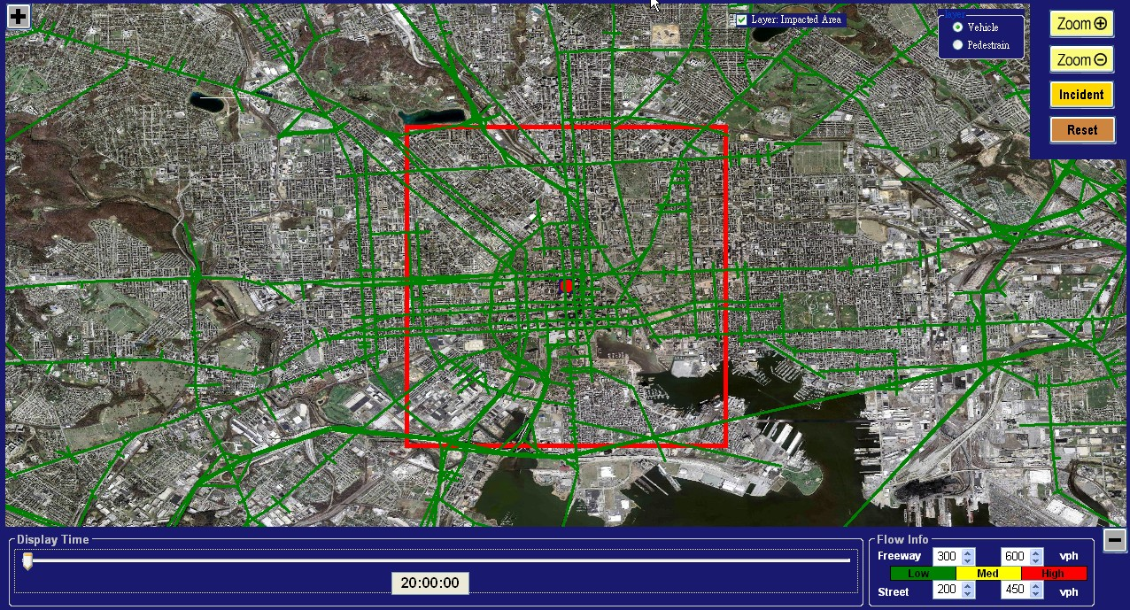
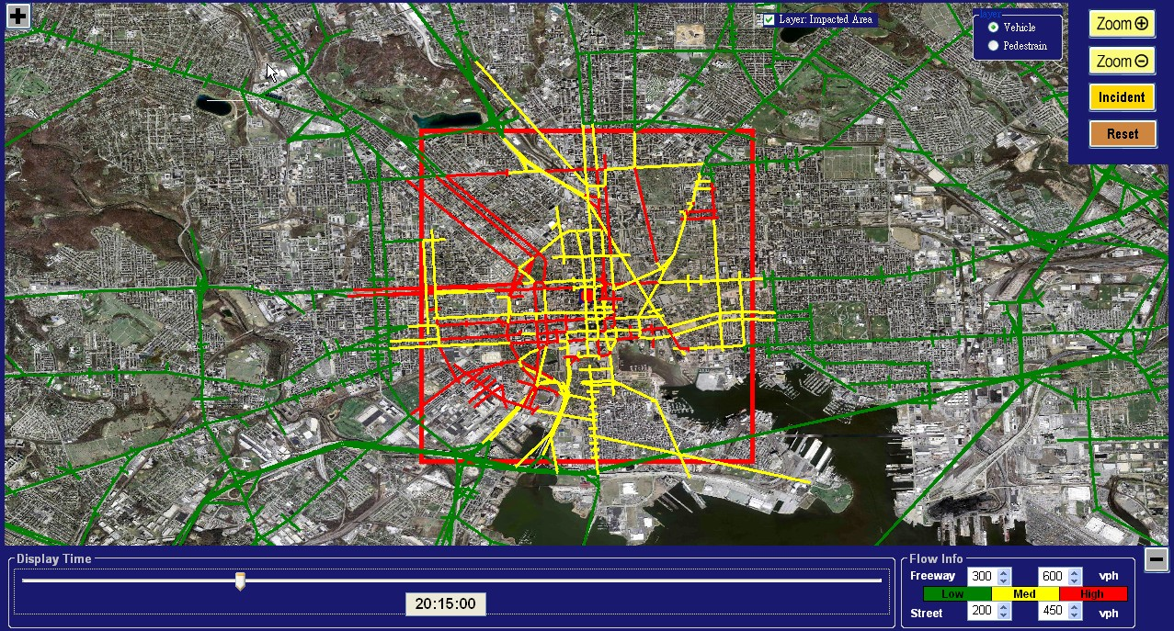
Network performance within the impact zones (Vehicle)

Slide 15






On-line Evacuation System
TransModeler
DYNASIM
VISSIM
The Web
“Native” Simulators (adapted/developed for UMDTEST)
Simulator “Wrappers”
Traffic Network Data
UMDTEST servers

Slide 16
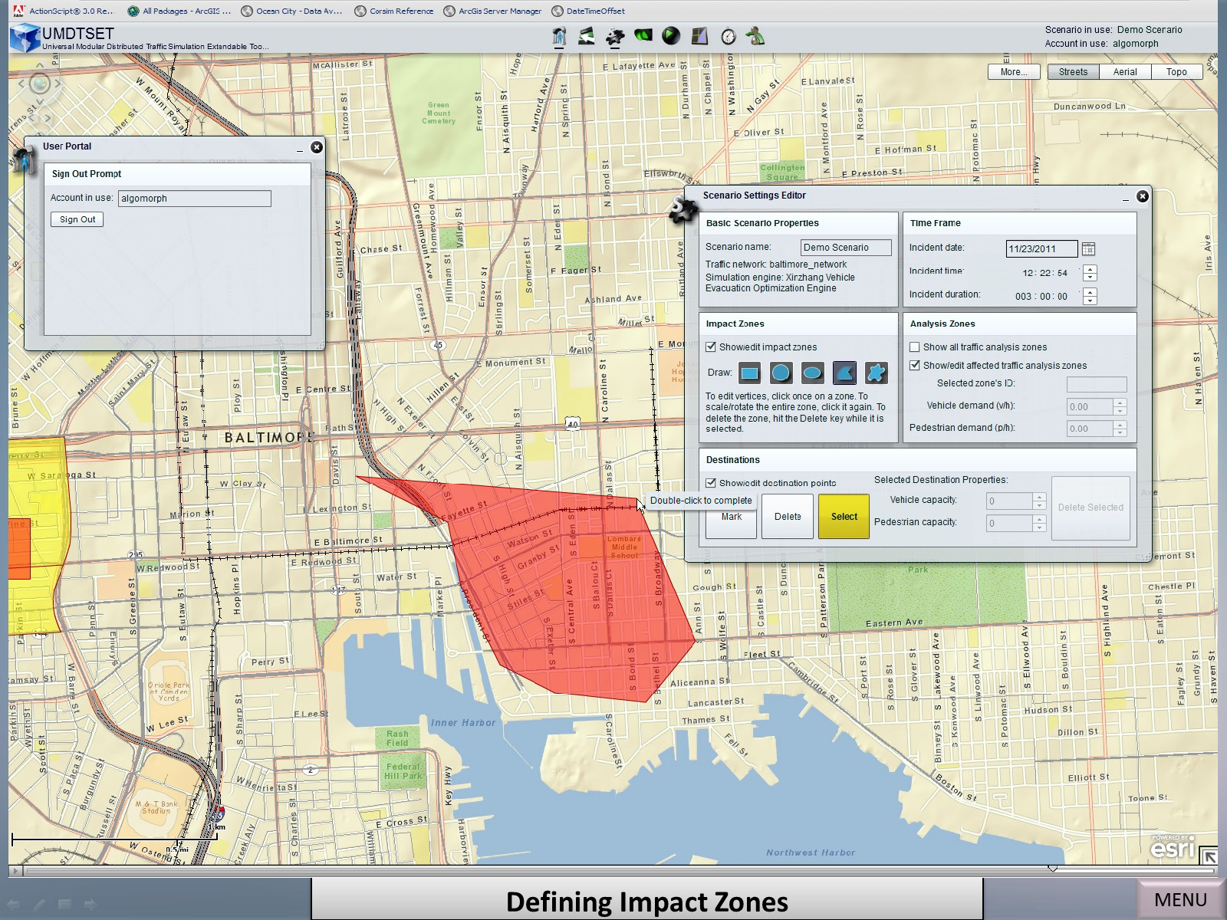
Defining Impact Zones

Slide 17
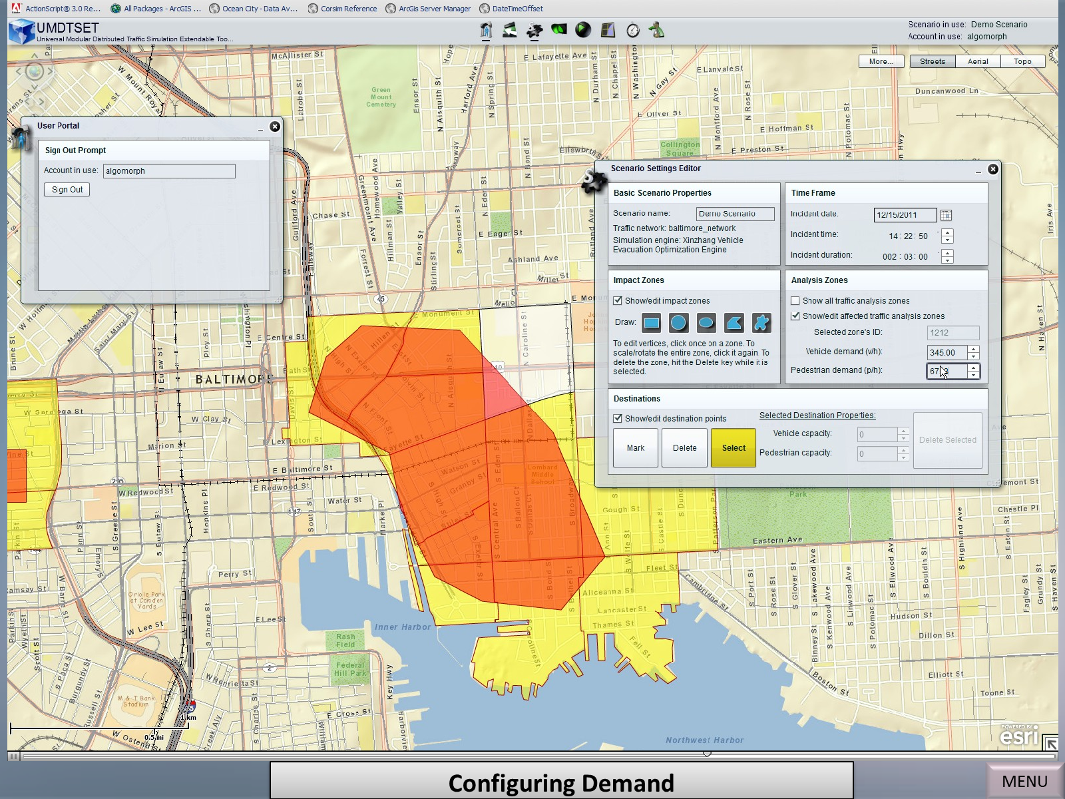
Configuring Demand

Slide 18
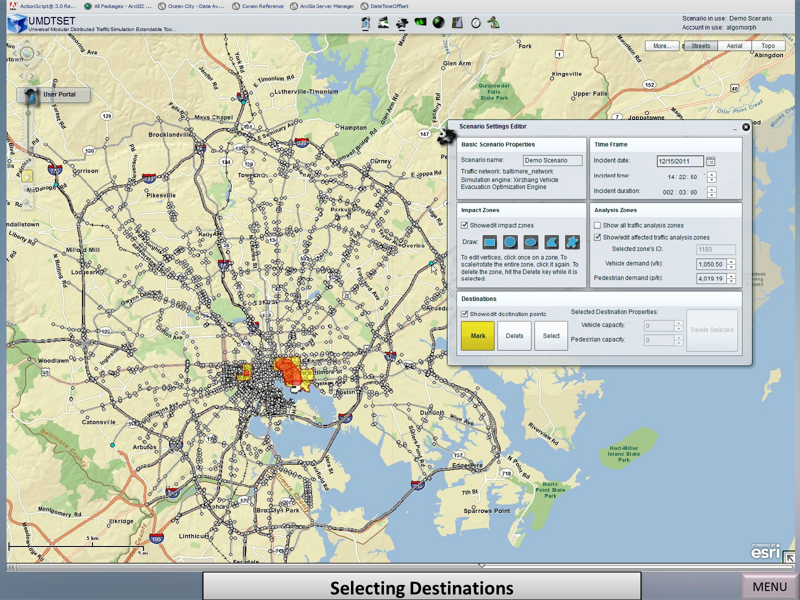
Selecting Destinations

Slide 19
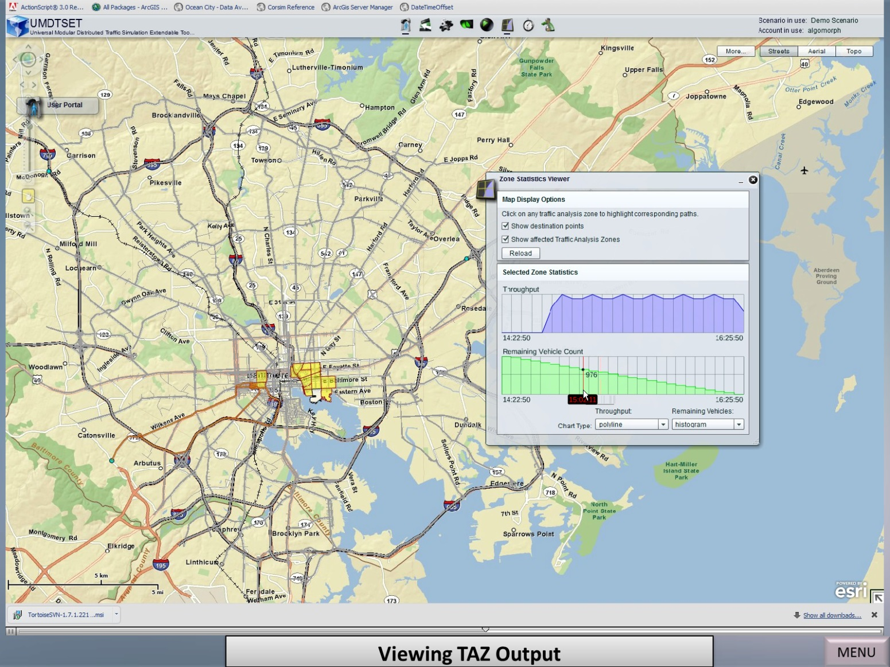
Viewing TAZ Output

Slide 20
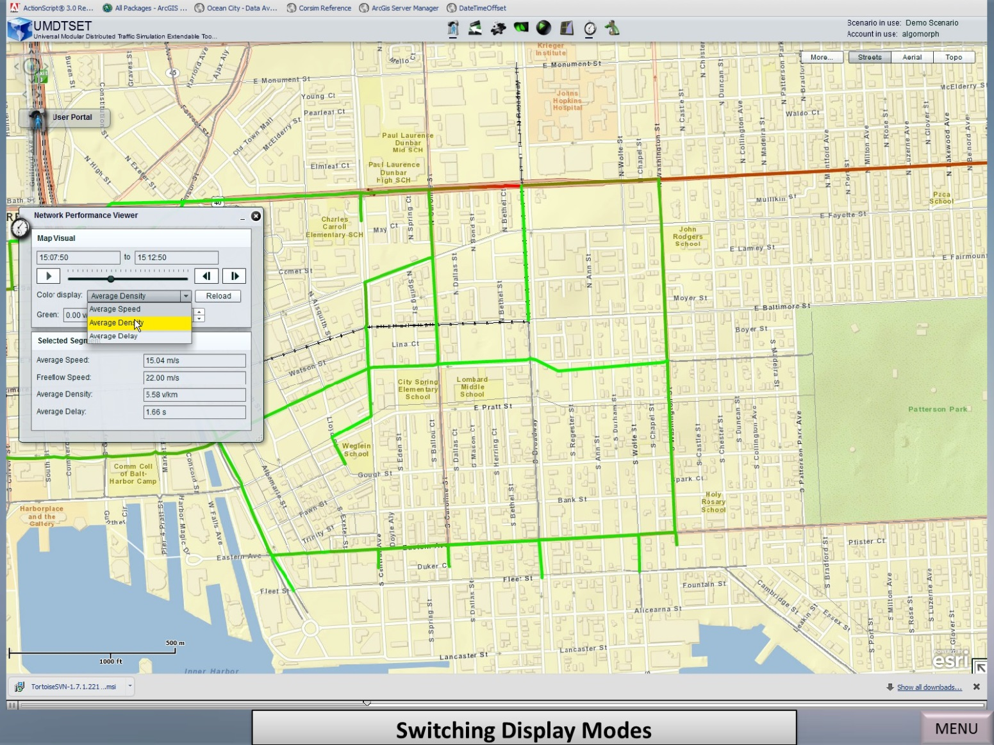
Viewing Network-wide Statistics

Slide 21

Thanks
Website: www. attap.umd.edu

