Slide 1
Design of a Dilemma Zone Protection System US 40 @ MD 910C (Western Maryland Parkway)
Traffic Safety and Operations Lab

Slide 2
Outline
Location overview
Accidents history
Field data collection
Speed profiles
Acceleration and deceleration rates
Protection design concept
System components
Proposed design layout

Slide 3
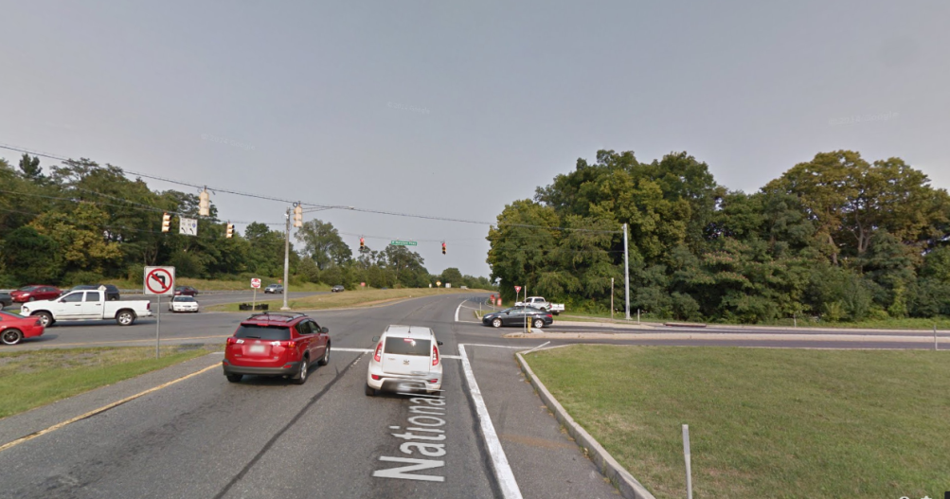
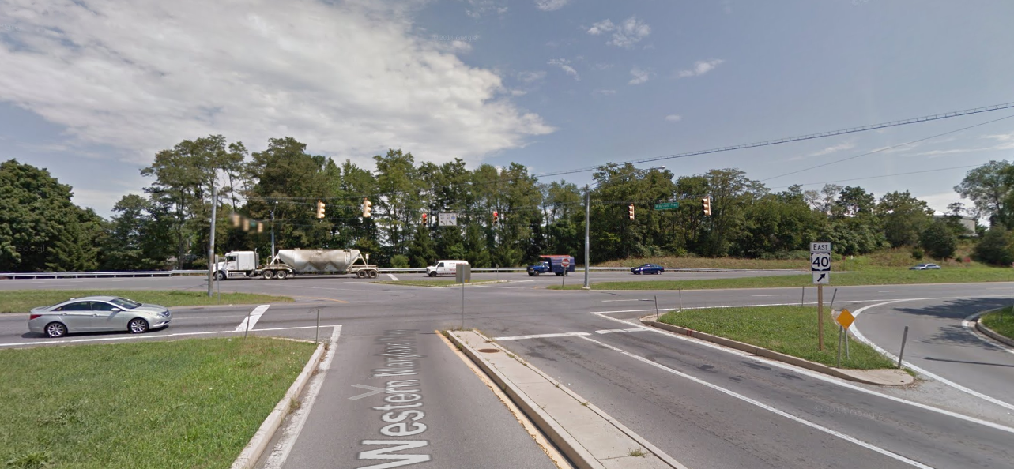
Location Overview
US 40@ Western Maryland Parkway
4 lanes divided highway (US 40), 3 approach lanes for Western Maryland Parkway (2-left, 1-right)
Isolated intersection
55 mph speed limit
Ramp from I-81 for eastbound
5% HV
MD 910C
US 40
US 40
MD 910C
Notes:
This location has high truck percentage (14%) also sights are block by Sign for southbound and eastbound approaches
The southbound has grade of +1.4% l from 1000 to the intersection. This also cause the truck driver not to stop… (maybe)

Slide 4
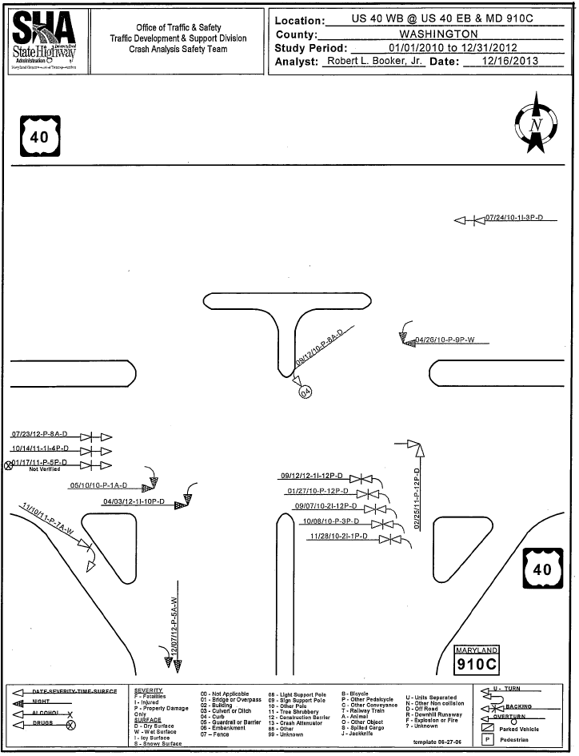
Accidents History
Historical accidents data (2011 ~2013)
7 crashes potentially related to dilemma zone decisions for 3 years
3 injuries
Accident history diagram

Slide 5
Field Data Collection
4 video camcorders with two reference points
850 ft, 650ft, 500 ft, and 300ft
1 camcorder for the stop line and the signal
Data Collection Period
Oct 10th 2014 from 11:30 AM to 12:30 PM and 3:00 PM to 6:00 PM
Data Processing
Video times are synced with the GPS satellite time
Exact times to reference points are extracted from videos
900 ft video capture
signal video capture

Slide 6
Field Data Summary
Speed Profiles (preliminary data collection)
Location | 900 ft | 500 ft | 200 ft
Average speed (mph) | 49.7 | 46.4 | 40.0
Minimum speed (mph) | 18.9 | 10.9 | 4.58
Maximum speed (mph) | 74.1 | 69.4 | 61.2
Sample Size | 1233 | 1371 | 1343

Slide 7
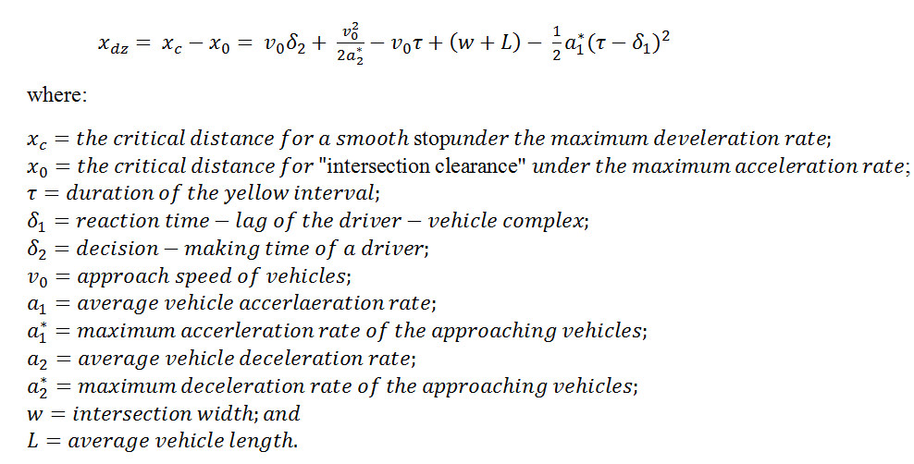
Dilemma Zone Distribution
Other Parameters-(Default Value)
Acceleration and Deceleration
Driver Reaction Time | 1.14sec
Driver Reaction Lag | 1.14sec
Vehicle Length (Passenger Car) | 12ft
Vehicle Length (Heavy Vehicle) | 60ft
Yellow Duration | 5.0sec
Intersection Width | 122ft
 | Acceleration Rate (${ft}/{s^{2}}$) | Deceleration Rate (${ft}/{s^{2}}$)
Average (Passenger Cars) | 3.79 | -9.33
Average (Heavy Vehicles) | 2.1 | -9.2
Median | 2.96 | -8.80
Minimum | 0.1 | -2.07
Maximum | 12.27 | -26.80

Slide 8
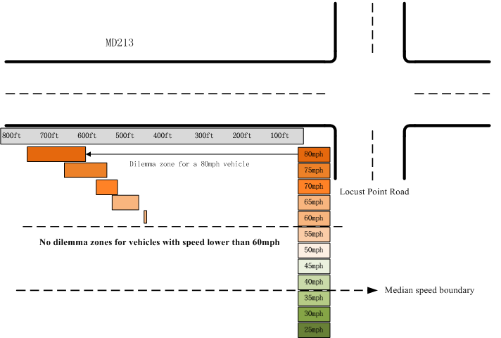
Dilemma Zone Distribution (passenger cars only) (Theoretical Acceleration/Deceleration Rates –AASHTO)
749ft
445ft
Range need to be covered by the detection system
Acceleration rate | 10.00 ft/s²
Deceleration rate | -11.20 ft/s²
Intersection Width | 122ft
Vehicle Length (Passenger Car) | 12ft
Yellow Duration | 5.5sec
Driver Reaction Time | 1.14sec
Notes:
Revised

Slide 9
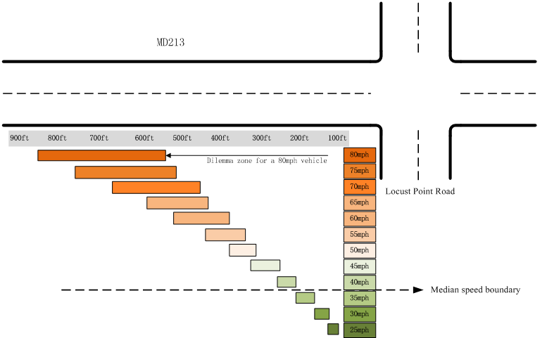
Dilemma Zone Distribution (passenger cars only) (Average Acc./Dec. Rates from field)
872ft
103ft
Deceleration Rate (ft/s^2) Passenger cars only
Average | -9.33
std | 5.07
Max | -26.80
Min | -2.07
Median | -8.80
85th percentile | -13.24
# of record | 74
Range need to be covered by the detection system
Average acceleration rate | 3.79ft/s²
Average deceleration rate | -9.33ft/s²
Intersection Width | 122ft
Vehicle Length (Passenger Car) | 12ft
Yellow Duration | 5.5sec
Driver Reaction Time | 1.14sec
Notes:
Revised

Slide 10
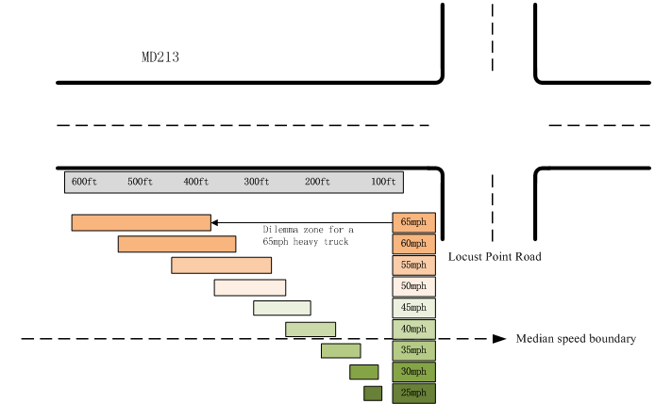
Dilemma Zone Distribution ( For heavy trucks only) (Using Average Acc./Dec. Rates)
Deceleration Rate (ft/s^2) trucks only
Average | -9.20
std | 6.16
Max | -25.83
Min | -2.20
Median | -7.25
85th percentile | -12.60
# of record | 14
603ft
40ft
Range need to be covered by the detection system
Average acceleration rate | 3.79ft/s²
Average deceleration rate | -9.20t/s²
Intersection Width | 122ft
Vehicle Length (Passenger Car) | 12ft
Yellow Duration | 5.5sec
Driver Reaction Time | 1.14sec
38mph

Slide 11
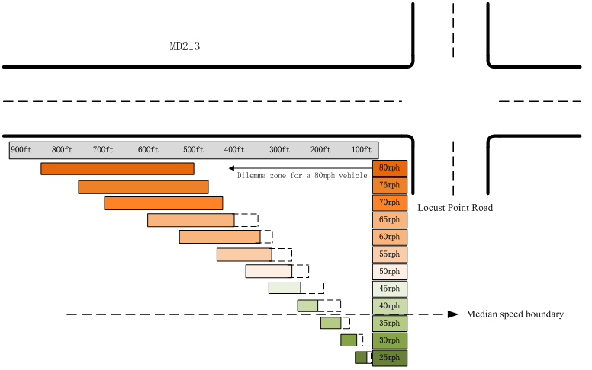
Recommended Dilemma Zone Distribution (Average acc./Dec. Rates from passenger cars and from trucks)
Avg. acceleration rate | 3.79ft/s²
Avg. deceleration rate | -9.33ft/s²
Avg. acceleration rate (Truck) | 3.79ft/s²
Avg. deceleration rate (Truck) | -9.20t/s²
Intersection Width | 122ft
Vehicle Length (Passenger Car) | 12ft
Yellow Duration | 5.5sec
Driver Reaction Time | 1.14sec
872ft
40 ft
Range need to be covered by the detection system due to large percentage trucks
Combination of DZ distributions
of heavy vehicles and
Average passenger cars

Slide 12
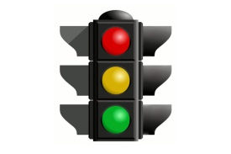
Design Concept
Activation and deactivation of the message sign
Advanced warning sign with speed control
Signal Controller
PREPARE TO STOP WHEN FLASHING
Signal control includes all-red extension
Speed, location, arrival time
Advisory SPEED
50
Microwave detector
Detection Zone
Upper limit from the distribution of DZ (field data)
Location of AWS with flasher

Slide 13
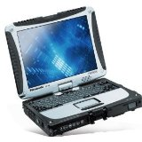
System components
Option 1
Real-time Monitoring
I.e. Panasonic toughbook
Wireless Modem
Lab (monitoring)
Connection Module
(click 223 301)
i.e. Raven X modem
Econolite ASC/3
Option 2
Advanced Warning
Two Smartsensor Advanced
Connection Module
(click 223 112)
PREPARE TO STOP WHEN FLASHING
Wireless connector
Wireless connector
Microcontroller
Advisory SPEED
55

Slide 14
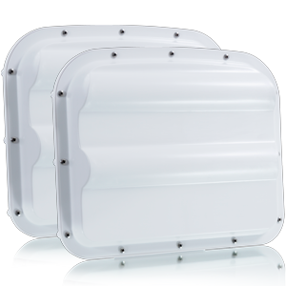
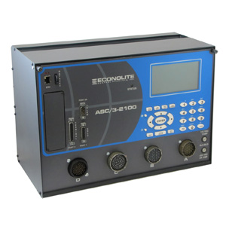
Major System Components
Sensor(s) for dilemma zone protection
Microwave long range detector (Smartsensor Advanced Extended Range)
can cover up to the upper limit of DZ
Provides real-time traffic data (speed, location) over each sliced interval 0.1 second)
Signal controller (Econolite ASC/3)
Provides all-red extension to the driver who tries to run over the all-red phase
SmartSensor Advance extended range
Up to 600 ft detection for motor vehicle
Up to 900 ft detection for HV
Econolite ASC/3

Slide 15
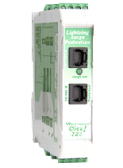
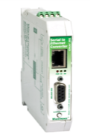
Real-Time Monitoring System
PC
Harden PC can be stored in cabinet (i.e. Panasonic toughbook)
Store and send the log file to the Lab
Modem
Wireless communications (i.e. Raven X modem)
Connection Module
Allow additional connections to sensors (i.e. Click 301)
Surge protection (i.e. Click 223)
In cabinet PC
i.e. Panasonic toughbook
Wireless Modem
i.e.Raven X modem
Surge Protection
i.e. Click 223 (Wavetronix)
Connection module
i.e. Click 301 (Wavetronix)
Real-time monitoring

Slide 16
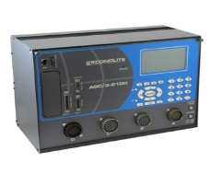
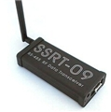
AWS system
Advanced warning sign
Activated when the signal changes to the yellow
Location ($D_{S}$)
$D_{S}=uppper limit of DZ distribution+ T_{PRT}∗v$
$T_{PRT}$: perception-reaction time (1.5 seconds);
$v$: vehicle speed.
Advisory speed
Advisory speed for vehicles to safely stop ahead of the stop line
RF signal transmitter
Send the activation/deactivation signal to AWS (i.e. RF Data Transceiver: SSRT-09-RS485)
Microcontroller
Receive signals via the wireless connection to control AWS
* Wireless connections can be replaced with wire connections
PREPARE TO STOP WHEN FLASHING
Wireless
Microcontroller
(activate AWS)
ASC/3
Wireless communication
i.e. RF Data Transceiver: SSRT-09-RS485

Slide 17
List of Equipment
Major Component
Smartsensor Advanced Extended Range
Transportation Equipment & Services, Inc.
Econolite ASC/3
Econolite
Laptop
Panasonic Toughbook CF-53 CF-53SJCZYLM ( CF-53SJCHYLM )
http://toughruggedlaptops.com
Raven X modem
Raven Series - Proven, 2G/3G gateway (Raven XE)
http://www.sierrawireless.com/
Click 223, 301
Transportation Equipment & Services, Inc.
RF Data Transceiver: SSRT-09-RS485
http://www.abacom-tech.com
Monitoring Module
AWS
Module

Slide 18
All-Red Extension operational flow chart
All red phase starts
Extension Criteria
During the all-red phase
If any vehicles are detected above the threshold in the detection zone, the controller will activate the all-red extension until the target vehicles have passed the intersection
T = 0
AR = all red
Any vehicle above the thresholds and AR extendable?
T < AR?
NO
YES
T = T + 0.1
Vehicle Speed | Distance to stop line
>= 35 mph | < 200 ft
>= 45 mph | < 300 ft
>= 55 mph | < 450 ft
>= 65 mph | < 600 ft
> = 75 mph | Any detection zone
YES
NO
Does vehicle can clear the intersection without extension?
End All red
YES
NO
Update AR
AR = AR + extension

Slide 19
Proposed Design (Type-1:AWS only)
Signal Controller
Microwave sensor (0-500 ft)
Microwave sensor (500-900 ft)
Advanced warning sign
PREPARE TO STOP WHEN FLASHING
Detection Zone
Detection Zone
500 feet
400 feet
Recommended detection zone range
900 feet
Location of sign
1050 feet
Two microwave detectors (0-500 and 500-900 feet)

Slide 20
Proposed Design: Type 2 (AWS with speed limit)
Advanced warning sign with Posted Speed Limit
Signal Controller
PREPARE TO STOP WHEN FLASHING
Microwave sensor (0-500 ft)
Microwave sensor (500-900 ft)
Detection Zone
Detection Zone
500 feet
400 feet
Recommended detection zone range
900 feet
Location of sign
1050 feet
Two microwave detectors (0-500 and 500-900 feet)

Slide 21
Proposed Design: Type 3: (AWS with speed limit)
Advanced warning sign with advisory speed Limit
Signal Controller
PREPARE TO STOP WHEN FLASHING
Microwave sensor (0-500 ft)
Microwave sensor (500-900 ft)
Advisory SPEED
50
Detection Zone
Detection Zone
500 feet
400 feet
Recommended detection zone range
900 feet
Location of sign
1050 feet
Two microwave detectors (0-500 and 500-900 feet)

