Slide 1
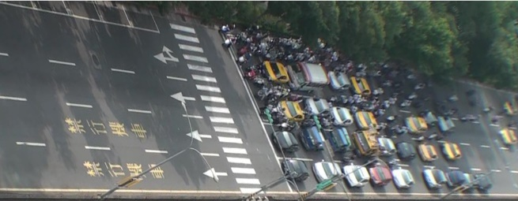
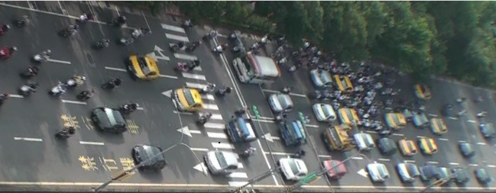
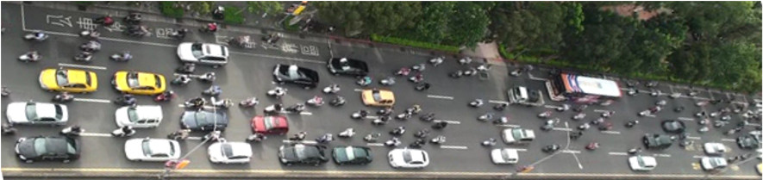
An Empirical Study of the Scooter-Vehicle Mixed Traffic Propagation on Urban Arterials
by Chien-Lun Lan and Gang-Len Chang
University of Maryland, College Park
Abstract
Research Background
The Proposed Model
Lane Choice
The field observation reflects the following patterns:
Cars tend to stay on the same travel lane, but will perform lane changes to merge into the lane that serves their turning needs.
Scooters, with high mobility, tend to choose the lane with fewer vehicles to advance to the downstream stop line.
Travel Time Estimation
Cars will decelerate and join the end-of-queue; scooters may decide to filter through the stop queues and not reduce their speed to zero.
Scooters are one of the primary transportation modes in many developing countries, but design guidelines and software for arterial signals accommodating heavy scooter-vehicle mixed flows are still in their infancy.
Traffic professionals often have no choice but to apply existing models that cannot address scooters’ complex maneuvers.
This study conducts field observations of the mixed traffic flow from their discharging to the formation of stop queues.
Based on the statistical analysis results, this study develops a series of formulations to describe the behavior of mixed traffic flows.
The developed models are evaluated and confirmed to be reliable to serve as the basis for designing arterial control plans.
Field Observations
To study scooter-vehicle mixed traffic, this research selects two consecutive arterial approaches for field observation.
By using camcorders mounted on a high-rise building, the vehicle trajectories are retrieved on a frame-by-frame basis.
Research Objectives
This research tries to understand the fundamental properties of scooter-vehicle mixed traffic flows, focusing on empirical investigation of their macroscopic behavior.
This study further formulates all statistically validated empirical relations with a series of traffic models.
Discharge Process
It is noticeable that scooters often form several queue lines in a lane while cars can only form a single queue. The field survey reveals that the discharge rate for such mixed flows may vary with the number of scooters in the stop queue.
Speed trajectory of vehicles joining the end-of-queue with and without filtering behavior
Merging into Stop Queue
As vehicles approach the stop line and observe significant differences in queue length among the neighboring lanes, they may perform lane-changing to merge into the lane with shorter queue.
Scooter Filtering Process
Scooters, due to their small physical sizes, tend to advance between vehicle queue-lines to reach available downstream spaces. It is observed from the field data that scooters’ filtering speed decreases as the mixed flow density increases.
Evaluations
Queue evolutions
Queue evolution is one of the most important factors in design of intersection signals. The evaluation compares the model-estimated and the field-observed queue evolutions. Lane 1 is scooter-prohibited, whereas lane 3 serves both scooters and cars.
With an approach of 190M long, it is observed that scooters arrive at the stop-line before cars with a leading time of 8 seconds, which reflects the real-world scooter-vehicle mixed traffic scenario.
Conclusions
Acceleration/Deceleration
The average acceleration/deceleration rates between cars and scooters from the field survey are different.
Comparing to cars
Scooters have higher initial acceleration rate
Scooters brake later but harder
Field Data
The scooter-mixed traffic data was collected from the northbound approaches of an 8-lane major arterial, Xinsheng South Road, in Taipei, Taiwan.
Traffic volume during data collection is about 9,000 vehicles per hour in the target direction; among all vehicle flows, 83% are scooters, 15% are cars, and 2% are buses.
Scooter Discharge Rates
The discharge rates for cars and scooters under non-mixed traffic condition are set to be 1,800 and 14,000 vphpl, respectively.
This paper presents the results of empirical investigation with respect to the evolution of scooter-mixed traffic flows from discharging, propagation, to the formation of queues at the downstream intersection.
A series of concise equations are proposed to describe the complex propagation process over an arterial link.
The numerical evaluations of the proposed models with field observations have offered insights into the properties of mixed traffic flows, and can serve as the basis for development of an arterial signal progression model.
Speed of vehicles during deceleration process
Acceleration/deceleration rates of vehicles

