Slide 1
Lane use factor estimation for intersections with lane drop
Park & Kevin
Notes:
Hello everyone, today I’m going to present the study on lane use factor estimation for intersections with lane drop. Thanks for Park’s generous help.

Slide 2
Outline
Introduction
Literature review
Lane drop types
Data collection
Data analysis and proposed LUF
Summary
Notes:
This is the outline of the presentation. I will first introduce the background of the study, and give a literature review. Then the lane drop types and data collection will be showed. After that, I will discuss in details about the data analysis part. At last a summary table will be present.

Slide 3
Introduction
What is LUF (Lane Use Factor)
The ratio of the highest lane volume over the total volume in a lane group
Used to determine the critical lane volume for signal phase or intersection analysis
Currently used LUF ( from HCM 2000 )
Number of approach lanes | Lane use factor
1 | 1
2 | 0.55
3 | 0.4
4 | 0.3
5 | 0.24
Double left turns | 0.6
Triple left turns | 0.45
Notes:
Lane use factor, which is the ratio of the highest lane volume over the total volume in a lane group, is usually used to determine the critical lane volume for the signal phase or intersection analysis.
Highway Capacity Manual has provided the suggested lane use factors for normal intersections based on different approach lanes, as we can see in this table.

Slide 4
Introduction
Lane drop intersection types
Merge
One of the lanes has to merge after the intersection
Form a Single lane (Alternative Merge)
The two lanes merge each other without indication of which lane yields the right-of-way.
Are the LUFs for intersection without lane drop and intersection with lane drop be the same?
If the LUFs are different from normal LUF, what will be the values?
Notes:
However, lane drop intersections are widely existed among urban or rural streets and highways. The HCM doesn’t consider the effect of lane drop on lane use factor. There are two types of lane drop, the first one is Merge, which means one of the lanes has to merge after the intersection; and the other one is Form a single lane (or Alternative merge), which means two lanes merge each other without indication of which lane yields the right-of-way. So what we are interested in is that are the LUFs for intersection with and without lane drop be the same. And if they are different, what will be the suitable value of lane use factors for lane drop intersection

Slide 5
Literature review
Nanda Srinivasan (2011) from NCHRP focused on auxiliary through lanes to estimated the volume. (TRB)
However, the estimated model used signal information; the lane use factor is still unknown for the many types of lane drop.
Jae-Joon Lee, Nagui M. Rouphail, and Joseph E. Hummer (2005) from North Carolina University developed a set of field-verified estimates for the lane utilization factor. (NCDOT project)
However, the lane utilization factor was a different concept from the lane use factor focused in this research; the field data was collected in North Carolina state only, which may not be in Maryland.
Notes:
Some previous study has focused on lane drop intersection. A report from NCHRP build models to estimate the volume of auxiliary through lanes. However, the estimated model used signal information, which should not be available before the lane use factor is determined. And even though the model can estimate the volume, the lane use factor is still unknown for intersection with three lanes, or double left turns.
And another study from NC University developed a set of estimation models for the lane utilization factors. This lane utilization factor is different from the lane use factor focused in this study, the difference between them will be explained in next slide, besides that, the models were based on field data in North Carolina state only, whether they can be used in Maryland should be varified.

Slide 6
Literature review
Difference between LUF and lane utilization factor
$LUF=\frac{v_{gl}}{v_{g}}$ (1)
where $v_{g}$=total lane flow rate (vph);
$v_{gl}$=highest lane flow rate in a lane group (vph).
Lane utilization factor$=\frac{v_{g}}{v_{gl}N}$ (2)
where $v_{g}$=total lane flow rate for the lane group (veh/h)
$v_{gl}$=highest lane flow rate in a lane group (vph)
N = number of lanes in lane group
(Jae-Joon Lee, Nagui M. Rouphail, and Joseph E. Hummer 2005)
The LUF can be obtained by the lane utilization factor by:
$LUF$=1/(N*Lane utilization factor) (3)
Where N = number of lanes in lane group
So this study will test whether the models from NC university can fit the field data from Maryland.
Notes:
Equation 1 and 2 shows how to get the lane use factor and lane utilization factor. Actually we can find that the LUF can be obtained by the lane utilization factor by equation 3, so this study will test whether the models from NC university can fit the field data from Maryland.

Slide 7
Lane drop types
5 lane drop types have been studied
(1). Two through lanes with one lane drop
(2). Three through lanes with one lane drop
(3). Double left turn lanes with one lane drop
(4). Two through lanes form a single lane
(5). Double left turn lanes form a single lane
Notes:
This study considers 5 lane drop types. They are …

Slide 8
data collection
29 different sites in Maryland
Over 130 hours traffic data
AM peak, PM peak and off-peak hours in weekdays
Types | No. of locations | No. of data group (# of 15 min)
3 through →2 | 6 | 71
2 through → 1 (exclusive) | 10 | 251
2 left →1 | 8 | 148
2 through “form a single lane” | 3 | 37
2 left “form a single lane” | 2 | 44
Notes:
In total there are 30 different sites were collected in Maryland during July to September 2013. Over 130 hours of traffic data were gathered including AM peak, PM peak and off-peak hours in weekdays. And from this table, we can see how much data were collected for each type of lane drop.

Slide 9
Data analysis and proposed LUF
Data analysis methods
1. Boxplot
Examine the outliers;
2.Statistical test
Compared with the normal LUF;
Compared with the estimation of models from NC university(if exist);
3. Scatter plot
Observe patterns with possible factors;
4. Categorize data based on the identified factors if necessary
5. Provide suggested LUF
Notes:
After the data collection, each type of lane drop will be analyzed separately in the following process, for the first step, a boxplot is used to examine the outliers, secondly the field data is compared with normal LUF and the estimation of models from NC university if the model exists. Then some scatter plots are present to observe the patterns between LUF and possible variables. According to the scatter plot, the data may be categorized based on identified factors if necessary. At last, the suggested LUF will be provided.

Slide 10
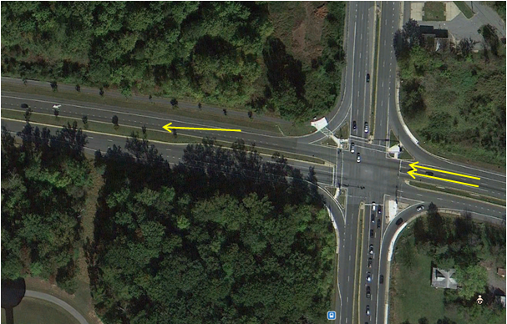
Data analysis and proposed LUF
Type 1: 2 through – 1
Example:
MD 650 @ Spenceville Road
Right most lane merge into left lane after 850 feet from the intersection
Notes:
Let’s begin with type 1, which is two through lanes with one lane drop. Here is an example site in Maryland, we can see the general geometry of this type.

Slide 11
Data analysis and proposed LUF
Type 1: 2 through – 1
10 Locations
Spenceville Rd(MD 28) & Norbeck Rd (MD 650) @ Montgomery
North bound and west bound
Norback Rd (MD 28) & Georgia Ave (MD 97) @ Montgomery
Enterprise Rd (MD 193) & Annapolis Rd (MD 450) @ Prince George
Bel Air Rd (US 1) & Mountain Rd (MD 152) @ Harford
Greenbelt Rd (MD 193) & Lanham Severn Rd (MD 564) @ Prince George
East bound and west bound
Queens Chapel Rd (MD 500) & Hamilton St (MD 208) @ Prince George
Hamilton St (MD 208) & Ager Rd @ Prince George
Watkins Park Dr (MD 193) & Central Ave (MD 214)
Notes:
In this study, 11 locations are collected. The addresses of intersections are listed here.

Slide 12
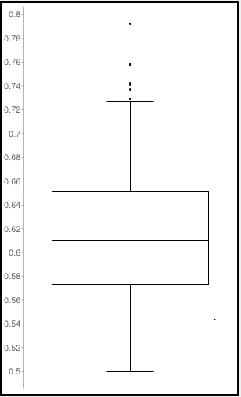
Data analysis and proposed LUF
Type 1: 2 through – 1
1. Boxplot
LUFs are mainly located between 0.57 and 0.65.
Sample size | 227
Median | 0.610
Minimum | 0.500
Maximum | 0.792
First quartile | 0.573
Third quartile | 0.651
Outliers (8) | 0.792 0.758 0.758 0.742 0.741 0.737 0.729 0.729
Notes:
During the field survey and video taking, there were some extremely bad weathers, some accidents near the intersection, or sometimes very low traffic volume. For those situations traffic may performance unusual, and the data with these situations were discarded.
The rest of the data contains 251 data groups. By using a boxplot, the basic descriptive statistics of the lane use factor is as below:
This is … This is …
Here we can find 23 outliers from the data, after checking the data, these data are found from one particular site. The right turn traffic of that site is shared with the through traffic near the intersection, which causes most of the through traffic uses the left lane. That is the reason why LUFs of that site are much high than other locations.

Slide 13
Data analysis and proposed LUF
Type 1: 2 through – 1
2. Compared with normal LUF
Descriptive statistics
Test the difference:
H0: The mean of LUF from field survey is the same as normal LUF for two lanes (0.55);
H1: The mean of LUF from field survey is not the same as normal LUF for two lanes (0.55);
Result:
T-test: 17.075
P value<0.0001
Reject H0
Conclusion:
The difference is statistically significant
Normal LUF is not suitable for this type of lane drop intersection
Descriptive statistics | LUF from field survey
Mean | 0.613
Standard Error | 0.0035
Median | 0.60
Standard Deviation | 0.052
Sample Variance | 0.0027
Range | 0.23
Minimum | 0.50
Maximum | 0.73
Count | 219
Confidence Level(95.0%) | 0.0069
Notes:
So after discarding the outliers, the descriptive statistics of the remaining data is showed here. In order the test the whether the normal LUF can be used for lane drop condition, a t-test is used to test the difference between the field LUF and normal LUF which is 0.55.
From the result, we can find that the difference is statistically significant, which shows that the normal LUF is not suitable for this type of lane drop intersection.

Slide 14
Data analysis and proposed LUF
Type 1: 2 through – 1
3. Test the model from NC University
$$LUF=\frac{1}{2∗0.5435∗e^{\left(0.1782ShortK+0.6273Avg_{InvolK}−0.1047N_{sign}\right)}}$$
Where $ShortK:\text{Short} \text{lane} \text{length}\text{ (}\text{ft}\text{) }÷\text{1000}$;
$Avg_{InvolK}$: Average lane volume (vphpl) $÷$1000;
$N_{sign}$: Number of signs informing drivers of lane drop.
Test the difference:
H0: The means of two data groups are the same;
H1: The means of two data groups are not the same;
Result:
T-test: 32.296
P value<0.0001
Reject H0
Conclusion:
The difference is statistically significant
The model is not suitable for the data from field survey
Descriptive statistics | Lane use factor from field survey | Lane use factor from the model
Mean | 0.613 | 0.782
Standard Error | 0.0035 | 0.004
Median | 0.60 | 0.768
Standard Deviation | 0.052 | 0.058
Sample Variance | 0.0027 | 0.003
Range | 0.23 | 0.237
Minimum | 0.50 | 0.659
Maximum | 0.73 | 0.897
Count | 219 | 219
Confidence Level(95.0%) | 0.0069 | 0.008
Notes:
Then in order to validate the model from NC Univ, another t-test is used to test the difference between the field LUF and the estimated LUF of the model from NC university. The is the model, this is the descriptive statistics. Our goal is to test their difference in mean. From the result, we can see that the mean of two data groups are significantly different, which proves the model is not suitable for the data from field survey.

Slide 15
Data analysis and proposed LUF
Type 1: 2 through – 1
4. Scatter plot
(LUF vs. total volume):
As total volume increases, LUF decreases;
Most LUFs are above 0.55
Current LUF: 0.55
Normal intersection
Notes:
Because the normal LUF and the estimation from the model are both not suitable for this type of lane drop, suggested LUF should be provided. Based on the scatter plot, we try to find some relation between LUF and some variables. This is the scatter plot for LUF and total volume. We can see that as total volume increases, , LUF decreases. And most LUFs are above normal LUF.

Slide 16
Data analysis and proposed LUF
Type 1: 2 through – 1
4. Scatter plot
(LUF vs. length of lane drop):
Current LUF: 0.55
Normal intersection
No obvious trend observed.
Notes:
When doing a scatter plot for LUF and length of lane drop, there is no obvious trend observed.

Slide 17
Data analysis and proposed LUF
Type 1: 2 through – 1
5. Divide the data according to different volume range
Most LUF<0.65, when volume>600;
Ranges: less than 600vph; more than 600vph.
Mean: 0.62
Mean: 0.59
Notes:
So from the scatter plot for LUF and Total volume, we can find that when volume is higher than 600vph, most LUFs are less than 0.65, and when volume is less than 600vph, the LUF seems equally distribute around 0.65. Actually, the mean of these two ranges are like this. we divide the data into two ranges and test their difference.

Slide 18
Data analysis and proposed LUF
Type 1: 2 through – 1
5. Divide the data according to different volume range
Compare LUFs between ranges
Test the difference:
H0: The means of LUFs in two volume ranges are the same;
H1: The means of LUFs in two volume ranges are not the same;
Result:
T-test: 2.209
P value=0.028<0.05
Reject H0
Conclusion:
The difference is statistically significant
Based on approach volume, two LUFs are suggested
Descriptive statistics | Total volume: 0-600vph | Total volume: over 600vph
Mean | 0.620 | 0.592
Standard Error | 0.004 | 0.007
Median | 0.610 | 0.591
Standard Deviation | 0.053 | 0.029
Sample Variance | 0.003 | 0.001
Range | 0.227 | 0.100
Minimum | 0.500 | 0.544
Maximum | 0.727 | 0.644
Count | 201 | 18
Confidence Level(95.0%) | 0.007 | 0.015
Confident interval for mean | (0.613,0.627) | (0.577,0.607)
Notes:
Based on the descriptive statistics of these two data groups, using a t-test, we can find that the difference of LUF in two ranges is significant. So based on approach’s total volume, two LUFs are suggested.

Slide 19
Data analysis and proposed LUF
Type 1: 2 through – 1
6. Conclusion
Suggested lane use factor for two lanes with one lane drop:
Total volume | Less than 600 vph | More than 600 vph
Lane use factor | 0.62 | 0.59
Normal lane use factor for two lanes | 0.55
Notes:
When the volume is less than 600vph, the suggested lane use factor is 0.62, when the volume is higher than 600vph, suggested LUF is 0.59.

Slide 20
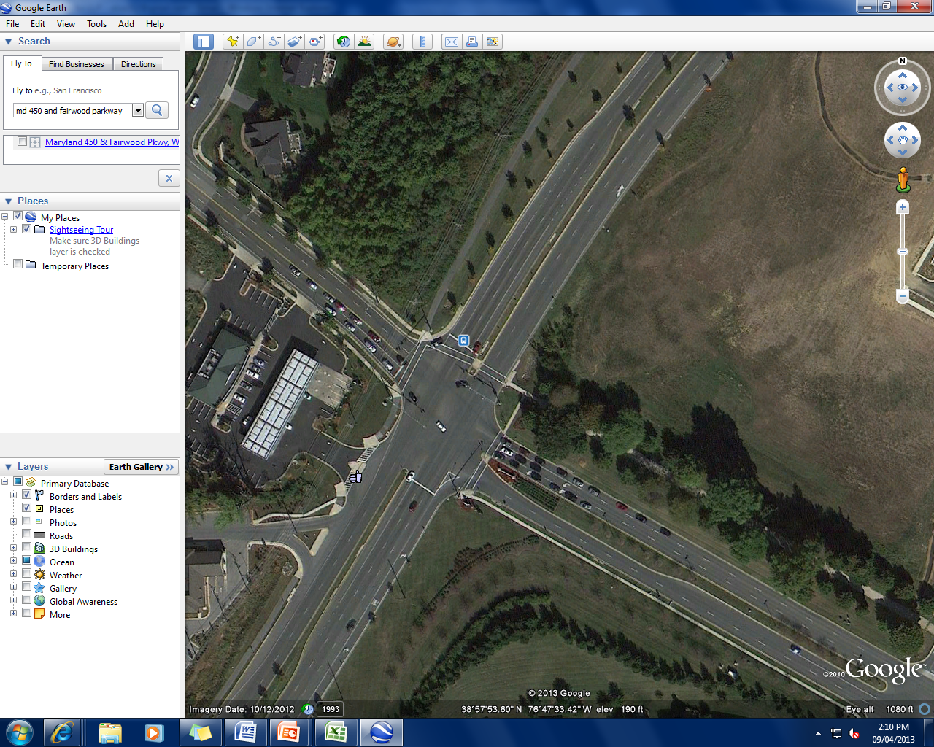
Data analysis and proposed LUF
Type 2: 3 through – 2
Example:
MD 450 @ Fairwood Parkway
Right most lane merge to center lane after 900 ft from the intersection
Notes:
This is the second type of lane drop, here is an example.

Slide 21
Data analysis and proposed LUF
Type 2: 3 through – 2
6 Locations
Annapolis Rd (MD 450) & Fairwood Pkwy @ Prince George
Baltimore Ave (US 1) & South Dr @ Prince George
Campus Way S (MD 977H) & Largo Rd (MD 202) @ Prince George
Campus Way S & Central Ave (MD 214) @ Prince George
Iverson St (MD 458)& Branch Ave (MD 5) @ Prince George
Adelphi Rd & University Blvd (MD 193) @ Prince George
Notes:
Data from 6 locations is collected

Slide 22
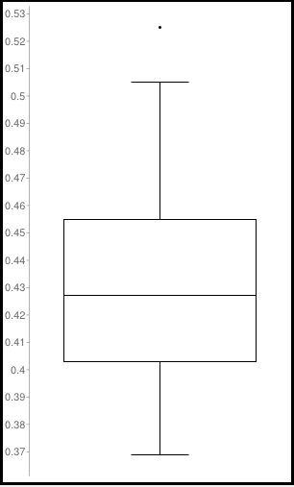
Data analysis and proposed LUF
Type 2: 3 through – 2
1. Boxplot
Most LUFs are located between 0.4 and o.45
Sample size | 71
Median | 0.427
Minimum | 0.369
Maximum | 0.525
First quartile | 0.403
Third quartile | 0.455
Outliers(1) | 0.525
Notes:
The boxplot is used, and we can find that most LUFs are located between 0.4 and 0.45, and one outlier is found.

Slide 23
Data analysis and proposed LUF
Type 2: 3 through – 2
2. Compared with normal LUF
Descriptive statistics
Test the difference:
H0: The mean of LUF from field survey is the same as normal LUF for three lanes (0.4);
H1: The mean of LUF from field survey is not the same as normal LUF for three lanes (0.4);
Result:
T-test: 8.097
P value<0.0001
Reject H0
Conclusion:
The difference is statistically significant
Normal LUF is not suitable for this type of lane drop intersection
Descriptive statistics | LUF from field survey
Mean | 0.430
Standard Error | 0.004
Median | 0.427
Standard Deviation | 0.031
Sample Variance | 0.001
Range | 0.136
Minimum | 0.369
Maximum | 0.505
Count | 70
Confidence Level(95.0%) | 0.008
Notes:
After discarding the outlier, the remain data is used to test the difference between normal LUF and LUF of lane drop. The difference is significant based on the t-test result.

Slide 24
Data analysis and proposed LUF
Type 2: 3 through – 2
3. Test the model from NC University
$$LUF=\frac{1}{3∗(0.4033+0.2814ShortK+0.0576∗Avg_{InvloK})}$$
Where $ShortK:\text{Short} \text{lane} \text{length}\text{ (}\text{ft}\text{) }÷\text{1000}$;
$Avg_{InvolK}$: Average lane volume (vphpl) $÷$1000
Test the difference:
H0: The means of two data groups are the same;
H1: The means of two data groups are not the same;
Result:
T-test: 7.576
P value<0.0001
Reject H0
Conclusion:
The difference is statistically significant
The model is not suitable for the LUF from field survey
Descriptive statistics | Lane use factor from field survey | Lane use factor from the model
Mean | 0.430 | 0.471
Standard Error | 0.004 | 0.004
Median | 0.427 | 0.470
Standard Deviation | 0.031 | 0.033
Sample Variance | 0.001 | 0.001
Range | 0.136 | 0.118
Minimum | 0.369 | 0.402
Maximum | 0.505 | 0.520
Count | 70 | 70
Confidence Level(95.0%) | 0.008 | 0.008
Notes:
Then the model is validated, the t-test result also shows the model is not suitable for field data from Maryland.

Slide 25
Data analysis and proposed LUF
Type 2: 3 through – 2
4. Scatter plot
(LUF vs. total volume):
Most LUFs are between 0.4 and 0.5;
no obvious trend observed.
Current LUF: 0.4
Normal intersection
Notes:
The scatter plot for LUF and total volume shows no obvious trend.

Slide 26
Data analysis and proposed LUF
Type 2: 3 through – 2
4. Scatter plot
(LUF vs. length of lane drop):
Current LUF: 0.4
Normal intersection
No obvious trend observed.
Notes:
Also for the scatter plot for LUF and length of lane drop.

Slide 27
Data analysis and proposed LUF
Type 2: 3 through – 2
Since the data in the scatter plots does not depend on factors (volume and distance to neighboring intersection), the data is not further categorized
6. Conclusion
Suggested lane use factor for two lanes with one lane drop:
Suggested lane use factor | 0.43
Normal lane use factor for three lanes | 0.4
Notes:
So because the data in the scatter plots does not depend on factors (volume and distance to neighboring intersection), the data is not further categorized. The suggested LUF is 0.43.

Slide 28
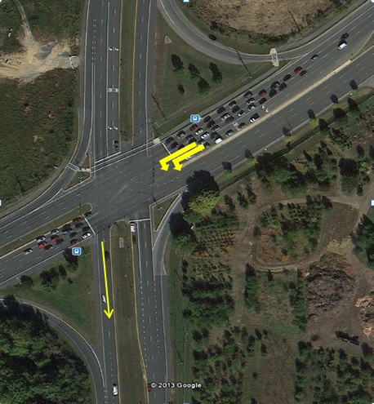
Data analysis and proposed LUF
Type 3: 2 left– 1
Example:
Enterprise Road @ Annapolis Road
Right lane merge to left lane after 640 feet from intersection
Notes:
The third type is double left turns with one lane drop, and this is the example.

Slide 29
Data analysis and proposed LUF
Type 3: 2 left– 1
8 Locations
Paint Branch Dr & University Blvd (MD 193) @ Prince George
Baltimore Ave (US 1) & Contee Rd @ Prince George
Norback Rd (MD 28) & Georgia Ave (MD 97) @ Montgomery
Enterprise Rd (MD 193) & Annapolis Rd (MD 450) @ Prince George
Bel Air Rd (US 1) & Mountain Rd (MD 152) @ Harford
Greenbelt Rd (MD 193) & Lanham Severn Rd (MD 564) @ Prince George
North bound and south bound
Watkins Park Dr (MD 193) & Central Ave (MD 214)
Notes:
Data from 8 locations is collected

Slide 30
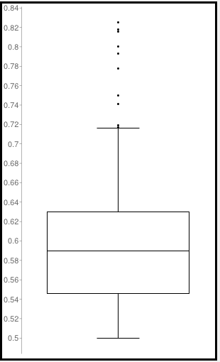
Data analysis and proposed LUF
Type 3: 2 left– 1
1. Boxplot
Outliers happen when the volume is low (less than 200 vph), the LUF becomes fluctuated when the volume is low.
Sample size | 148
Median | 0.590
Minimum | 0.500
Maximum | 0.825
First quartile | 0.546
Third quartile | 0.630
Outliers (10) | 0.825 0.818 0.816 0.800 0.793 0.778 0.750 0.741 0.719 0.717
Notes:
The boxplot shows that there are 10 outliers, after checking the data, these 10 outliers mainly come from the same location, in which there is low left turn volume during the collection period.

Slide 31
Data analysis and proposed LUF
Type 3: 2 left– 1
2. Compared with normal LUF
Descriptive statistics
Test the difference:
H0: The mean of LUF from field survey is the same as normal LUF for double left turns(0.6);
H1: The mean of LUF from field survey is not the same as normal LUF for double left turns(0.6);
Result:
T-test: 3.163
P value=0.0017<0.05
Reject H0
Conclusion:
The difference is statistically significant
Normal LUF is not suitable for this type of lane drop intersection
Descriptive statistics | LUF from field survey
Mean | 0.586
Standard Error | 0.004
Median | 0.585
Standard Deviation | 0.052
Sample Variance | 0.003
Range | 0.234
Minimum | 0.500
Maximum | 0.716
Count | 138
Confidence Level(95.0%) | 0.009
Notes:
So we discard the outliers, and compare the remain LUFs to normal LUF. From the test, we can find the normal LUF is not suitable for this type of lane drop intersection

Slide 32
Data analysis and proposed LUF
Type 3: 2 left– 1
3. Test the model from NC University
$$LUF=\frac{1}{2∗(0.6161+0.8636∗Avg_{InvloK})}$$
Where $Avg_{InvolK}$: Average lane volume (vphpl) $÷$1000;
Test the difference:
H0: The means of two data groups are the same;
H1: The means of two data groups are not the same;
Result:
T-test: 22.273
P value<0.0001
Reject H0
Conclusion:
The difference is statistically significant
The model is not suitable for the LUF from field survey
Descriptive statistics | Lane use factor from field survey | Lane use factor from the model
Mean | 0.586 | 0.707
Standard Error | 0.004 | 0.003
Median | 0.585 | 0.714
Standard Deviation | 0.052 | 0.037
Sample Variance | 0.003 | 0.001
Range | 0.234 | 0.169
Minimum | 0.482 | 0.607
Maximum | 0.716 | 0.777
Count | 138 | 138
Confidence Level(95.0%) | 0.009 | 0.006
Notes:
For the model from NC univ, the predicted LUFs are obviously higher than the field-data, and the test result shows the model is also not suitable to be used.

Slide 33
Data analysis and proposed LUF
Type 3: 2 left– 1
4. Scatter plot
(LUF vs. total volume):
Total volume increases, the LUF decreases. Data points are settled around 0.6
Current LUF: 0.6
Normal intersection
Notes:
Next step is to check the scatter plot, from this figure, we can find that when total volume increases, the LUF decreases. Data points are settled around 0.6.

Slide 34
Data analysis and proposed LUF
Type 3: 2 left– 1
4. Scatter plot
(LUF vs. length of lane drop):
Current LUF: 0.6
Normal intersection
No obvious trend observed.
Notes:
And from this figure, we see no obvious trend between LUF and length of lane drop.

Slide 35
Data analysis and proposed LUF
Type 3: 2 left– 1
5. Divide the data according to different volume range
Most LUF<0.60, when volume>300;
Ranges: less than 300vph; more than 300vph.
Mean: 0.59
Mean: 0.56
Notes:
Then based on the scatterplot for LUF and total volume, we can find that when volume is higher than 300vph, most LUF is less than 0.6, and when the volume is less than 300, the mean of the LUFs seems to be about 0.6. So the data is divided into two ranges.

Slide 36
Data analysis and proposed LUF
Type 3: 2 left– 1
5. Divide the data according to different volume range
Compare LUFs between ranges
Test the difference:
H0: The means of two volume ranges are the same;
H1: The means of two volume ranges are not the same;
Result:
T-test: 23.1
P value<0.0001
Reject H0
Conclusion:
The difference is statistically significant
Based on approach volume, two LUFs are suggested
Descriptive statistics | Total volume: 0-600vph | Total volume: over 600vph
Mean | 0.591 | 0.564
Standard Error | 0.005 | 0.006
Median | 0.591 | 0.564
Standard Deviation | 0.055 | 0.030
Sample Variance | 0.003 | 0.001
Range | 0.234 | 0.108
Minimum | 0.500 | 0.513
Maximum | 0.716 | 0.621
Count | 113 | 25
Confidence Level(95.0%) | 0.010 | 0.012
Confident interval for mean | (0.581,0.601) | (0.552,0.576)
Notes:
Then the LUFs in two volume ranges are compared. The difference is significant from the t-test result. So Based on approach volume, two LUFs are suggested.

Slide 37
Data analysis and proposed LUF
Type 3: 2 left– 1
5. Divide the data according to different volume range.
Since the LUF when volume is less than 300 vph is close to normal LUF, compare their difference.
Test the difference:
H0: The mean of LUF when volume is less than 300 vph is the same as normal LUF for double left turns(0.6);
H1: The mean of LUF when volume is less than 300 vph is not the same as normal LUF for double left turns(0.6);
Result:
T-test: 1.74
P value=0.083>0.05
Not reject H0
Conclusion:
The difference is not statistically significant
Normal LUF is suitable for this type of lane drop intersection when volume is less than 300 vph.
Descriptive statistics | LUF when volume < 300 vph
Mean | 0.591
Standard Error | 0.005
Median | 0.591
Standard Deviation | 0.055
Sample Variance | 0.003
Range | 0.234
Minimum | 0.500
Maximum | 0.716
Count | 113
Confidence Level(95.0%) | 0.010
Notes:
So we discard the outliers, and compare the remain LUFs to normal LUF. From the test, we can find the normal LUF is not suitable for this type of lane drop intersection

Slide 38
Data analysis and proposed LUF
Type 3: 2 left– 1
6. Conclusion
Suggested lane use factor for two lanes with one lane drop:
Different from other situations, the LUF is less than normal LUF.
Total volume | Less than 300 vph | More than 300 vph
Lane use factor | 0.60 | 0.56
Normal lane use factor for two lanes | 0.60
Notes:
When the volume is less than 300vph, the suggested lane use factor is 0.59, when the volume is higher than 300vph, suggested LUF is 0.56.
From the suggested LUF values, we can find the LUF of lane drop is less than normal LUF, which is different from other situations. Why is that?

Slide 39
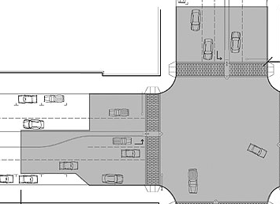
Data analysis and proposed LUF
Type 3: 2 left– 1
Possible reasons:
Double left turns at normal intersection
Outer lane volume is higher;
Double left turns with lane drop
Inner lane volume is higher (this pattern is observed while collecting data);
Traffic usually prefers outer lane rather than inner lane because of more space and less stress.
Traffic shift from from outer lane to inner lane because of the lane drop, but the lane use factor goes down
Lane drop
40% Traffic
58% Traffic
60% Traffic
42% Traffic
Notes:
The possible reason is that for Double left turns at normal intersection, Traffic usually prefers outer lane rather than inner lane because of more space and less stress. The figure is an example. And for Double left turns with lane drop, Inner lane volume is higher (this pattern is observed while collecting data); Traffic shift from from outer lane to inner lane because of the lane drop, but the lane use factor goes down. So it’s reasonable to get a lower LUF when there is a lane drop after the intersection.

Slide 40
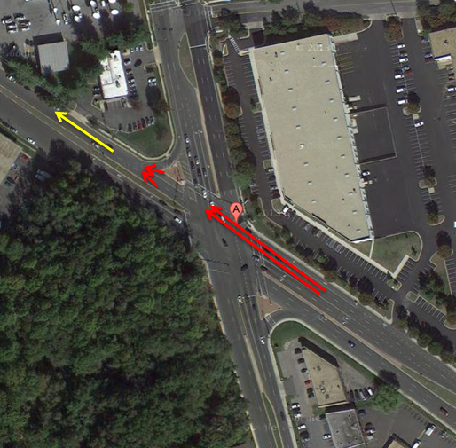
Data analysis and proposed LUF
Type 4: 2 through form a single lane
Example:
MD 650 @ MD 410
Form a single lane after 200 feet from the intersection
Notes:
The fourth type is 2 through lanes form a single lane. This is an example.

Slide 41
Data analysis and proposed LUF
Type 4: 2 through form a single lane
3 Locations
Ritchie Rd at Walker Mill Rd @ Prince George
Ethan Allen Ave (MD 410) & New Hampshire Ave (MD 650) @ Prince George
Spencerville Rd(MD 28) & Norbeck Rd (MD 650) @ Montgomery
Notes:
Data from 3 locations is collected.

Slide 42
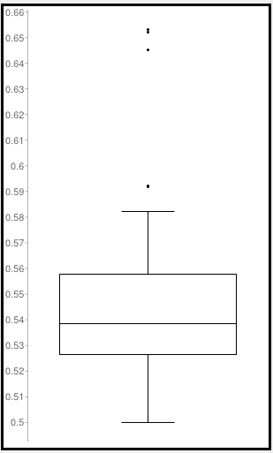
Data analysis and proposed LUF
Type 4: 2 through form a single lane
1. Boxplot
Most LUFs are located between 0.53 and o.56
Sample size | 45
Median | 0.538
Minimum | 0.500
Maximum | 0.653
First quartile | 0.526
Third quartile | 0.558
Outliers (5) | 0.653 0.652 0.645 0.592 0.592
Notes:
From the boxplot, 5 outliers are found, and Most LUFs are located between 0.53 and o.56, the range of the data is small compared to other situations.

Slide 43
Data analysis and proposed LUF
Type 4: 2 through form a single lane
2. Compared with normal LUF
Descriptive statistics
Test the difference:
H0: The mean of LUF from field survey is the same as normal LUF for two lanes(0.55);
H1: The mean of LUF from field survey is not the same as normal LUF for two lanes (0.55);
Result:
T-test: 1.925
P value=0.058>0.05
Not reject H0
Conclusion:
The difference is not statistically significant
Descriptive statistics | LUF from field survey
Mean | 0.543
Standard Error | 0.003
Median | 0.537
Standard Deviation | 0.023
Sample Variance | 0.0004
Range | 0.082
Minimum | 0.500
Maximum | 0.582
Count | 40
Confidence Level(95.0%) | 0.01
Notes:
When compare the field LUF with normal LUF, we find that the difference is not significant, which shows that the mean of the field LUF can be regarded as normal LUF, which is 0.55.

Slide 44
Data analysis and proposed LUF
Type 4: 2 through form a single lane
3. Scatter plot
(LUF vs. total volume):
The LUF does not change over different volume level (0.55)
Current LUF: 0.55
Normal intersection
Notes:
From the scatter plot, we can find data points does change over different volume level, they are stably distributed.

Slide 45
Data analysis and proposed LUF
Type 4: 2 through form a single lane
4. Conclusion
LUFs from field survey are stable;
The mean of the LUF from field survey is not statistically different from the normal LUF.
No changes on LUF for two lanes form a single lane:
Suggested lane use factor | 0.55
Normal lane use factor for three lanes | 0.55
Notes:
So based on the finding above, there is no changes on LUF for two lanes form a single lane. It’s still 0.55

Slide 46
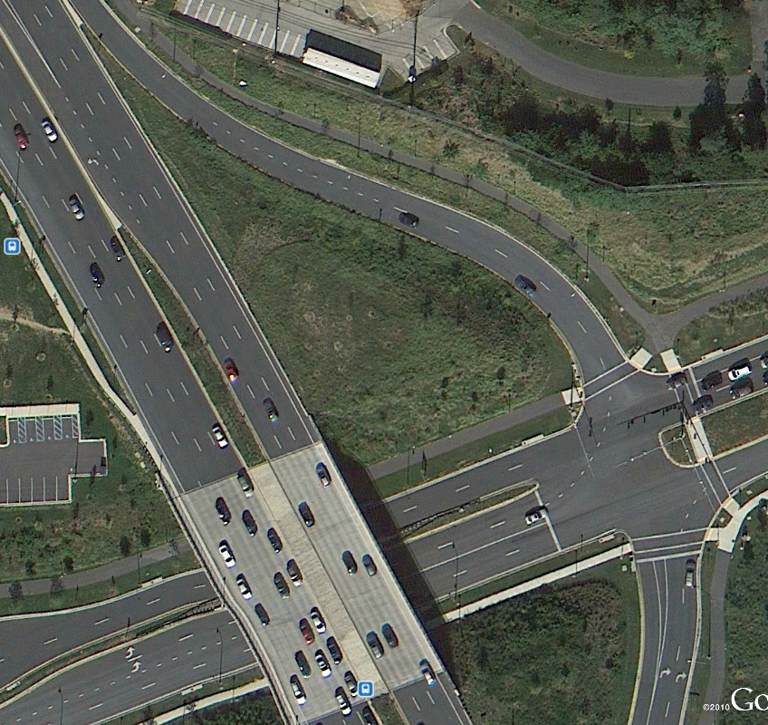
Data analysis and proposed LUF
Type 5: 2 left form a single lane
Example:
Montrose Parkway @ MD 355
Alternate merging after 350 feet from the intersection
Notes:
The last type is double left turns with one lane drop. This is the example

Slide 47
Data analysis and proposed LUF
Type 5: 2 left form a single lane
2 Locations
Martin Luther King Jr Hwy (MD 704) & John Hanson Hwy (US 50) @ Prince George
Rockville Pike (MD 355) & Montrose Pkwy @ Montgomery
Notes:
Data of 2 locations is collected

Slide 48
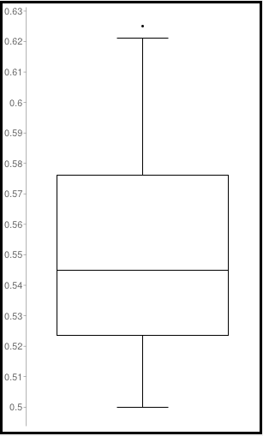
Data analysis and proposed LUF
Type 5: 2 left form a single lane
1. Boxplot
Most LUFs are located between 0.52 and o.58
Sample size | 44
Median | 0.545
Minimum | 0.500
Maximum | 0.625
First quartile | 0.524
Third quartile | 0.576
Outliers (5) | 0.625
Notes:
The boxplot shows Most LUFs are located between 0.52 and o.58

Slide 49
Data analysis and proposed LUF
Type 5: 2 left form a single lane
2. Compared with normal LUF
Descriptive statistics
Test the difference:
H0: The mean of LUF from field survey is the same as normal LUF for two lanes(0.60);
H1: The mean of LUF from field survey is not the same as normal LUF for two lanes (0.60);
Result:
T-test: 10.451
P value<0.0001
Reject H0
Conclusion:
The difference is statistically significant
Normal LUF is not suitable for this type of lane drop intersection
Descriptive statistics | LUF from field survey
Mean | 0.549
Standard Error | 0.0049
Median | 0.543
Standard Deviation | 0.032
Sample Variance | 0.001
Range | 0.121
Minimum | 0.500
Maximum | 0.621
Count | 43
Confidence Level(95.0%) | 0.010
Notes:
Then the t test is used to compare the filed LUF and normal LUF, the result shows significance of the difference. And we cannot use normal LUF in this type of lane drop

Slide 50
Data analysis and proposed LUF
Type 5: 2 left form a single lane
3. Scatter plot
(LUF vs. total volume):
LUFs are scattered between 0.5 and 0.6.
No obvious trend is observed.
Current LUF: 0.6
Normal intersection
Notes:
Then from the scatter plot, LUFs LUFs are scattered between 0.5 and 0.6. No obvious trend is observed. The distribution seems stable.

Slide 51
Data analysis and proposed LUF
Type 5: 2 left form a single lane
4. Conclusion
LUFs from field survey are stable;
The mean of the LUF from field survey is statistically different from the normal LUF.
Suggested lane use factor for two lanes form single lane:
Suggested lane use factor | 0.55
Normal lane use factor for three lanes | 0.6
Notes:
So the suggested LUF is the mean of the field LUF, which is 0.55.

Slide 52
Summary
Suggested lane use factor values with lane drop conditions:
Types | Minimum | Maximum | Suggested LUF value |  | Current LUF value
3 through →2 | 0.37 | 0.51 | 0.43 |  | 0.40
2 through → 1 (exclusive) | 0.50 | 0.73 | Total volume Less than 600 vph | 0.62 | 0.55
 | 0.54 | 0.64 | Total volume More than 600 vph | 0.59
2 left →1 | 0.50 | 0.72 | Total volume Less than 300 vph | 0.60 | 0.60
 | 0.51 | 0.62 | Total volume More than 300 vph | 0.56
2 through “form a single lane” | 0.50 | 0.58 | 0.55 |  | 0.55
2 left “form a single lane” | 0.50 | 0.62 | 0.55 |  | 0.60
Notes:
At last, the summary of 5 types’ LUF are provided here. We can see the minimum, maximum LUF from the field data, and the suggested LUF and current normal LUF are listed.

Slide 53
Thank you very much!

