Slide 1

Development of a Traffic Incident Management System for
Contending with Non-recurrent Highway Congestion
Woon Kim, Directed by Dr. Gang-Len Chang
March 11, 2014
Dept. of Civil and Environmental Engineering
University of Maryland, College Park
Notes:
Today, I am going to present my dissertation work, which is a development of a Traffic Incident Management System for
Contending with Non-recurrent Highway Congestion.

Slide 2
Overview
Introduction
Component 1: Incident response management strategies
Component 2: Prediction models for clearance times
Component 3: A detour decision support system
Contributions, future research, and conclusions
Notes:
This presentation consists of introduction and some details for three main models.

Slide 3
Research Background
Introduction
Non-recurrent traffic congestion due to incidents has contributed up to 60 percent of the total freeway corridor delay in the United States (Lindley, 1987).
About 25 percent of congestion in the U.S. is incident-related (FHWA, 2005).
The starting time and duration of non-recurrent congestion, due mainly to incidents, are random in nature.
Thus, it is critical to have an efficient and effective incident management system.
Notes:
Many studies have been conducted for the traffic incident and the resulting impacts. One of studies showed that about 25 percent of congestion in the U.S. is incident-related. The problem is that the cause of the non-recurrent congestion, that is an incident, is random in occurrence and duration. Thus, it is very difficult to predict when and where it will occur in advance. So, the best way to minimize the incident-induced impact is its fast detection, prompt response, and clearance once it occurs. For this sake, the efficient, and effective incident management system is critical.

Slide 4
Key Tasks in an Incident Management System
Introduction
An optimal deployment strategy for response units
Estimation of required clearance times for reported incidents
Detour feasibility analysis
Detour optimization analysis
Provide travel time information to roadway users
  queue, delay and travel time analysis
Notes:
The proposed incident management system includes these five key tasks. Among them, this study has been focuses on these three subjects.

Slide 5
Incident Management System
Introduction
Incident Detection
Dispatching
ERU
Collecting/Updating
Incident & Traffic
related Data
1. Incident Response Management Strategies
2. Prediction Models for Clearance Times
Predicting Incident
Duration
Estimating
Clearance
Time
3. A Detour Decision Support System
Evaluating
Traffic & Incident Impact
to the Network
Detour
Optimization
Detour?
Implementing
Optimal Detour Plans
YES
Establishing Feasible Detour Plans
Detour feasibility analysis system
NO
Output
Analyzing the Necessity of Detour Operations
Inform to Highway Users
Notes:
Then, let’s see how those tasks support the proposed system. Once an incident is detected, an emergency response unit will be dispatched based on the optimal deployment strategies (v). Arrived response crews start clearing the incident and report related information to the control center. Based on those data and the developed model (v), the clearance duration of the detected incident will be predicted. The predicted clearance time along with other relevant information will be input into the detour feasibility analysis system to assess the necessity of a detour operation based on the developed detour decision support system (v). If it produces a positive decision, then the optimized detour plan will be implemented and the relevant outputs such as estimated delay, max queue, and travel time will be provided to users.

Slide 6
Needs for Each Component
Introduction
1. Incident Response Management Strategies
  To maximize contributions of incident response units with limited resources by assigning them to optimal locations.
2. Prediction Models for Clearance Times
  To contend with stochastic nature of clearance times so as to maximize the system’s operational reliability.
3. A Detour Decision Support System
  To facilitate responsible agencies to perform efficient traffic management in real time operations.
Notes:
Why do we need those components in such a system?
The first component is needed because the available resources are so limited compared with demands.
Second, a prediction model for CT can reduce the stochastic nature of CT so as to max the operational reliability of the system.
Third, a decision support system for detour operations can facilitate responsible agencies to make more reliable decisions for real-time operations.

Slide 7
Research Objectives
Introduction
1. Incident Response Management Strategies
  Develop a deployment strategy for incident response units to minimize the total incident-induced delay
2. Prediction Models for Clearance Times
  Develop a reliable model to estimate the clearance duration of a detected incident, and to identify critical contributing factors as well as their interrelationships
3. A Detour Decision Support System
  Develop a detour decision support model for control center staff to determine the necessity of detouring traffic
Notes:
Therefore, each component has the following objectives.
The first component aims to develop an optimal deployment strategy for response units to min the total delay induced by incidents, while the second component intends to develop a reliable model to predict clearance times.
The third one pursues to develop a technical tool to determine the necessity of detouring.

Slide 8
1. Incident Response Management Strategies
Notes:
Then let’s go over some details for the first component.

Slide 9
Literature Review
1. Incident Response Management Strategies
Facility location problem
  how many response units are needed?
  where should they be allocated in response to the temporal and spatial distribution of incidents?
    Covering models (Toregas et al., 1971; Schilling et al., 1979; Hogan and ReVelle, 1986; Nair and Miller-Hooks, 2009)
    P-median models; and (Hakimi, 1964; Carson and Batta, 1990; Haghani et al., 2003; Yang et al., 2005)
    P-center models (Sylvester, 1857; Garfinkel et al., 1977; ReVelle and Hogan, 1989; Talwar, 2002)
Minimize the number of service stations, the total operational costs, or to maximize the demand (incidents) covered by the pre-determined number of facilities
Notes:
Traditionally, this subject has been known as “facility location problem” to solve how many facilities are needed and where they should be located under the given constrains. The literature related to allocating response units usually focused on determining optimal stations for available units to minimize average response times or operational costs, based on the fact that prompt incident responses contribute to reducing response times. However, this study has been approached from a different perspective to solve the problem.

Slide 10
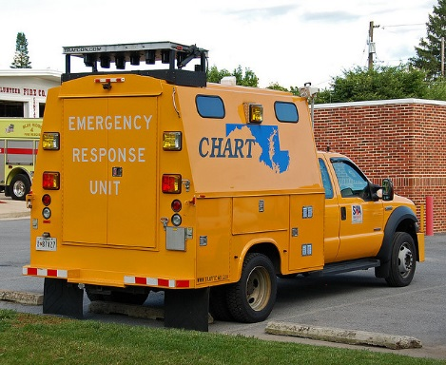
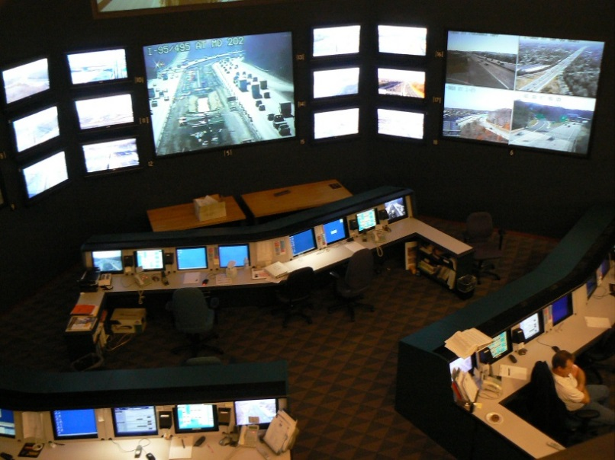
Data Sources
1. Incident Response Management Strategies
Incident management program operated by Maryland state highway administration (MDSHA)
  Coordinated Highways Action Response Team (CHART)
    Has documented incident-related information over the past two decades
    Date/time, location, nature, involved vehicles, lane closure…
Notes:
Using incident data documented by CHART, I was able to find the effectiveness of a well-operated incident management program.

Slide 11
Effectiveness of CHART
1. Incident Response Management Strategies
CHART responded approximately 81 % (22,796/28,345) of incidents during last two years
Does the CHART involvement matter?
 | w/o CHART | w/ CHART
Mean on CT (mins) | 37.91 | 27.51
CHART reduced the avg. clearance time by 27 %
Does the prompt CHART response matter?
First responder | Others | CHART
Mean on CT (mins) | 39.49 | 21.85
CHART reduced the avg. clearance time by 45 %
Notes:
Based on the data CHART contributed to reducing the avg. clearance time by 27%. When CHART was a primary responder, the avg. clearance time was further reduced by 45%.

Slide 12
Needs for Research
1. Incident Response Management Strategies
The efficient response of CHART can contribute to the reduction in not only the response time but also the clearance time → reduction in delay
However, not all incidents can be promptly responded by CHART due to their limited resources
Therefore, it is critical to develop a strategy to optimally deploy available response units so as to maximize their contributions
Notes:
From this result we can know that CHART can contribute to the reduction in both response time and the clearance time. However, not all incidents can be promptly responded by CHART due to their limited resources.
Thus, it is critical to develop a strategy to optimally deploy available response units so as to maximize their contributions

Slide 13
Model Construction
1. Incident Response Management Strategies
Inputs
  Incident distribution, incident duration, lane blockage information, traffic volume, capacity, and available resources
Objective function
  Minimize the total delay induced by incidents
Constraints
  Every freeway segment must be served by one unit
  Response units can only be dispatched from location i if they are stationed there
  The total number of response units is limited by available resources
Outputs
  Assigned station and coverage for each unit
Notes:
To deal with this problem, I developed an integer program. The objective function is to minimize the total delay caused by incidents under three constraints. The outputs of this model are assigned station and service coverage for each unit.

Slide 14
Relations between Incident Duration and Total Delay
1. Incident Response Management Strategies
Cumulative
Arrivals and
Departures
Arrival rate, q
f (T_{i} , rc, c, q)
Departure rate, rc₂ (Reduced capacity 2)
Departure rate, c
B
Departure rate, rc₁
(Reduced capacity 1)
A
onset
response
cleared
recovered
Time
early
cleared
early recovered
A
Reduced delay due to additional lanes open
B
Reduced delay due to reduced clearance duration
Notes:
To formulate the objective function, I used the relation between an incident duration and the corresponding total delay. This triangular shape represents the incident-induced delay based on the given incident duration from here to here. By effective incident responses, the delay can be reduced by area A and B (v). Since only data for estimating area A are available in this study (v), this study used this area (v) as the incident-induced delay and formulated it using incident duration, reduced capacity, capacity, and traffic volume.

Slide 15

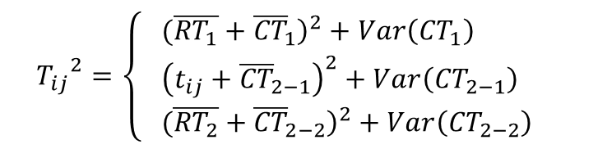
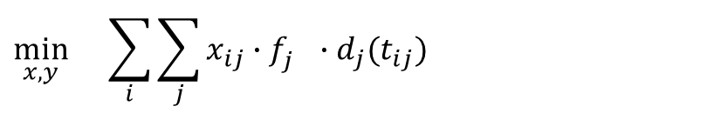

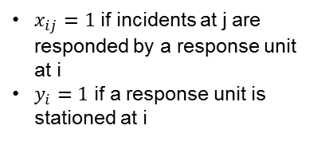
Model Formulation
1. Incident Response Management Strategies
Objective Function: Min total delay for responded incidents
$x_{ij}=1$ if incidents at j are responded by a response unit at i
$y_{i}=1$ if a response unit is stationed at i
$$\min_{x,y}{}\sum_{i}{\sum_{j}{x_{ij}∙f_{j}^{}∙d_{j}(t_{ij})}}$$
$G\left(N,A\right)$:a network of freeways, where N and A are the sets of nodes and links
$i, j$: index for nodes i, j $∈N$
${f_{j}}^{}$: probability that an incident occurs at node j
$t_{ij}$: travel time from i to j
$d_{j}$: delay from incidents occurring at node j according to $t_{ij}$
$T_{ij}$: response time + estimated clearance time according to $t_{ij}$
$q_{j}$: traffic volume at j
$c_{j}$: capacity at j
${rc}_{j}$: reduced capacity at j
Total Delay
1. Delay from incidents occurring at node j (Olmstead, 1996)
$d_{j}\left(t_{ij}\right)=\frac{1}{2} {T_{ij}}^{2}\left(q_{j}−{rc}_{j}^{}\right)\left(\frac{c_{j}−{rc}_{j}^{}}{c_{j}^{}−q_{j}}\right)$
T_{ij} : Response Time + Clearance time
Stochastic nature
2. Response time and clearance time (Olmstead, 1996)
$${T_{ij}}^{2}=\left\{\begin{aligned}& {\left. (\overline{{RT}_{1}}+{\overline{CT}}_{1}\right)}^{2}+Var\left({CT}_{1}\right) \\ & {\left(t_{ij}+{\overline{CT}}_{2−1}\right)}^{2}+Var\left({CT}_{2−1}\right) \\ &{\left. (\overline{{RT}_{2}}+{\overline{CT}}_{2−2}\right)}^{2}+Var\left({CT}_{2−2}\right) \end{aligned}\right.$$
CHART is not involved
CHART is involved and first responder
CHART is involved but not the first responder
Notes:
Objective function was formulated to minimize total delay for responded incident. Here, xij is one of decision variables indicating if an incident at node j is responded by a response unit at i or not. Fj repsetns probability that an incident occurs at node j.
Dj represents delay induced by incidents, and this can be expressed like this using incident duration, traffic volume, reduced capacity, and capacity as I mentioned earlier.
Incident durations were estimated from historical data. To reflect the stochastic nature of clearance time, mean and variance were used.

Slide 16


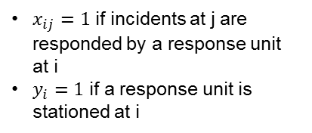




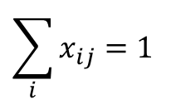



Model Formulation (cont’d)
1. Incident Response Management Strategies
Constraints:
1. Every freeway segment must be served
$x_{ij}=1$ if incidents at j are responded by a response unit at i
$y_{i}=1$ if a response unit is stationed at i
$$\sum_{i}{x_{ij}}=1$$
$$∀ i∈N$$
$G\left(N,A\right)$:a network of freeways, where N and A are the sets of nodes and links
$i, j$: index for nodes i, j $∈N$
R : available resources
2. Response units can only be dispatched from location i if they are stationed there (y_{i} = 1)
$$x_{ij}≤ y_{i}$$
$$∀ j∈N$$
3. The total number of available response units is limited by available resources (R)
$$\sum_{i}{y_{i}}≤R$$
$$x_{ij}^{}=\left[0,1\right]$$
$$∀ (i,j)∈N$$
$$y_{i}=\left[0,1\right]$$
$$∀ i∈N$$
Notes:
There constraints can be formulated like these.

Slide 17
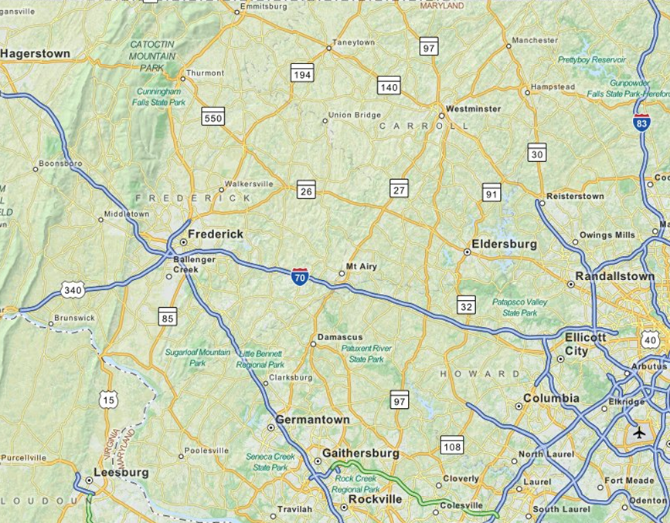
Empirical Study
1. Incident Response Management Strategies
Segments of I-70, I-270 and US 15 in MD
Site Characteristics
63 miles
Radial shape of roads
Frederick, Howard, and Carroll
Counties
Highway Incident Management
TOC-7
3 units
Operation Hours:
5AM – 9PM on weekday
  Study Period: AM peak
  (7AM – 9:30 AM on weekday)
US15
I-70
I-270
Notes:
The developed model was applied to District 7 in MD for evaluation.
This figure shows the network. It covers three counties.
Currently three CHART units are operated during AM peak period.

Slide 18
Incident Frequency Distribution
1. Incident Response Management Strategies
Incident frequencies fluctuate over the network !
I-70
I-270
US 15
Notes:
This figure shows that incident frequencies fluctuate over the network, which indicates the need of the optimal use of the limited resources.

Slide 19
Model output Analysis
1. Incident Response Management Strategies
Assigned station and service coverage for each unit
Average travel time (minutes)
CHART current practice (7.79 mins)
Proposed model
Traditional model
Notes:
To evaluate the proposed model avg travel time and total delay from the proposed model have been compared with those from a traditional model and current CHART practice. Since the traditional model aims to minimize total response times, it showed smaller travel time by response units than the proposed model and the current CHART’s practice (v).

Slide 20
Model output analysis (cont’d)
1. Incident Response Management Strategies
Total delay (veh-hr)
CHART current practice (5,612,805 veh-hr)
Proposed model
Traditional model
Notes:
However, the proposed model showed better performance than the traditional model and the CHART’s practice (v) in terms of total delay. The estimated total delay from the proposed model is about one million veh-hr smaller than the CHART’s practice.
Almost 70,000 veh-hr → think about how much we can save from this number considering fuel consumptions and emissions.

Slide 21
Incident Management System
Incident Detection
Dispatching
ERU
Collecting/Updating
Incident & Traffic
related Data
1. Incident Response Management Strategies
2. Prediction Models for Clearance Times
Predicting Incident
Duration
Estimating
Clearance
Time
3. A Detour Decision Support System
Evaluating
Traffic & Incident Impact
to the Network
Detour
Optimization
Detour?
Implementing
Optimal Detour Plans
YES
Establishing Feasible Detour Plans
Detour feasibility analysis system
NO
Output
Analyzing the Necessity of Detour Operations
Inform to Highway Users
Notes:
Then, let’s move to the second component, a prediction model for clearance durations.

Slide 22
2. Prediction Models for
Clearance Times

Slide 23
A Model for Estimating Clearance Times
2. Prediction Models for Clearance Times
Key input for the incident management system
  Optimal deployment strategy analysis
  Detour feasibility analysis
  Detour optimization analysis
  Traveler information – queue, delay and travel time analysis
However, the required clearance time for a reported incident is very difficult to reliably predict in advance.
Why do we need such a model?
Notes:
The estimated clearance time is one of key inputs for other primary components embedded in an incident management system, analyzing such as detour feasibility, queue, delay, and travel time.
However, it is very difficult to reliably predict clearance times in advance, because … (next)

Slide 24
Challenge to Predict Clearance Times
2. Prediction Models for Clearance Times
Skewed shape and distributed in a wide range
  Difficult to fit with a continuous or discrete distribution
  Most statistical models cannot perform well
    They tend to focus on the major classes of the data
CT (mins) | Frequency | Ratio
<=30 | 3870 | 65%
30-60 | 1176 | 20%
60-90 | 397 | 7%
90-120 | 138 | 2%
>120 | 344 | 6%
total | 5925 | 100%
  However, most studies in the literature applied statistical approaches to develop a model
Notes:
the distribution of clearance times is highly right-skewed in a wide range. So it is difficult to fit in any continuous or discrete distribution. For this reason, most statistical models cannot perform well, but most previous studies on this subject used statistical approaches such as … (next)
summary(database$CLEARANSE_TIME_min)
Min. 1st Qu. Median Mean 3rd Qu. Max.
1.01 9.30 19.60 37.40 40.68 918.10

Slide 25
Literature Review
2. Prediction Models for Clearance Times
Probabilistic Distributions (Golob et al., 1987; Giuliano, 1989; Garib et al., 1997; Sullivan, 1997; Ozbay and Kachroo, 1999)
Conditional Probability Models (Nam and Mannering, 2000; Boyles et al., 2007)
Regression Models (Khattak et al., 1995; Giuliano, 1989; Garib et al., 1997; Ozbay and Kachroo, 1999)
Decision/Classification Tree Models (Ozbay and Kachroo, 1999; Smith et al. in 2001; Ozbay and Noyan in 2006)
Discrete Choice or Classification Models (Lin et al., 2004)
Time Sequential Models (Khattak et al., 1995; Wei and Lee, 2007)
Unconventional Models (Wang et al., 2005; Wu et al., 2011)
In the most literature
Using limited scale data
No validation for models
The proposed Model is
tackling heterogeneity in most incident data sets
enhancing prediction accuracies; and
assessing the prediction model’s robustness for different data sets
Notes:
Conditional probability models, regression models, discrete choice models, and so on.
In addition, most literature used limited scale data to develop a model and no validation has been conducted in most previous studies.
Therefore, this study aims to develop a reliable and robust model based on incident data collected during several years in the entire Maryland.

Slide 26
Flowchart to Develop the Proposed Model
2. Prediction Models for Clearance Times
Phase 1: Filter out outliers
Non-statistics-based approach
No assumption for distributions
Phase 2: Sequential Classifiers with Association Rules (SCAR)
An integrated system
for predicting incident clearance times
Phase 3: Develop Supplemental models
Focusing on intermediate CT and
incidents that cannot be categorized by SCAR
Notes:
The proposed model was developed in this sequence.
First, I filtered out some outliers, then used association rules technique to build a sequential classifier named as SCAR. This technique does not require any assumption for distributions. Then supplemental models were developed for a dataset that SCAR cannot handle.
The final product is an integrated system consisting of models from phases 2 and 3.

Slide 27
Phase 1 – Filter Out Outliers
2. Prediction Models for Clearance Times
PAM: Partitioning Around Medoids (Kaufman and Rousseeuw, 1990)
  Medoids: most centrally located elements
  Goal: detecting a group of clusters including a small number of elements
  36/6000 incidents are selected as outliers
Notes:
PAM is a method to split a dataset into a target number of clusters based on Medoid of each cluster. Here, Medoids are most centrally located elements. Using this method I was able to find a number of clusters including a small number of elements., and there were considered as outliers and excluded in this study.
Additionally, I excluded some data which show unreasonable or limited information.

Slide 28
Flowchart to Develop the Proposed Model
2. Prediction Models for Clearance Times
Short: ≤ 30 mins
Intermediate: 30-120 mins
Long: ≥ 120 mins
Phase 1: Filter out outliers
Phase 2: Sequential Classifiers with Association Rules (SCAR)
An integrated system
for predicting incident clearance times
Phase 3: Develop Supplemental models
Notes:
Then let’s move to the next Phase (v). In this phase, I developed a sequential classifier using association rules to classify incidents into three categories (v) – minor, intermediate, and major.

Slide 29


Association Rules (Agrawal et al., 1993)
2. Prediction Models for Clearance Times
Mining explicit relations between clearance time and associated factors in a format of rules.
  For example,
  Support of an itemset X (supp(X)): the proportion of data entries in the database which include the itemset X
  Confidence of a rule: conf(X→ Y) = supp(X $∪$ Y)/supp(X)
    {personal injury, rainy} → {intermediate CT}
    antecedent consequent
    LHS RHS
    X Y
    6 3
supp(X)=6
supp(X $∪$ Y) =3
conf(X→ Y) = 3/6 = 0.5
Notes:
This study used association rules technique to discover interesting relations between clearance times and associated factors in a format of rules. For example, incidents causing personal injury on rainy day can be classified as an intermediate incident which take about 30 to 120 minutes to clear it. Here this term is called “antecedent”, LHS, or X, while this term is called “consequent”, RHS, or Y. If 6 incidents have this characters and three of them show this consequent in the study data set, then we can say the support of LHS is 6, the support of this rule is 3 and the confidence of this rul is 3/6 equal to 0.5.

Slide 30
Procedure to Construct the SCAR System
2. Prediction Models for Clearance Times
Phase 1
Extract rules using an AR technique
Any significant rules?
NO
Phase 3
Phase 2
YES
Build a classifier
using the best set of ARs
Filter out classified cases based on the developed set of classifiers
Notes:
The extracted association rules are examined if they are significant with high confidence. The selected significant rules are used to build a classifier, and then exclude the classified data. Additional rules are mined using the remained data and repeat the procedure until no significant rules are found.

Slide 31

Illustration of the SCAR System
2. Prediction Models for Clearance Times
An Incident Is Detected
(TOC3 & Minor lane closure & no info. for pavement condition)
AR 1
or
(AOC & 12 lanes on both & on US-50)
AR 2
Classifier 1
or
(on weekday & disabled veh & CHART detected)
AR 3
Yes
No
Short
(≤ 30 mins)
(2 veh involved & fatality) or
(during daytime & minor road & fatality)
AR 1
Classifier 2
AR 2
Yes
No
Short
(≤ 30 mins)
Continued…
Notes:
This figure illustrates the developed SCAR system. For example, first three significant rules were found and combined them to form the first classifier. Since majority of data satisfying this classifier show short clearance time less than 30 minutes, I classified them as “short”. After excluding them using the remained data two significant rules are mined to form a second classifier. The clearance time was determined as short and this process is continued. Once an incident is detected, the collected incident information will be input to the system and assess if it satisfies any rule consisting of the first classifier. If yes, it will predict the clearance time of the incident as short, otherwise it is sent to the next classifier and continue searching for the matching rule.

Slide 32
Phase 2 - Model Results
2. Prediction Models for Clearance Times
44 Classifiers
Each consists of 2 or 3 ARs
About 72% of samples can be explained with SCAR
Accuracies for each category of clearance duration
Clearance Time | Class ratio | # of Classifiers | Accuracy
 |  |  | Train | Test
Short | 64.98% | 27 | 87.70% | 90.37%
Intermediate | 28.95% | 13 | 90.50% | 92.51%
Long | 6.07% | 4 | 75.86% | 79.66%
30 -120 mins
Notes:
The developed scar system includes 44 classifiers and performs well for predicting all categories of clearance times. But it can classify about 72% of the study data, since some incidents can be involved with unobservable factors or too complex interrelations of associated factors. Therefore, … (next)

Slide 33
Flowchart to Develop the Proposed Model
2. Prediction Models for Clearance Times
Phase 1: Filter out outliers
Phase 2: Sequential Classifiers with Association Rules (SCAR)
An integrated system
for predicting incident clearance times
Phase 3: Develop Supplemental models
  To predict CT for incidents that cannot be classified by SCAR
  To classify predicted intermediate CT into shorter intervals
Notes:
I developed a supplemental model for incidents that cannot be handled by SCAR. Do you remember that intermediate incidents classified by SCAR has a quite wide range from 30 to 120 minutes as predicted clearance times. To classify them into shorter intervals, I developed another supplemental model.

Slide 34
Phase 3 – Developing Supplemental Models
2. Prediction Models for Clearance Times
A model for data not classified by SCAR
  <= 30 minutes
  30 – 60 minutes
  60 – 90 minutes
  90 – 120 minutes
  > 120 minutes
A model to classify the predicted intermediate clearance times into smaller intervals
  Intermediate-sub1: 30 – 60 minutes
  Intermediate-sub2: 60 – 90 minutes
  Intermediate-sub3: 90 – 120 minutes
Support Vector Machine and Random Forests are applied
Notes:
The supplemental model for incidents that cannot be classified by SCAR can determine clearance times as one of these categories,
While the supplemental model for intermediate incidents can further determine clearance times as one of these categories which is a shorter range.
To develop these models, I applied two state of the art machine learning algorithms that are support vector machine and random forests.

Slide 35
Illustration of the Proposed System
2. Prediction Models for Clearance Times
Start: Input Incident Info.
SCAR
Can be classified by SCAR?
Yes
No
Yes
Is an intermediate incident?
No
Supplemental Model 1
Supplemental Model 2
30-60 mins
60-90 mins
90-120 mins
Output
Notes:
This figure shows how developed models are integrated to constitute the system for predicting incident clearance times. The incident information input by users are sent to SCAR first. If SCAR cannot categorize it, then supplemental model 1 is used to classify its clearance times. If SCAR classifies it as an intermediate incident, then supplemental model 2 is used to classify it into one of these categories. Otherwise the system predicts the clearance time of the incident as either less than 30 minutes or over 2 hours.

Slide 36
MOEs to Evaluate the System’s Performance
2. Prediction Models for Clearance Times
Contingency Table (c_{ij})
Clearance Duration (minutes) |  | Observation
 |  | ≤ 30 | 30 – 60 | 60 – 90 | 90 – 120 | > 120
Prediction | ≤ 30 | 1068 | 95 | 20 | 3 | 11
 | 30 – 60 | 130 | 146 | 50 | 16 | 23
 | 60 – 90 | 81 | 96 | 33 | 9 | 5
 | 90 – 120 | 13 | 37 | 23 | 9 | 5
 | > 120 | 8 | 12 | 9 | 8 | 60
Accuracy
Weights (w_{ij})
Clearance Duration (minutes) |  | Observation
 |  | ≤ 30 | 30 - 60 | 60 - 90 | 90 – 120 | > 120
Estimation/ Prediction | ≤ 30 | 1 | 0 | 0 | 0 | 0
 | 30 – 60 | 0.75 | 1 | 0 | 0 | 0
 | 60 – 90 | 0.5 | 0.75 | 1 | 0 | 0
 | 90 – 120 | 0.25 | 0.5 | 0.75 | 1 | 0
 | > 120 | 0 | 0.25 | 0.5 | 0.75 | 1
Notes:
To evaluate this system’s performance, I used two MOEs, accuracy and acceptability. Accuracy is defined as the ratio of correctly predicted cases to the total number of cases, so in this contingency table the diagonal cells (v) are used.

Slide 37
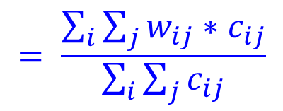
MOEs to Evaluate the System’s Performance
2. Prediction Models for Clearance Times
Contingency Table (c_{ij})
Clearance Duration (minutes) |  | Observation
 |  | ≤ 30 | 30 – 60 | 60 – 90 | 90 – 120 | > 120
Prediction | ≤ 30 | 1068 | 95 | 20 | 3 | 11
 | 30 – 60 | 130 | 146 | 50 | 16 | 23
 | 60 – 90 | 81 | 96 | 33 | 9 | 5
 | 90 – 120 | 13 | 37 | 23 | 9 | 5
 | > 120 | 8 | 12 | 9 | 8 | 60
Acceptability
Weights (w_{ij})
$$= \frac{\sum_{i}{\sum_{j}{w_{ij}∗c_{ij}}}}{\sum_{i}{\sum_{j}{c_{ij}}}}$$
Clearance Duration (minutes) |  | Observation
 |  | ≤ 30 | 30 - 60 | 60 - 90 | 90 – 120 | > 120
Estimation/ Prediction | ≤ 30 | 1 | 0 | 0 | 0 | 0
 | 30 – 60 | 0.75 | 1 | 0 | 0 | 0
 | 60 – 90 | 0.5 | 0.75 | 1 | 0 | 0
 | 90 – 120 | 0.25 | 0.5 | 0.75 | 1 | 0
 | > 120 | 0 | 0.25 | 0.5 | 0.75 | 1
w_{ij}: weights for cells (i, j)
c_{ij}: number of cases in a cell (i, j)
Notes:
On the other hand, acceptability includes the cases predicted longer than the observations, since these results are acceptable in an operational perspective. Thus, in this contingency table, the cells in the lower triangle (v) are used. To give some penalties to cases that are predicted far off from observations, different degree of partial credits are assigned as shown in this table (v) and acceptability is computed in this way.

Slide 38
Overall System Performance
2. Prediction Models for Clearance Times
Incident Categories | Clearance Duration (minutes) | Class ratio | Accuracy |  | Acceptability
 |  |  | Train | Test | Train | Test
Minor | <= 30 | 65.0% | 80.3% | 82.2% | 92.0% | 93.0%
Intermediate-sub1 | 30 – 60 | 20.0% | 38.1% | 37.8% | 58.0% | 62.2%
Intermediate-sub2 | 60 – 90 | 6.6% | 35.9% | 24.4% | 45.0% | 40.7%
Intermediate-sub3 | 90 – 120 | 2.4% | 46.2% | 20.0% | 54.8% | 33.3%
Major | 120 + | 6.0% | 57.5% | 57.7% | 57.5% | 57.7%
Total |  | 100.0% | 66.7% | 66.8% | 79.1% | 80.2%
Better than five comparable models developed using support vector regression, random forests, and multiple linear regression, in terms of accuracy and acceptability
Notes:
This table shows that the overall accuracy and acceptability for the proposed system are fairly good. This system was also compared with five comparable models developed using support vector regression, random forests, and multiple linear regression, and the proposed system outperformed them in terms of both accuracy and acceptability.

Slide 39
Incident Management System
Incident Detection
Dispatching
ERU
Collecting/Updating
Incident & Traffic
related Data
1. Incident Response Management Strategies
2. Prediction Models for Clearance Times
Predicting Incident
Duration
Estimating
Clearance
Time
3. A Detour Decision Support System
Evaluating
Traffic & Incident Impact
to the Network
Detour
Optimization
Detour?
Implementing
Optimal Detour Plans
YES
Establishing Feasible Detour Plans
Detour feasibility analysis system
NO
Output
Analyzing the Necessity of Detour Operations
Inform to Highway Users
Notes:
Then, let’s see some detail for the last component, detour decision support system.

Slide 40
3. A Detour Decision Support System

Slide 41
Study Background
3. Detour Decision Support System
Most states consider only
Incident duration > 30 minutes
Complete road closure
The proposed model :
Account for more critical factors
  Traffic volumes, benefit, cost, safety, travel times, etc.
Allow the decision maker to place different weights to different factors, based on the either resource constraints or priority.
Notes:
One of effective ways to mitigate congestion is diverting traffic to less congested routes. But increased traffic volume on detour routes may cause excessive delay and additional incidents on those routes. As a result, detour operation could be less beneficial in the nation-wide socioeconomic and environmental perspectives. Therefore, a decision for whether a detour operation be implemented or not should be made after assessing various related factors. However, most states considers only two factors, if incident duration is long or a road is completely closed. For this reason, this study aims to develop a technical tool to support the decision for the detour implementation (v) after reviewing numerous critical factors including traffic volumes, safety, benefit, cost, and travel times.

Slide 42
The Proposed System Architecture
3. Detour Decision Support System
Analytical Hierarchy Process
(1)
Decision Goal: Is Detouring Beneficial ?
Inputs by Users
Incident-related info
Traffic volume
Detour plan
Standard Flowchart
Initial Assessment to guarantee the detour will be beneficial in the roadway operation
(2)
Input Information
Detour Rate > 0%
(3)
NO
No Detour
YES
Benefit-Cost Ratio
Safety & Reliability
Accessibility
Acceptability
(4)
(5)
Detour
No Detour
Notes:
The developed system is integrated with AHP (analytical hierarchical process) to examine a number of criteria at the same time with different priorities. The goal of this system is to answer the question that “Is detouring truly beneficial?”. At the first step, the system takes inputs from users about incident-related info, traffic conditions, and pre-determined detour plans. Then it will go through the initial assessment to guarantee if the detour will be beneficial in the roadway operational perspective. For this assessment, I used a simulation developed by our research group to … (next)

Slide 43
Simulation-based Analysis
3. Detour Decision Support System
To estimate the optimal diversion rate from the freeway mainline to mitigate the congestion at the incident segment
  Concurrently adjust signal timings at the arterial intersections to best accommodate the detour traffic
  Multi-objective functions
    Max total throughput of the freeway corridor
    Min total time of detour travelers on the detour route
  Constraints
    Control for signal timing (min green time)
    Control diverging traffic (max diverging rate)
Notes:
… to estimate the optimal diversion rate. This simulation concurrently adjusts signal timings at the arterial intersections to best accommodate the detour traffic objecting to two objective functions – max total throughput of the freeway corridor and Min total time of detour travelers on the detour route under two constraints for min green time and max diverging rate.

Slide 44
The Proposed System Architecture
3. Detour Decision Support System
Analytical Hierarchy Process
(1)
Decision Goal: Is Detouring Beneficial ?
Inputs by Users
Incident-related info
Traffic volume
Detour plan
Standard Flowchart
Initial Assessment to guarantee the detour will be beneficial in the roadway operation
(2)
Input Information
Detour Rate > 0%
(3)
NO
No Detour
YES
Second Assessment to ensure the detour will be beneficial in various aspects
Benefit-Cost Ratio
Safety & Reliability
Accessibility
Acceptability
(4)
(5)
Detour
No Detour
Notes:
If the estimated optimal detour rate is positive, the system conducts the second assessment with several factors to ensure the detour will be beneficial in various aspects.

Slide 45
Decision Criteria on the Second Assessment
3. Detour Decision Support System
Benefit-Cost Ratio
Estimate Benefits:
Saved delay,
fuel consump-tion,
emission
Estimate Costs:
Operation & maintenance
Input:
Incident
& Traffic
Info.
Output:
B/C
Notes:
First, the benefit, cost analysis. Based on incident and traffic information benefits and costs from the detour operation will be estimated to compute the benefit-cost ratio.

Slide 46
Decision Criteria on the Second Assessment
3. Detour Decision Support System
Safety and Reliability
  Impacted area ➔ reduction in secondary incidents
  Measured by the max queue length
    A multiple linear regression model based on numerous variables regarding incident, location, heavy vehicle volumes, and traffic volumes (Kim et al. 2013)
Notes:
Second criterion is safety and reliability to reflect potential secondary incidents, and I used a multiple linear regression model developed by our research group for estimating the max queue length to represent this factor.

Slide 47
Decision Criteria on the Second Assessment
3. Detour Decision Support System
Accessibility
  Traffic signals, stop signs and speed limits on the detour route
  Measured by travel time
Acceptability
  Depend on the characteristics of driving populations and timely supply of the real-time traffic information
  Measured by the anticipated compliance rate (user input)
Notes:
Accessibility is measured by travel time to reflect the travel conditions on the detour route, while acceptability is measured by the expected compliance rate to reflect the characteristics of driving populations and the attractiveness of the suggested detour route.

Slide 48
The Proposed System Architecture
3. Detour Decision Support System
Analytical Hierarchy Process
(1)
Decision Goal: Is Detouring Beneficial ?
Inputs by Users
Incident-related info
Traffic volume
Detour plan
Standard Flowchart
Initial Assessment to guarantee the detour will be beneficial in the roadway operation
(2)
Input Information
Detour Rate > 0%
(3)
NO
No Detour
YES
Second Assessment to ensure the detour will be beneficial in various aspects
Benefit-Cost Ratio
Safety & Reliability
Accessibility
Acceptability
(4)
Final Decision
(5)
Detour
No Detour
Notes:
After reviewing all these factors, the system makes a final decision.

Slide 49
Case Study
3. Detour Decision Support System
Benefit-cost ratio: 0.31
Safety and reliability :0.31
Accessibility: 0.18
Acceptability: 0.20
Weights for Criteria
Scenario 1
A Full Road Closure (3/3)
Scenario 2
A Full Road Closure (3/3)
90 minute-incident duration
System Recommendation: Detour operations are NOT beneficial (recommended) with 62% confidence.
60 minute-incident duration
System Recommendation: Detour operations are beneficial (recommended) with 60% confidence.
# of signals on detour route: 2
Speed limit on detour route: 50 mph
# of signals on detour route: 5
Speed limit on detour route: 40 mph
Notes:
Let’s go over a case study to see how the proposed system works.
Here are two scenarios. They seem similar since both incidents made complete road closure during quite long time – 60 mins for the first one and 90 mins for the second one. But the system provided a positive decision for detour operations for the first scenario, while the system provided a negative decision for the second scenario. What would make this difference? If we see the travel conditions on the detour route, scenario 1 has less number of signals and higher speed limit than scenario 2. These make diverting traffic in scenario 1 travel faster than those in scenario 2.

Slide 50
Comparisons of Decisions by Agency
3. Detour Decision Support System
 | Scenario No. | 1 | 2
Decision Criteria (used by agencies in the literature) | Lane Blockage (# of closed lane(s)/total # of lanes) | 3/3 | 3/3
 | Incident Duration (minutes) | 60 | 90
Decisions by Agency | NC DOT-main office | Y | Y
 | NC DOT-Charlotte | Y | Y
 | NJ DOT | Y | Y
 | Oregon DOT | Y | Y
 | NY DOT | Y | Y
 | FL DOT | N | N
 | ARTIMIS (Ohio/Kentucky) | Y | Y
 | Idaho (Ada County) | Y | Y
 | Wisconsin DOT | Not clear | Not clear
Decision by Proposed System |  | Y | N
Scenario No. | 1 | 2
optimal detour flow | 0.85 | 0.54
total travel time (hr) w/ detour | 3,232 | 10,163
total travel time (hr) w/o detour | 3,617 | 10,182
saved travel time (hr) | 386 | 19
B/C w/ detour | 14.74 | 0.60
B/C w/o detour | 0.07 | 1.68
max queue w/ detour (mile) | 1.37 | 2.24
max queue w/o detour (mile) | 1.66 | 2.59
travel time (min) via freeway | 2.52 | 2.52
travel time (min) via detour | 6.55 | 7.52
Notes:
Then, let’s compare with other states’ practice. Since they use only two factors – lane blockage and incident duration, most states make same decision, yes for implementing detour operations. If we further observe for each criterion assessed by the system, detour operations will reduce total travel times of all vehicles for both scenarios, but the reduced travel time for scenario 2 is relatively small, therefore the benefit cost ratio with detour will be less than 1 for scenario 2.

Slide 51
The System Flexibility with Relative Importance
3. Detour Decision Support System
Base scenario
  15 minutes incident duration with full lane blockage (3/3)
B/C: 0.31
S&R: 0.31
Acces: 0.18
Accep: 0.20
Case A
Higher weights on B/C and safety and reliability
Detour operations are recommended with 58% confidence.
Case B
Higher weights on accessibility and acceptability
Case C
Equal weights on all factors
Detour operations are Not recommended with 53% confidence.
Detour operations are recommended with 53% confidence.
B/C: 0.18
S&R: 0.20
Acces: 0.31
Accep: 0.31
B/C: 0.25
S&R: 0.25
Acces: 0.25
Accep: 0.25
Notes:
Another advantage of this system is flexibility. Depending on which factor would be more important to users, the system produces different decisions for the same scenario.

Slide 52
Contributions,
Future Research, and
Conclusions

Slide 53
Contributions
1. Incident Response Management Strategies
Empirically investigated the effectiveness of a well-operated incident response program
  An efficient response operation can also reduce the incident clearance duration and produce significant benefits.
Developed an efficient model for optimally allocating the available response units from a new perspective of minimizing the total incident-induced delay
  The developed model’s performance and robustness have been confirmed from the extensive numerical results and the comparative study with the existing models and the current practice in Maryland
Notes:
To sum up, this study investigated the effectiveness of an incident response program and found out that an efficient response operation can reduce both response time and clearance duration.
Based on this finding this study developed an allocation model for available response units from a new perspective of minimizing the total delay.

Slide 54
Contributions (cont’d)
2. Prediction Models for Clearance Times
Developed an integrated system to provide a reliable prediction of the clearance duration for a detected incident.
  Incident clearance duration is one of the essential parameters for estimating the resulting traffic impacts and assessing the operational efficiency
Provided some insightful information on the interrelationships between key factors contributed to incident duration and their collective impacts on clearance times
  Would be useful for traffic agencies to plan and improve their incident management programs.
Notes:
In summary, this study proposed a reliable model to predict incident clearance times and provided some insightful information on the interrelationships between key factors and clearance times which will be useful for traffic agencies to plan and improve their incident management programs.

Slide 55
Contributions (cont’d)
3. Detour Decision Support System
Provided operational guidelines and tools for responsible agencies to conduct their assessment of traffic diversion plans as well as design of control strategies during the incident management period
Developed an integrated system that can assess the necessity of traffic detour/diversion based on the comprehensive review of associated factors

Slide 56
Future Research
Enhancing reliability of the incident response management strategy
  Considering the likelihood of having multiple incidents over a short time period
  Taking into account of the stochastic nature of incident patterns
  Investigating the pros and cons between the dispatching and patrolling strategies for different times of a day under various traffic conditions and incident patterns
  Studying the optimal fleet size based on the benefit-cost analysis for a given incident distribution, resource constraints, and operational costs
Notes:
In spite of the progress on this study, much still remains to enhance the model. For example, the likelihood of having multiple incidents and the stochastic nature of incident pattern should be incorporated into the allocation model for response units to make it more reliable.

Slide 57
Future Research (cont’d)
Enhancing computational efficiency for real-time operations of the detour decision support system
  To supplement or replace simulation- or optimization-based models
  To generate key traffic control parameters such as optimal diversion rate and reduced total travel time by detour operations.
Notes:
In addition, the developed decision support system for detour operations can be further improved by replacing the simulation model with a mathematical or statistical model to enhance the computational efficiency for real-time operations.

Slide 58
Conclusions
My field experimental analysis has confirmed the need to contend daily non-recurrent congestion with an efficient and effective incident management program.
  An efficient incident management needs to optimal use available resources, and best coordinate all responsible agencies.
Notes:
Our field experimental study has confirmed the need of an efficient and effective incident management system for optimal use of available resources and best coordination of responsible agencies.

Slide 59
Conclusions (cont’d)
This study enhanced the efficiency and effectiveness of the current traffic incident management system in Maryland by developing more reliable models embedded in the system.
  An incident management system with the proposed key models, incident detection, and detour optimization tools can substantially reduce the delay, fuel consumption, and emission caused by incidents.
  Such a system, if properly integrated with travel time information system, can substantially improve the quality and efficiency of commuters over congested highways.
Notes:
For this need, this study enhanced the efficiency and effectiveness of the current traffic incident management system in Maryland by developing more reliable models embedded in the system. The proposed system can substantially reduce the delay, fuel consumption, and emission caused by incidents, and improve the quality and efficiency of motorist by providing proper travelers’ information.

Slide 60
Thank You
Q & A

