Slide 1
Unconventional Arterial Intersection Design
Maryland State Highway Administration
Traffic Safety and Operations Lab
University of Maryland, College Park
University of Maryland Advanced Transportation Day
Aug. 28th 2014

Slide 2
Unconventional Arterial Intersection Design (UAID)
Rerouting
Reducing conflict points
Reducing Signal Phases
Emphasizing critical movements
Splitting the intersection plane
Reduced delay
Increased capacity
Improved safety

Slide 3
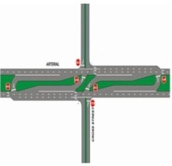
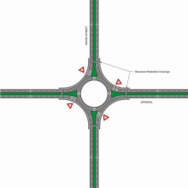
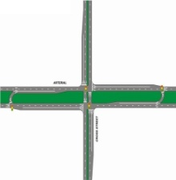
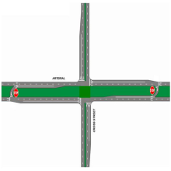
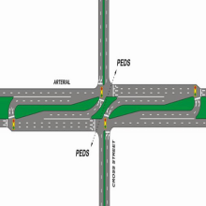
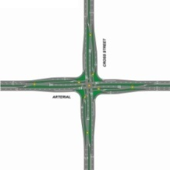
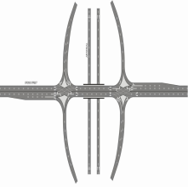
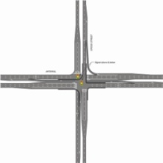
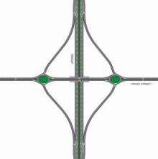
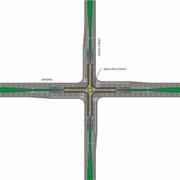
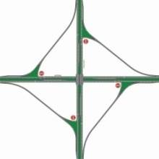
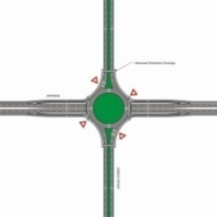
Roundabout
Unsignalized Superstreet
Unsignalized Median U-Turn
Superstreet
Median U-turn
Roundabout
Median U-Turn
Continuous Flow
Unsignalized
Superstreet
Superstreet
At Grade & Unsignalized
At Grade & Signalized
Unsignalized
Median U-Turn
Continuous Flow
Grade-Separated & Unsignalized
Grade-Separated & Signalized
Windmill Interchange
Echelon
Single Roundabout
Interchange
Diverging Diamond
Echelon
Double Roundabout
Interchange
Diverging Diamond Interchange
Single Roundabout Interchange
Center Turn Overpass
Double Roundabout Interchange
Windmill Interchange
Center Turn Overpass

Slide 4
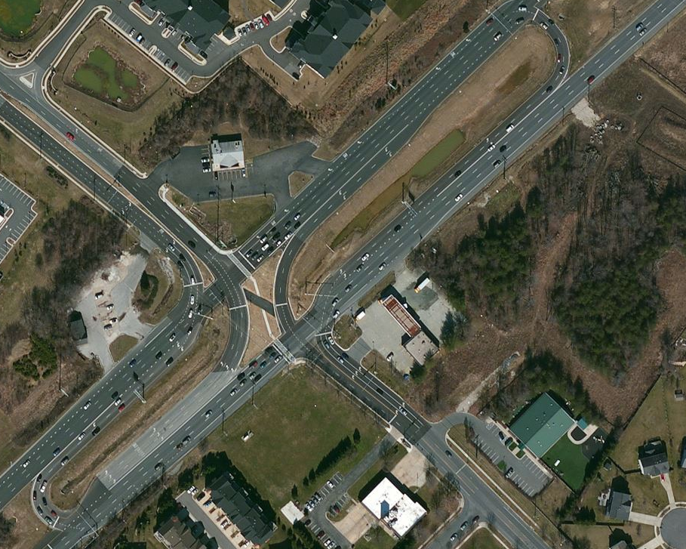
Superstreet
MD 3 & Waugh Chapel Rd., Odenton
Through and left-turn traffic from the minor road need take a U-turn.
Decreased arterial delay

Slide 5
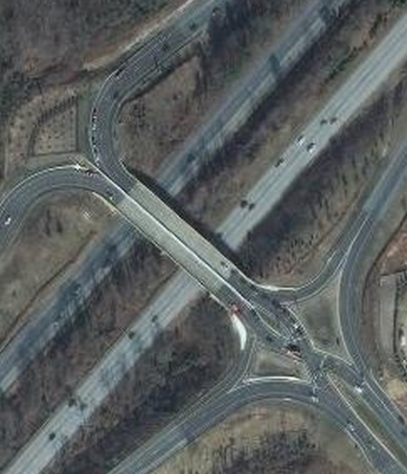
Diverging Diamond Interchange (DDI)
MD 295 & Arundel Mills Blvd., Hanover (half DDI)
Through traffic is on the left side for a short section and then crosses back.
Shorter off-ramp queues

Slide 6
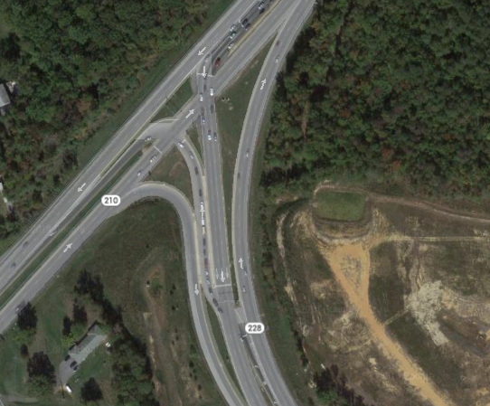
Continuous Flow Intersection (CFI)
MD210 & MD288, Accokeek
The first CFI on a U.S. state highway.
Left-turns begin several hundred feet ahead of the main intersection.
Increased capacity at the main intersection

Slide 7
Multi-stage analysis process
Planning Evaluation
Estimated delay
Queue length
Signal Optimization
Green splits
Offsets
Operation Analysis
Accurate delay
Level of service

Slide 8
MUID

Slide 9
MUID

