Slide 1





Traffic Safety and Operations Lab
University of Maryland
Maryland State Highway Administration
PPT模板下载：www.1ppt.com/moban/ 行业PPT模板：www.1ppt.com/hangye/
节日PPT模板：www.1ppt.com/jieri/ PPT素材下载：www.1ppt.com/sucai/
PPT背景图片：www.1ppt.com/beijing/ PPT图表下载：www.1ppt.com/tubiao/
优秀PPT下载：www.1ppt.com/xiazai/ PPT教程： www.1ppt.com/powerpoint/
Word教程： www.1ppt.com/word/ Excel教程：www.1ppt.com/excel/
资料下载：www.1ppt.com/ziliao/ PPT课件下载：www.1ppt.com/kejian/
范文下载：www.1ppt.com/fanwen/ 试卷下载：www.1ppt.com/shiti/
教案下载：www.1ppt.com/jiaoan/
An Integrated Signal Control System to Mitigate Queue Spillback on Freeway Off-ramps

Slide 2
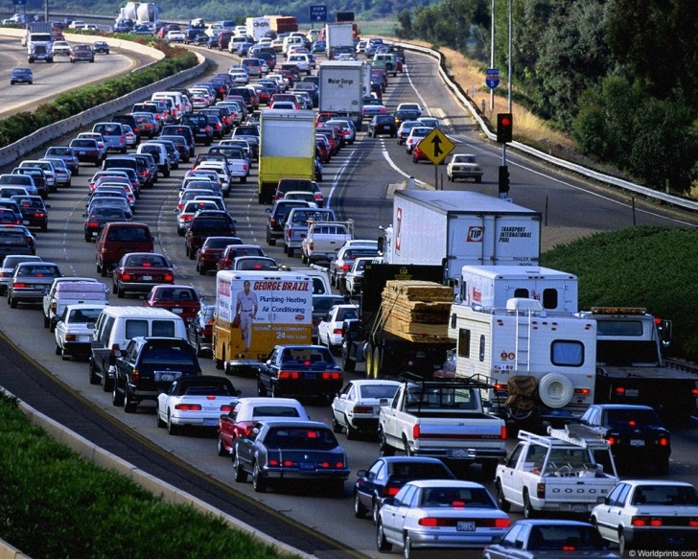
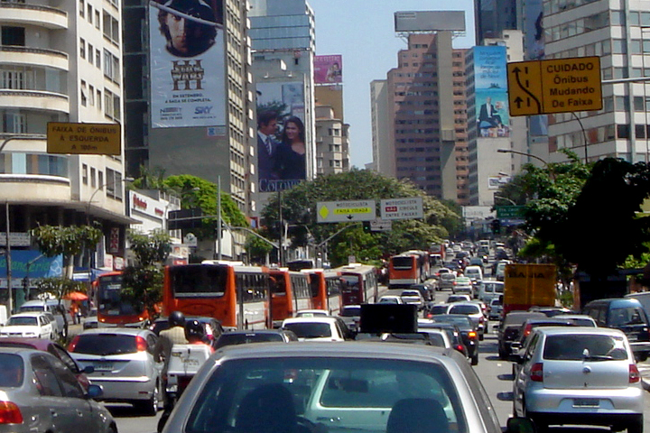
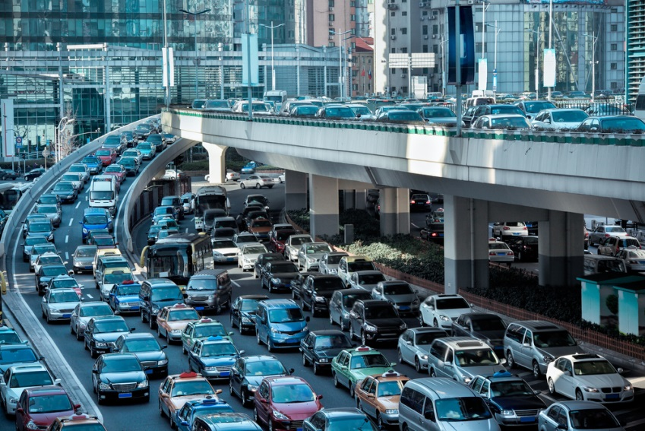
Traffic Congestion During Peak Hours
Interchanged Area
Freeway
Arterial
Notes:
It might look nicer if the images didn’t fade to transparent

Slide 3
Congestion
Bottleneck

Slide 4
System Framework
Stage 1
Pre-timed
Signal Plan Design
Stage 2
Real-time
Signal Control

Slide 5

Pre-timed Signal Control
Traffic Data
Notes:
The words “traffic data” appear before the image

Slide 6
Real-Time Signal Control
Stage 1
Stage 2
Stage 3
Data Collection
Data Analysis
Signal Priority Control

Slide 7
Data Collection
Queue spillback
Data
Analysis
Priority Control

Slide 8
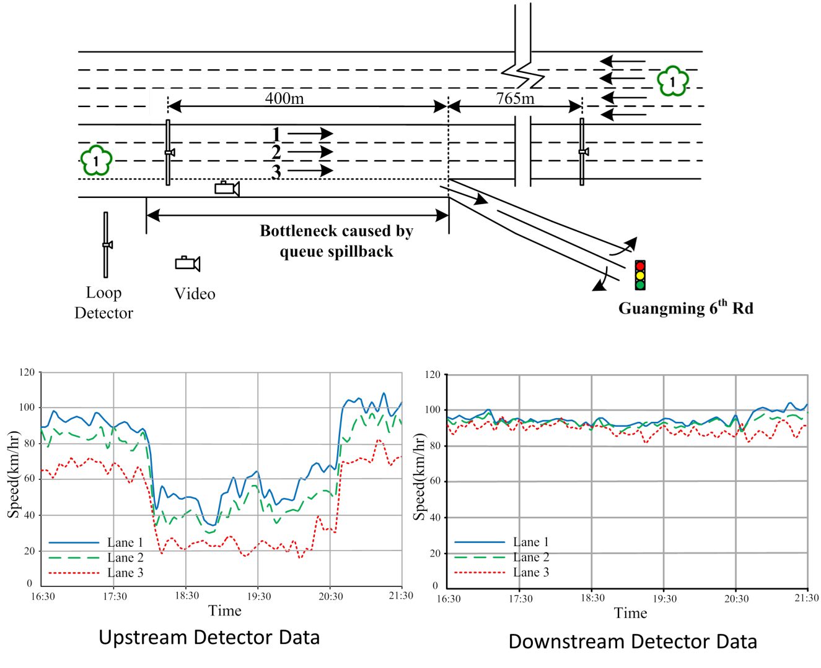
Field Site Demonstration
Guangming 6th Rd, Chupei, Taiwan
Queue spillback

Slide 9
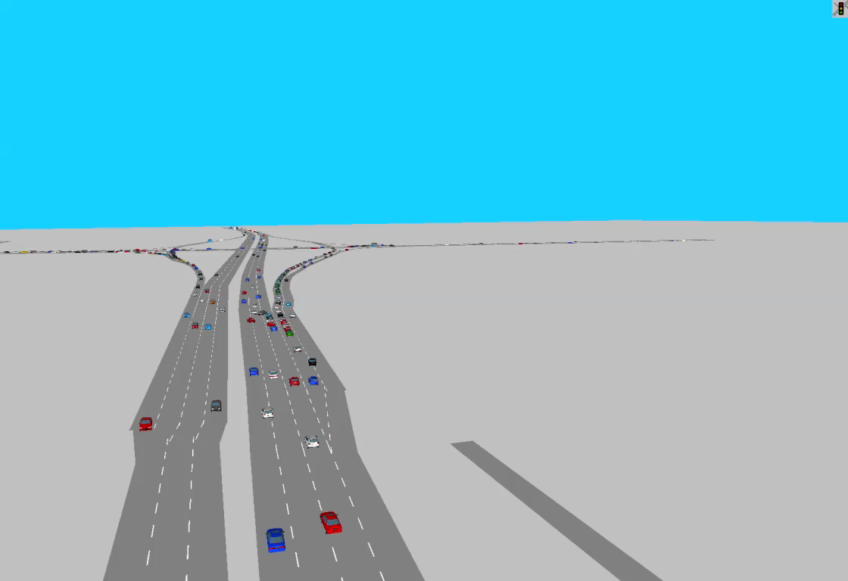
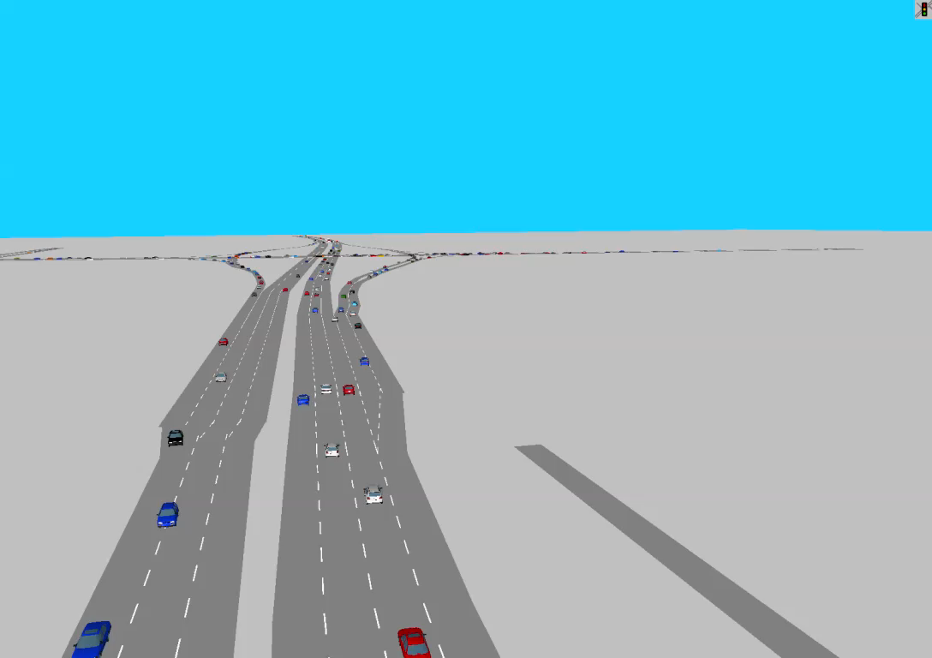
Case Study
No Control
With Dynamic Control

Slide 10
Case Study

Slide 11
Case Study
Network Performance
J | No-Control | Dynamic Control | Improvement
Average Delay (sec) | 101.25 | 83.14 | -17.89%
Average Number of Stops | 2.99 | 1.97 | -34.11%
Average Speed (km/h) | 32.24 | 37.84 | 17.34%

Slide 12
attap.umd.edu
THANKS & Questions?

