Slide 1
Applied Technology and Traffic Analysis Program(ATTAP) MIDCAP & MUID
Center for Traffic Safety and Operations
Dept. of Civil and Environmental Engineering
University of Maryland, College Park
Traffic Development & Support Division
Office of Traffic & Safety
Maryland State Highway Administration

Slide 2
CONTENTS
1
MIDCAP
2
MUID

Slide 3
MIDCAP
Maryland Intersection and Interchange Design & Capacity Analysis Program

Slide 4
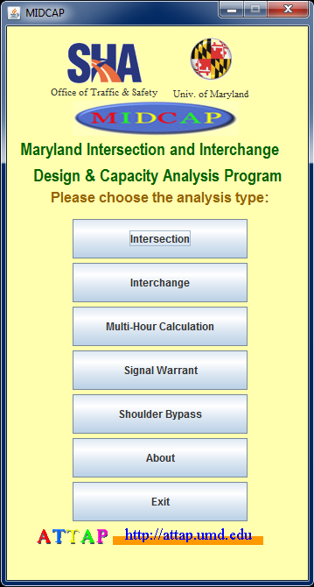
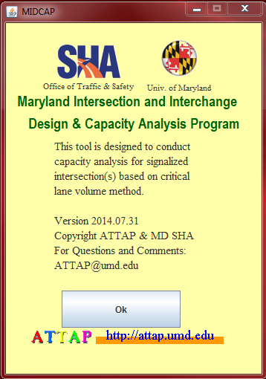
INTRODUCTION
Maryland Intersection and Interchange Design & Capacity Analysis Program (MIDCAP)
Developed by University of Maryland, College Park and MDSHA
A tool to conduct a capacity/ queuing analysis for signalized intersections and interchanges, signal warrant and shoulder bypass analysis at the preliminary, planning, or design stage
Ok
Ok

Slide 5
MODULES
Capacity and queue analysis
for signalized Intersections
for signalized interchanges
Signal Warrant
Shoulder Bypass Lanes (SBLs) Warrant

Slide 6
MODULE 1: CAPACITY AND QUEUE ANALYSIS
Uses the CLV method and MDSHA’s Queuing analysis procedure
Provides the volume-to-capacity ratio and corresponding level of service associated with a particular intersection/interchange design, given hourly turning movement volumes, lane configurations, right turn restrictions, and phase control (split or non-split)
Considers different types of intersection/interchange from conventional design (4 leg, 3 leg, diamond intersection) to unconventional design (Continuous Flow Intersection, Single Point Urban Interchange, and Diverging Diamond Interchange)

Slide 7
MODULE 1: CAPACITY AND QUEUE ANALYSIS
Framework
INPUT
Movement volumes
Lane configuration
Intersection type
Right-turn restriction
Determine critical movement and calculate intersection CLV
Calculate CLV for each approach
Calculate v/c and determine LOS
Calculate Max. queue length
Intersection Critical Lane Volume
Intersection v/c and LOS
Maximum Queue Length
OUTPUT

Slide 8
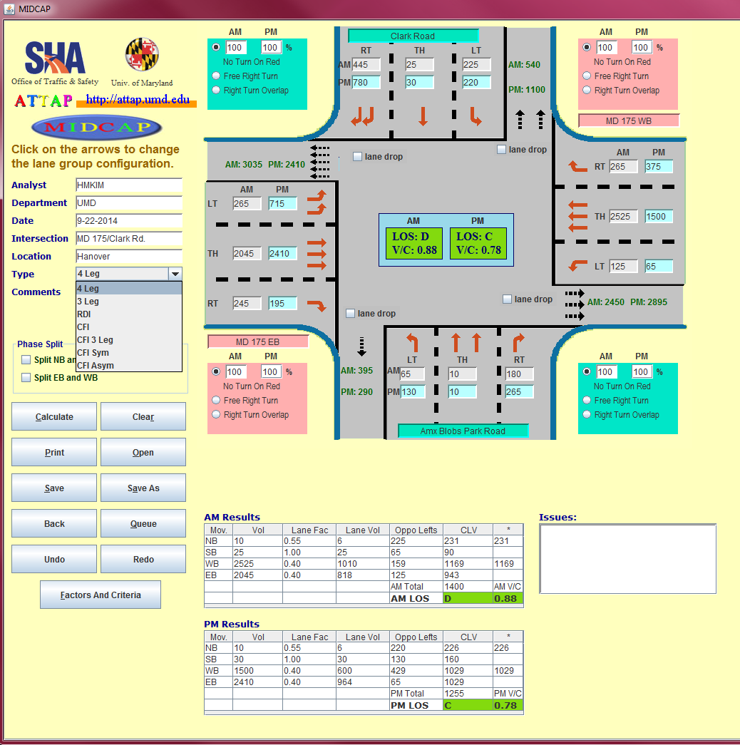
MODULE 1: CAPACITY AND QUEUE ANALYSIS
User-friendly interface
1
Choose Intersection Type
Set Lane Configurations
3
2
2
6
3
Input Movement Volumes
1
4
4
Choose Right Turn Control Type
5
5
Calculate Critical Lane Volume
6
Obtain Intersection LOS & V/C

Slide 9
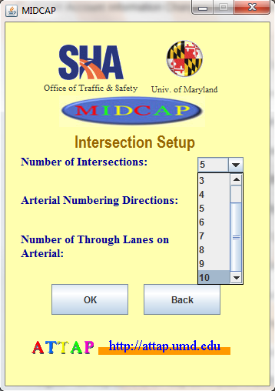
MODULE 1: CAPACITY AND QUEUE ANALYSIS
Multiple intersections analysis
Corridor analysis
Up to 10 intersections

Slide 10
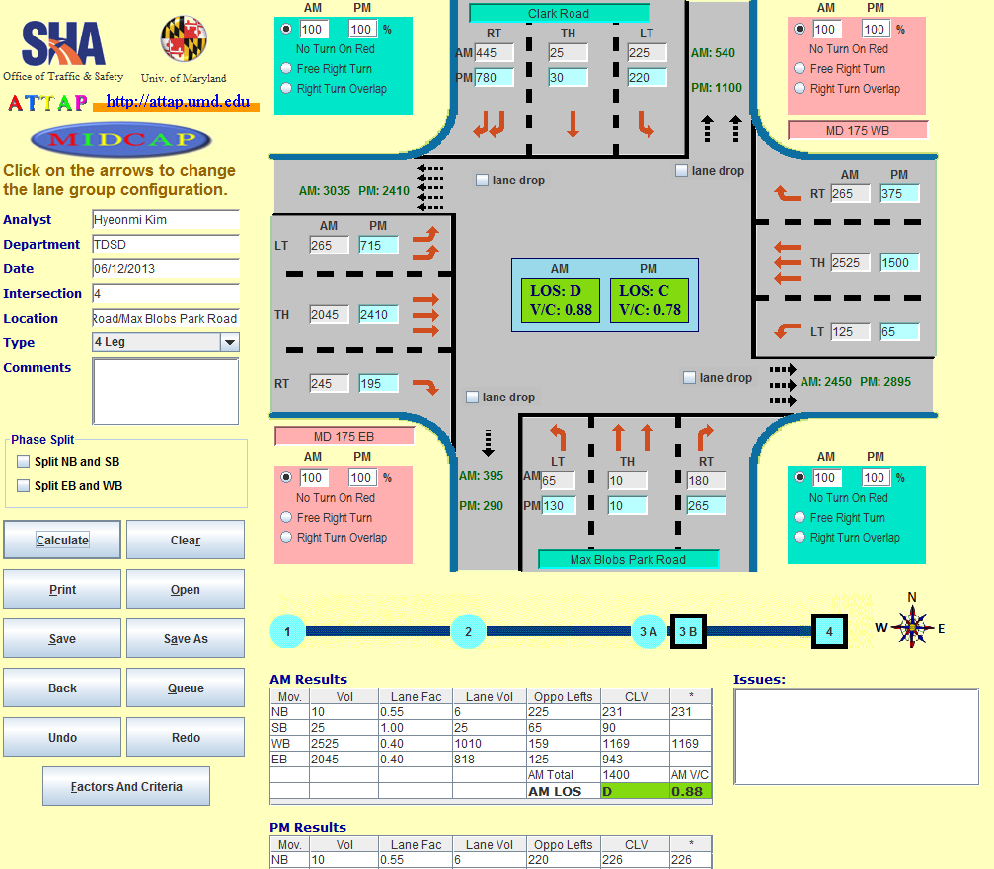
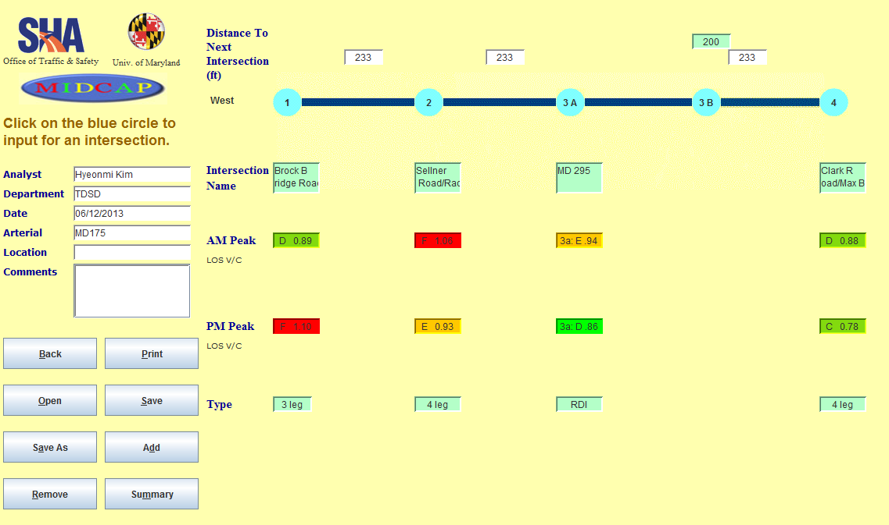
MODULE 1: CAPACITY AND QUEUE ANALYSIS
Integration of intersection and interchange designs
On the multiple intersection analysis
Intersections
Interchange

Slide 11
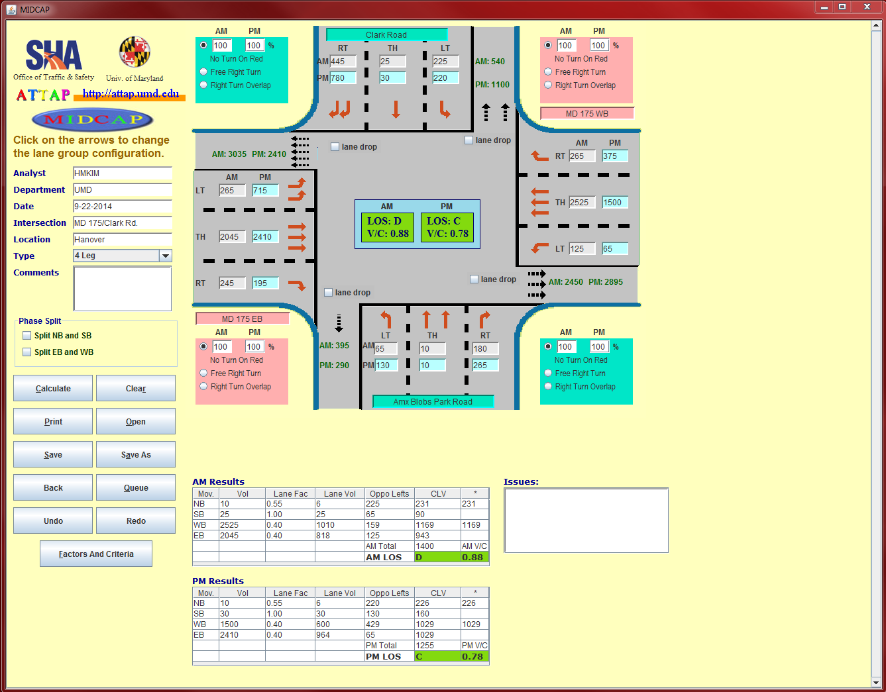
MODULE 1: CAPACITY AND QUEUE ANALYSIS
Analysis for both AM and PM peak hours at a time

Slide 12
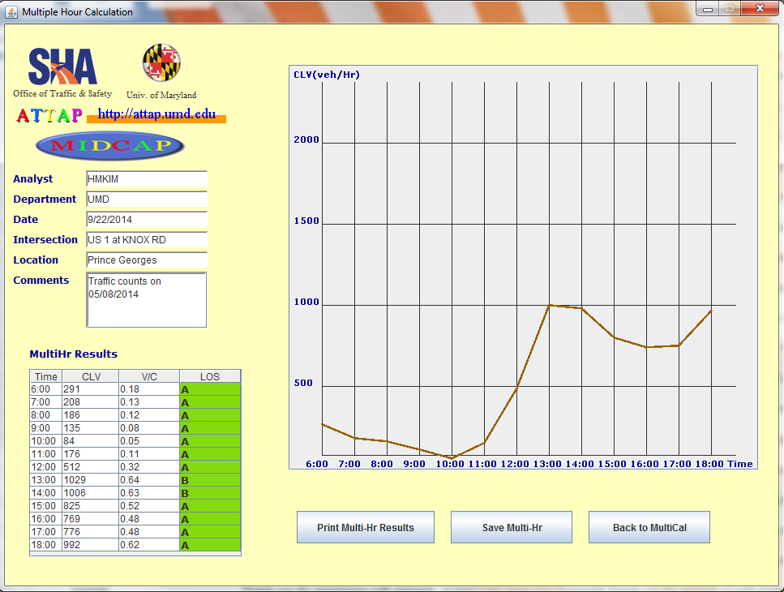
MODULE 1: CAPACITY AND QUEUE ANALYSIS
Multi-hour analysis

Slide 13
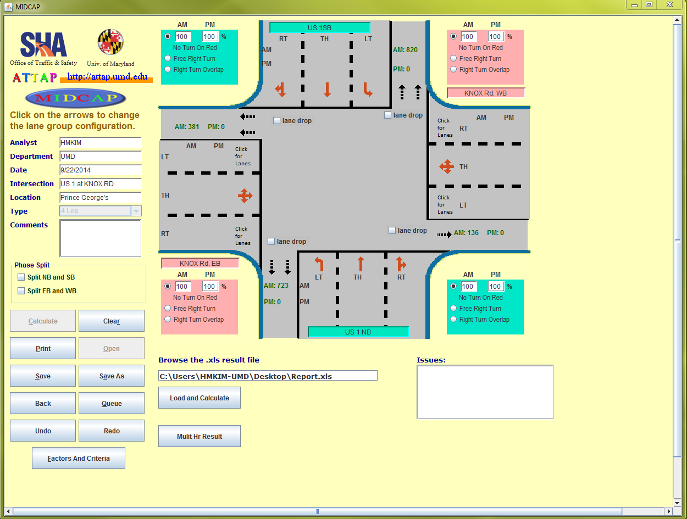
MODULE 1: CAPACITY AND QUEUE ANALYSIS
Import a report from Internet Traffic Monitoring System (I-TMS) as traffic volume input

Slide 14
MODULE 1: CAPACITY AND QUEUE ANALYSIS
Factors and Criteria
Editable Lane Use Factors, LOS criteria, and PCE values
Can be applied in different intersections and different approaches
Default values (see tables)

Slide 15
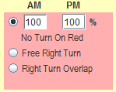
MODULE 1: CAPACITY AND QUEUE ANALYSIS
Right turn restriction
Percentage of no-turn-on-red traffic
Free right turn
Right turn overlap

Slide 16
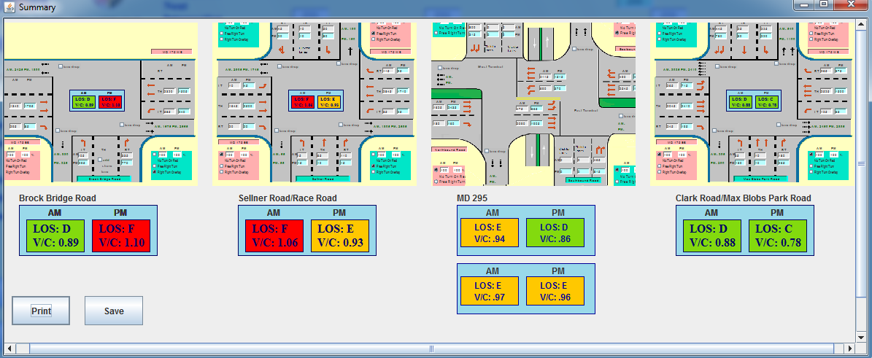
MODULE 1: CAPACITY AND QUEUE ANALYSIS
Comparison summary

Slide 17
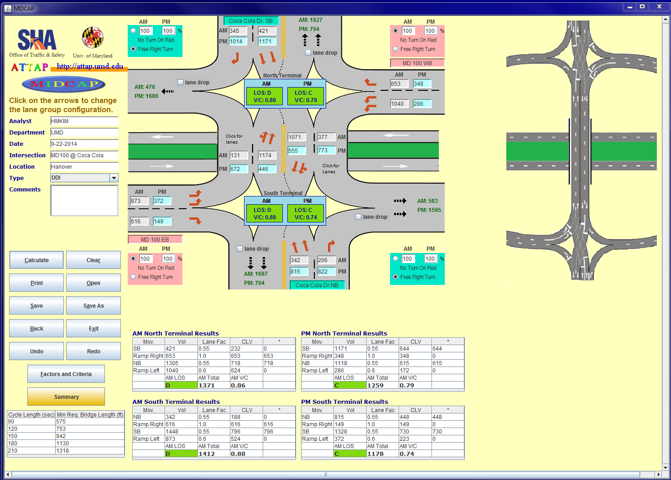
MODULE 1: CAPACITY AND QUEUE ANALYSIS
Recommended bridge length for DDI design

Slide 18
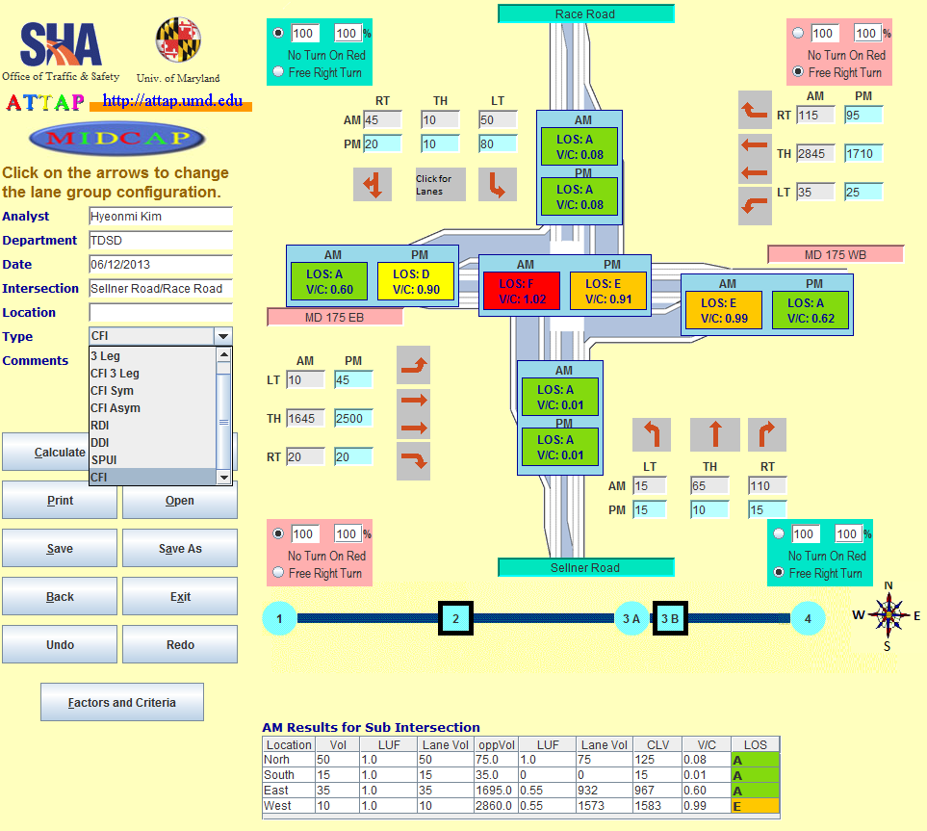
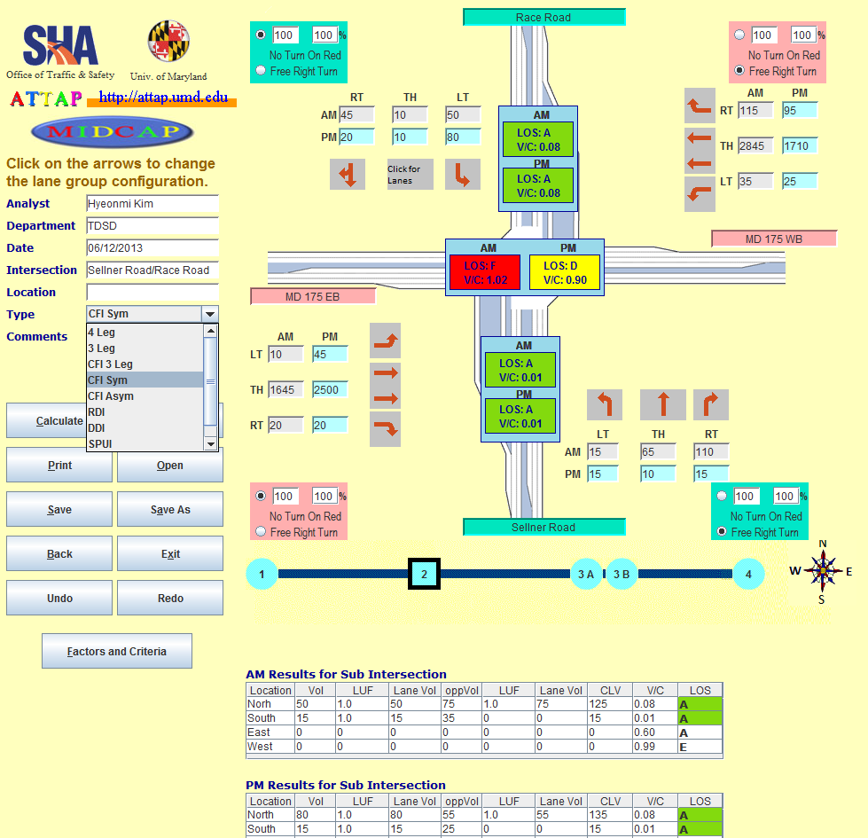
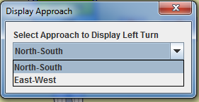
MODULE 1: CAPACITY AND QUEUE ANALYSIS
Different intersection and interchange designs
Full CFI
Symmetric CFI

Slide 19
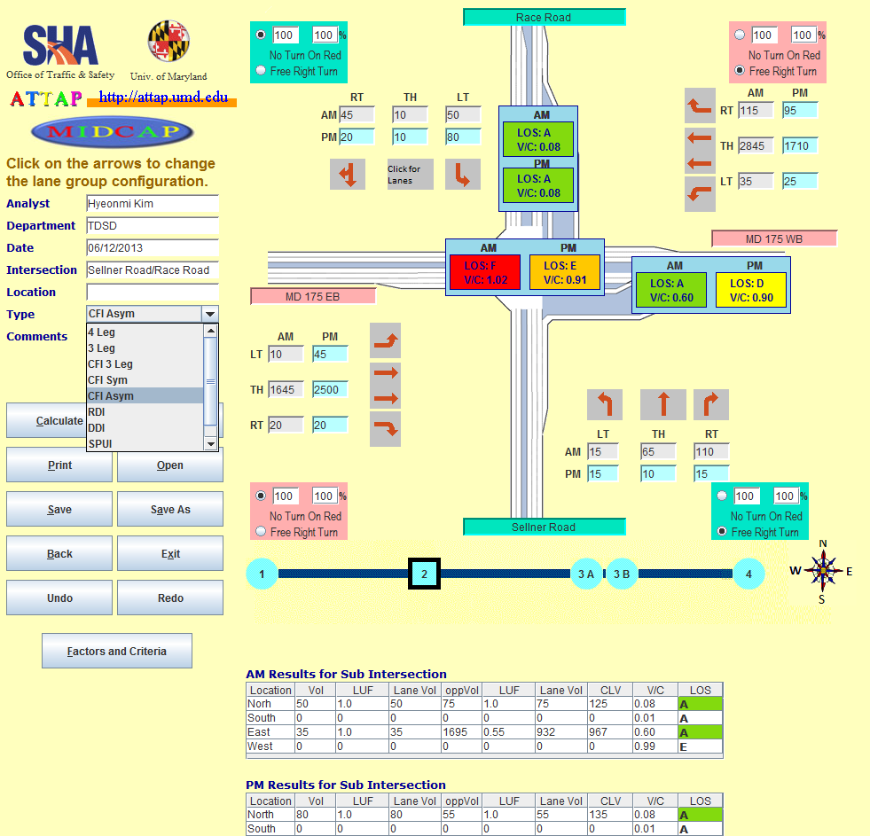
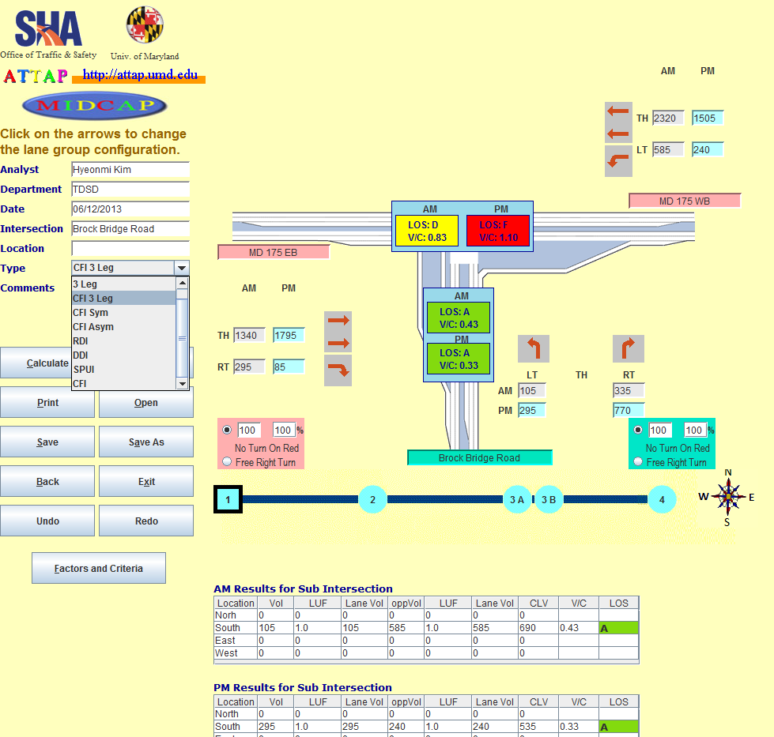
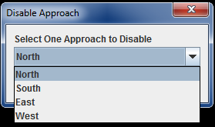
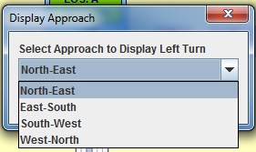
MODULE 1: CAPACITY AND QUEUE ANALYSIS
Different intersection and interchange designs
Asymmetric CFI
CFI-T

Slide 20
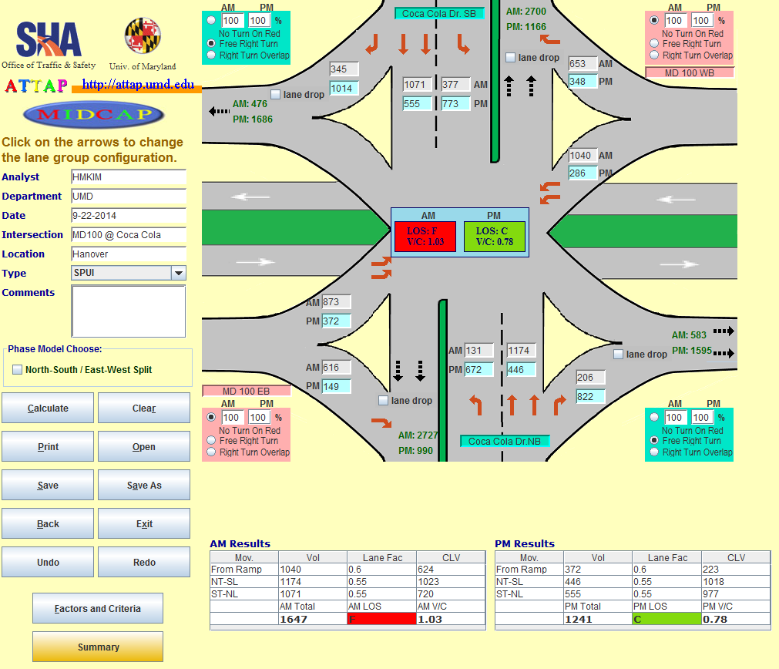
MODULE 1: CAPACITY AND QUEUE ANALYSIS
Different intersection and interchange designs
SPUI
DDI

Slide 21
MODULE 2: SIGNAL WARRANT
Uses the Maryland Manual on Uniform Traffic Control Devices (MUTCD) 2011 edition
Investigates the need for a traffic control signal by analyzing related factors such as traffic conditions and physical characteristics of the location
Provides whether the following traffic signal warrant is satisfied at a particular location or not
Warrant 1. Eight-Hour Vehicular Volume
Warrant 2. Four-Hour Vehicular Volume
Warrant 3. Peak Hour
Warrant 9. Intersection Near a Grade Crossing

Slide 22
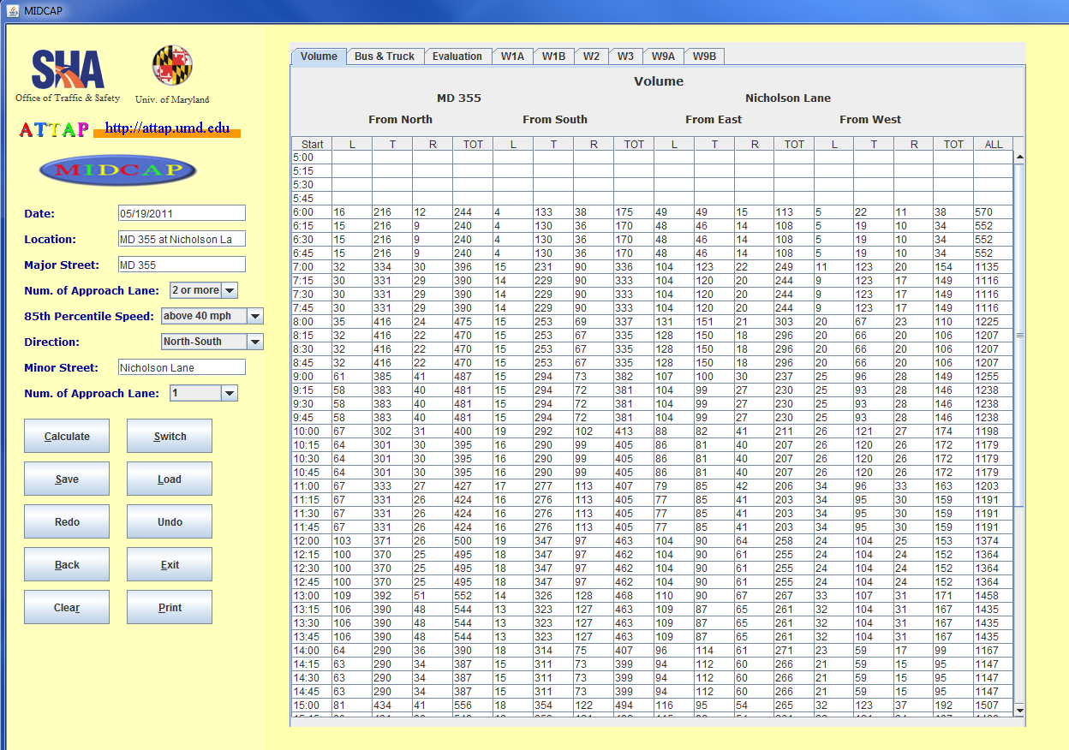
MODULE 2: SIGNAL WARRANT
User-friendly Interface
Import a turning movement report from Internet Traffic Monitoring System (I-TMS) as input
1
Load Traffic volume data
2
Set Location-specific Characteristics
2
3
Click Calculate button
3
1

Slide 23
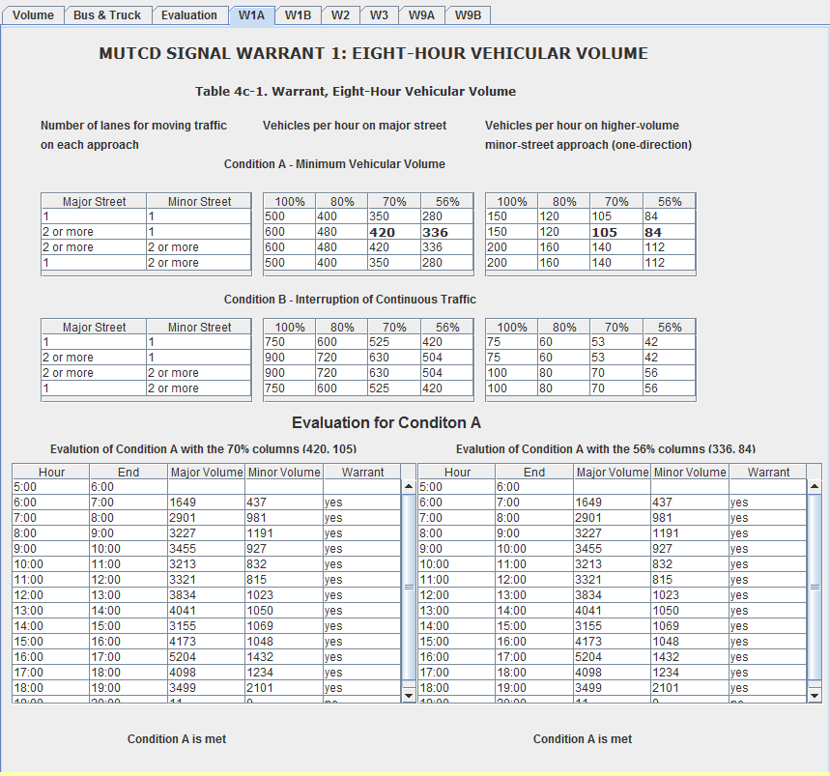
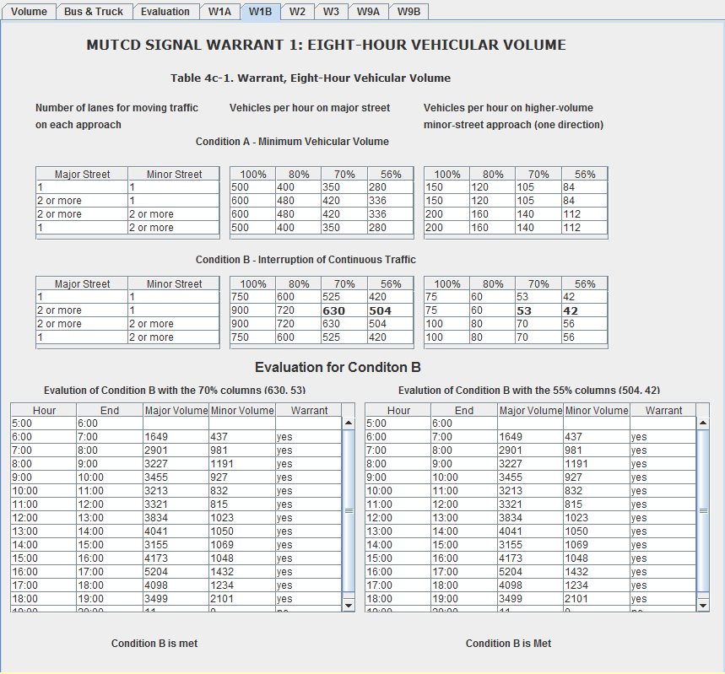
MODULE 2: SIGNAL WARRANT
User-friendly Interface
Evaluation results for Warrant 1

Slide 24
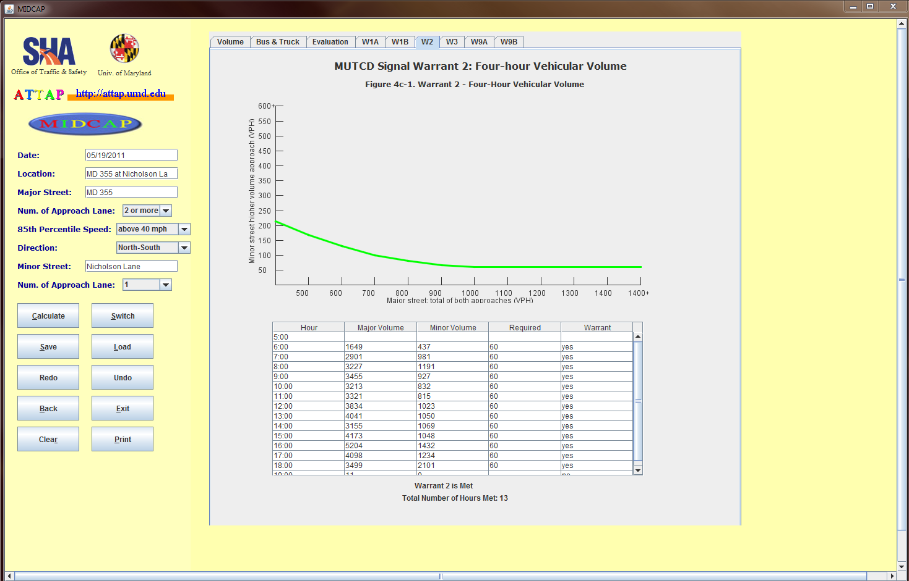
MODULE 2: SIGNAL WARRANT
User-friendly Interface
Evaluation results for Warrant 2

Slide 25
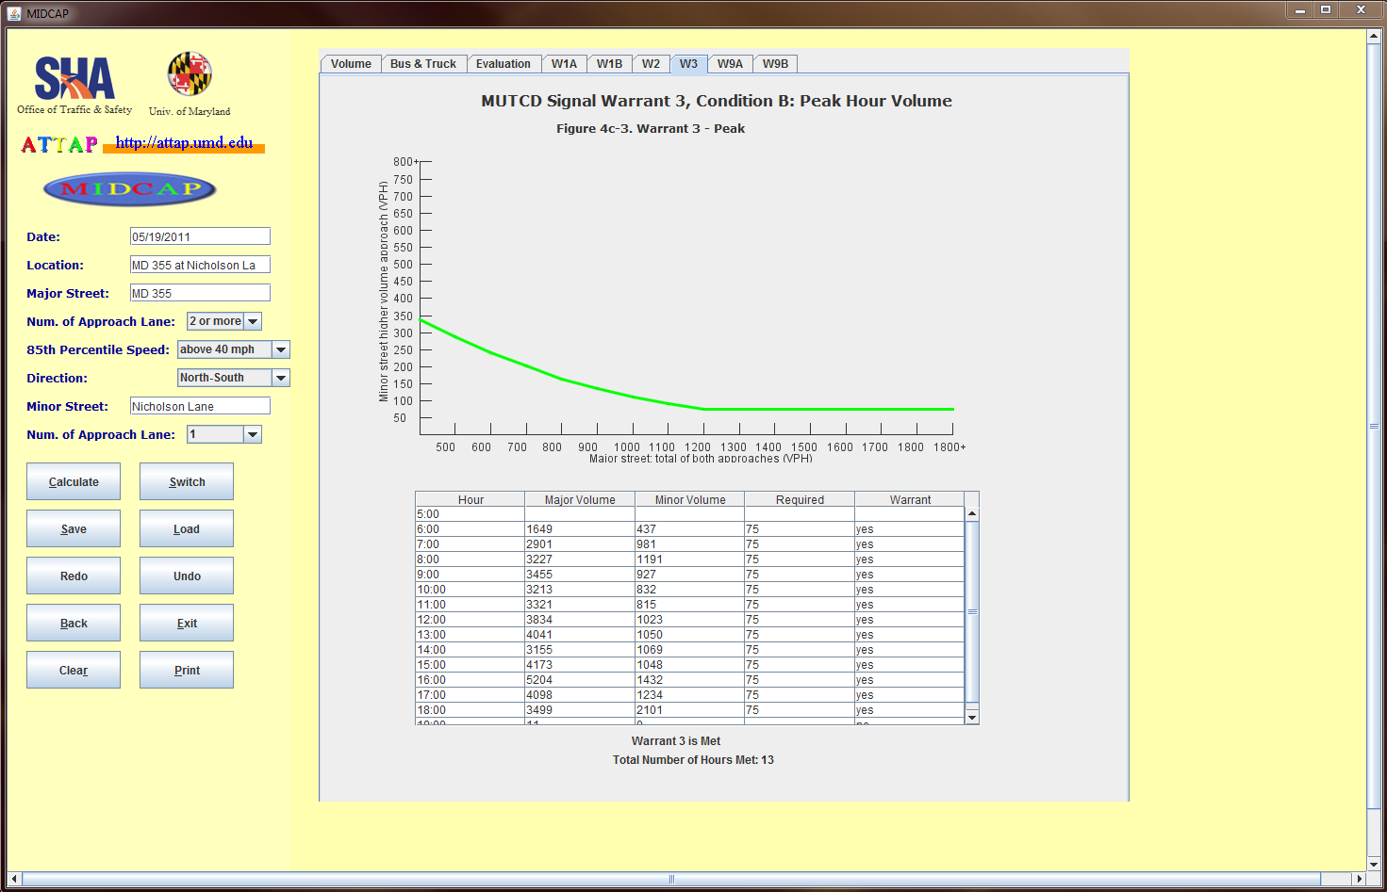
MODULE 2: SIGNAL WARRANT
User-friendly Interface
Evaluation results for Warrant 3

Slide 26
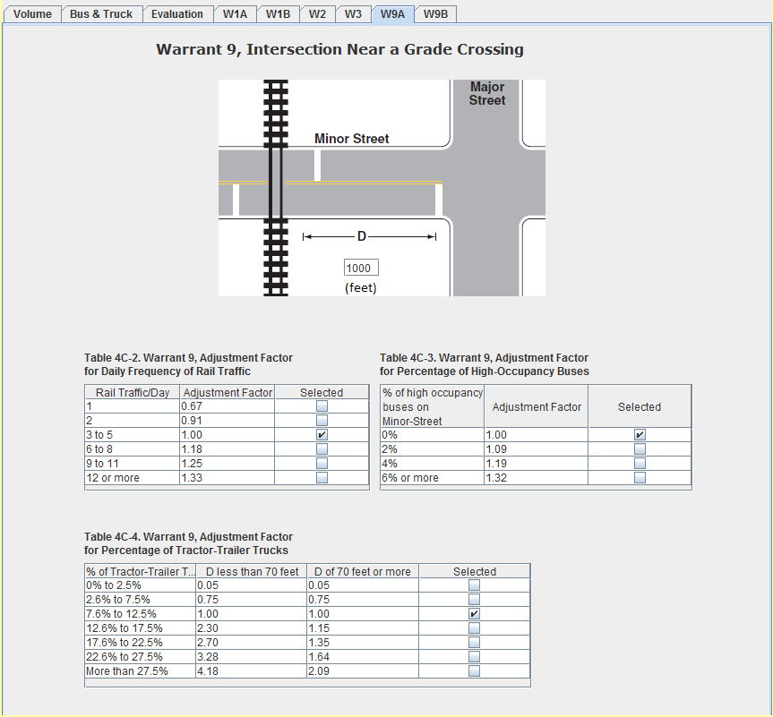
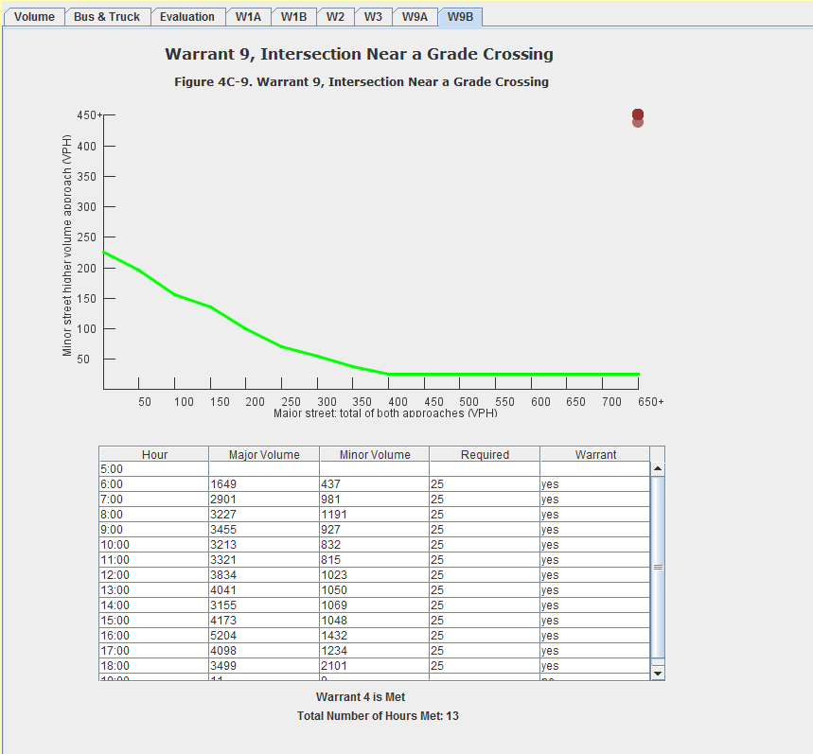
MODULE 2: SIGNAL WARRANT
User-friendly Interface
Evaluation results for Warrant 9

Slide 27
MODULE 3: SHOULDER BYPASS LANES(SBLs)
Using the MDSHA’s application and design guidelines for shoulder bypass lanes (SBLs)
Investigates the need for shoulder bypass lanes and left-turn lanes by analyzing related factors such as traffic conditions and physical characteristics of the location
Provides whether the following shoulder bypass lane warrant is satisfied at a particular location or not
Warrant 1. Vehicular Volumes
Warrant 2. Stopping Sight Distance
Warrant 3. Accident History

Slide 28
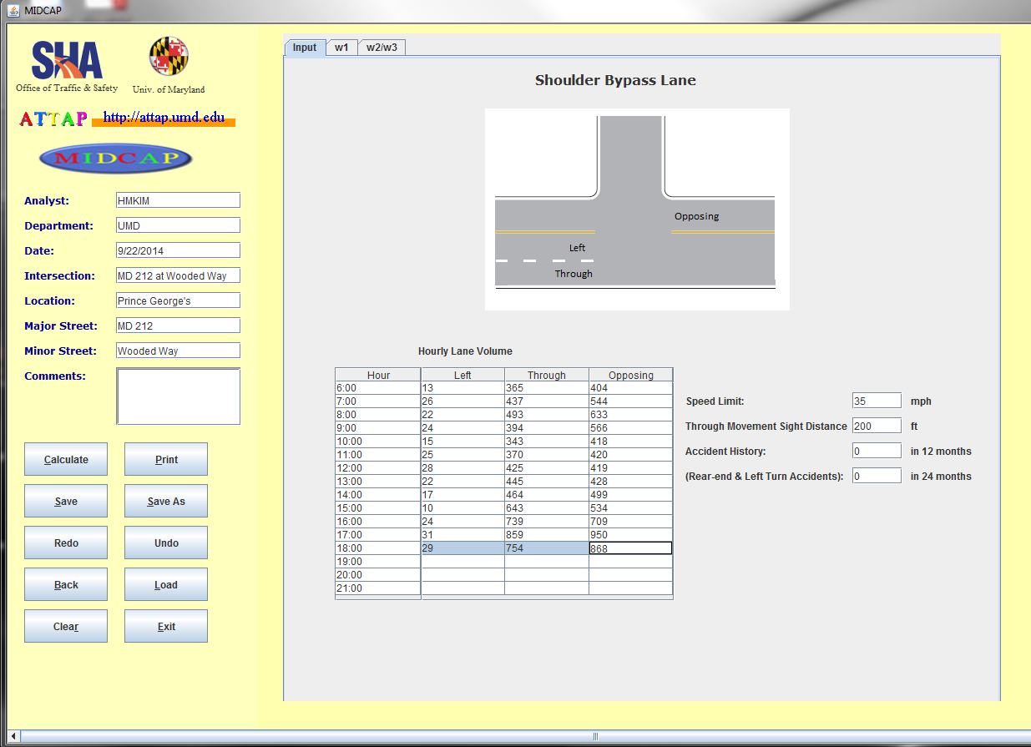
MODULE 3: SHOULDER BYPASS LANES(SBLs)
User-friendly Interface
1
Input Traffic volume data
2
Set Location-specific Characteristics
1
2
3
3
Click Calculate button

Slide 29
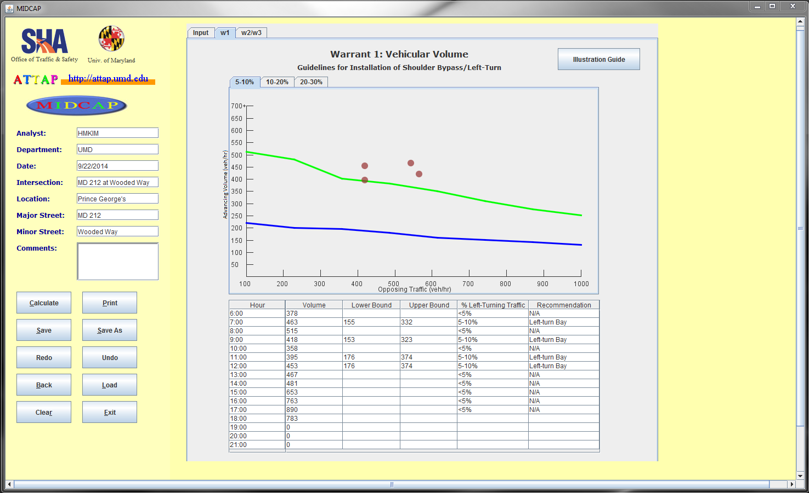
MODULE 3: SHOULDER BYPASS LANES(SBLs)
User-friendly Interface
Evaluation results for Warrant 1

Slide 30
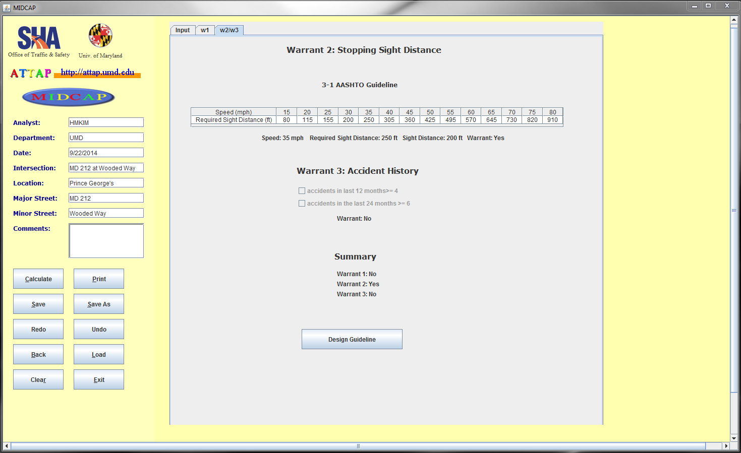
MODULE 3: SHOULDER BYPASS LANES(SBLs)
User-friendly Interface
Evaluation results for Warrant 2 and Warrant 3

Slide 31
MUID
Maryland Unconventional Intersection Design Analysis Tool

Slide 32
INTRODUCTION
Maryland Unconventional Intersection Design (MUID) Analysis Tool
Developed by University of Maryland, College Park and MDSHA
A tool to conduct a capacity/ queuing analysis as well as signal optimization for continuous flow intersection (CFI), diverging diamond interchange (DDI), and superstreet intersection
Notes:
Intersections/Interchanges

Slide 33
MODULES
Planning Evaluation Module
Queue length
Average Delay
Critical Lane Volumes (CLVs)
Signal Optimization Module
Offset
Cycle length
g/C ratio
Notes:
In the planning evaluation module, add “Queue/link ratio”
In the signal optimization module, may be “green split” is better than g/C ratio
Another module is output module, which shows input parameters, planning evaluation results and signal optimization results

Slide 34
PLANNING EVALUATION MODULE
Planning Evaluation Procedure
Identifying all factors contributing to the total delay and queue, including external factors such as demand, and internal factors such as intersection geometric features
Generating a comprehensive data set with all identified factors for simulating analysis
Deriving the quantitative relationships between intersection delays and contributing factors
Build simulation models using VISSIM and Calibrate VISSIM parameters with field data
Estimating the impact of queues on the overall intersection performance and developing a set of statistical models for queues length prediction at each critical location
Random sampling of different demand scenarios
Notes:
In the third stage, Intersection delays -> performance measures

Slide 35
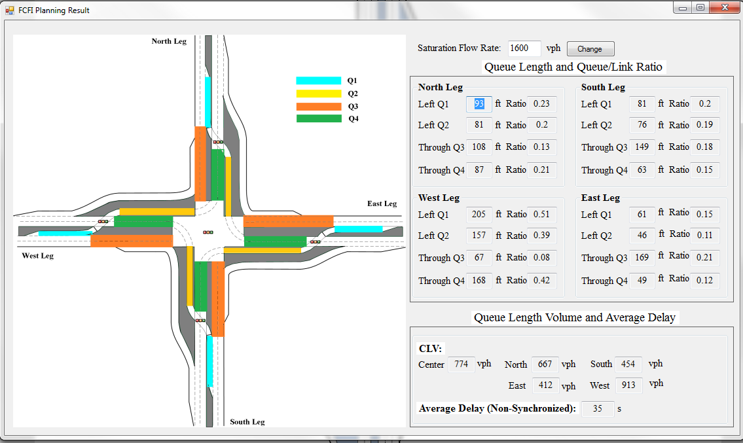
PLANNING EVALUATION MODULE
Planning Evaluation Results

Slide 36
SIGNAL OPTIMIZATION MODULE
Signal optimization Procedure
1
Calculate the CLV of each sub-intersection according to the phasing designs
2
Determine the common cycle length based on the CLV of the most congested sub-intersection
3
For each sub-intersection, optimize the green ratio of each phase with the objective of maximizing the capacity of intersection
4
Determine the critical traffic paths according to the demand pattern
5
Use a modified MAXBAND model to provide progressions to those critical traffic paths so as to optimize the offsets

Slide 37
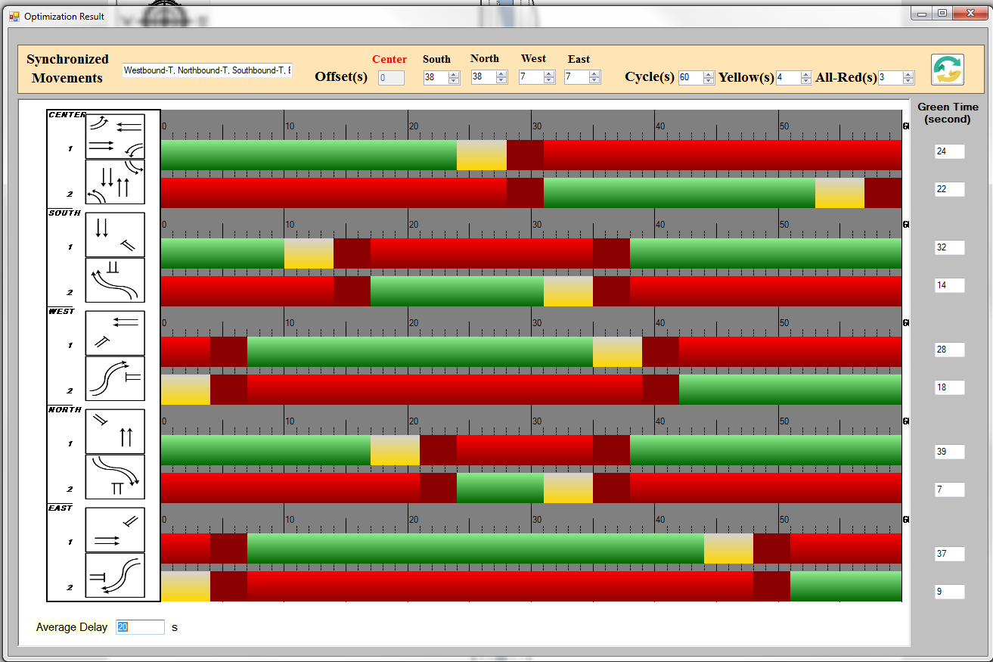
SIGNAL OPTIMIZATION MODULE
Signal Optimization Results
Notes:
Can you show two functions below?
The synchronized movements are listed on the top left corner
The user may change the green time and then the graph will update automatically, as well as the average delay
I have attached one slide at the end to somehow show the issues.

Slide 38
INTERSECTION/INTERCHANGE DESIGNS
Cover different intersection/interchange designs
Continuous Flow Intersection
CFI-T
Partial CFI(symmetrical)
Partial CFI(asymmetrical)
Full CFI
Diverging Diamond Interchange
Superstreet Intersection

Slide 39
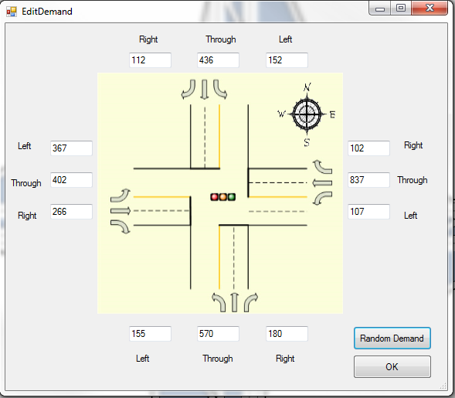
INPUT DEMAND
User-friendly Interface
Manually input demand or
Generate random demand

Slide 40
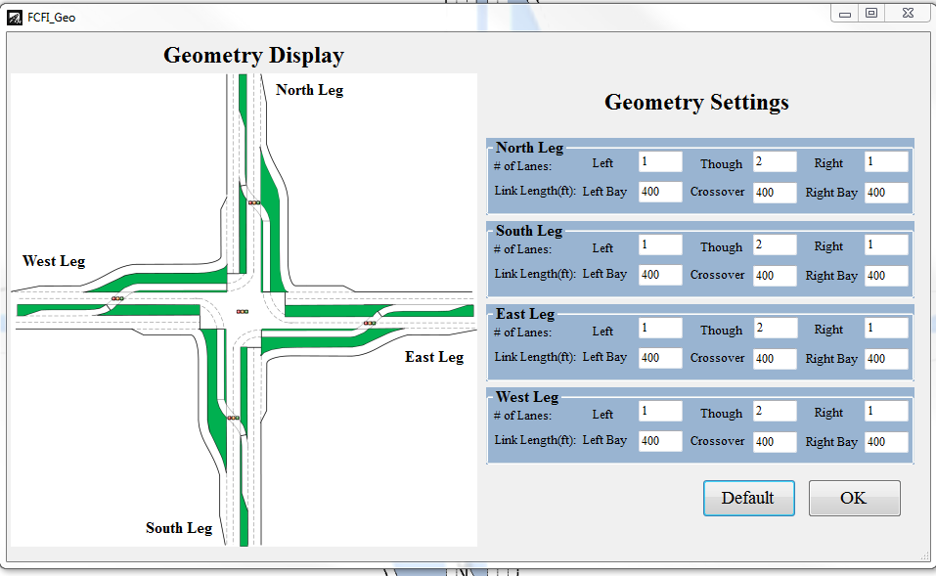
INPUT GEOMETRIC CHARACTERISTICS
User-friendly Interface
Manually input geometric information or
Generate random demand
Notes:
Generate random demand -> adopt the default geometry setting
I think this interface is user friendly mainly because the link will be colored if the corresponding textbox is being selected. Can you show this in the slides.? I have attached one page at the end of this file showing this advantage. It is from the slides for the Utah conference.

Slide 41
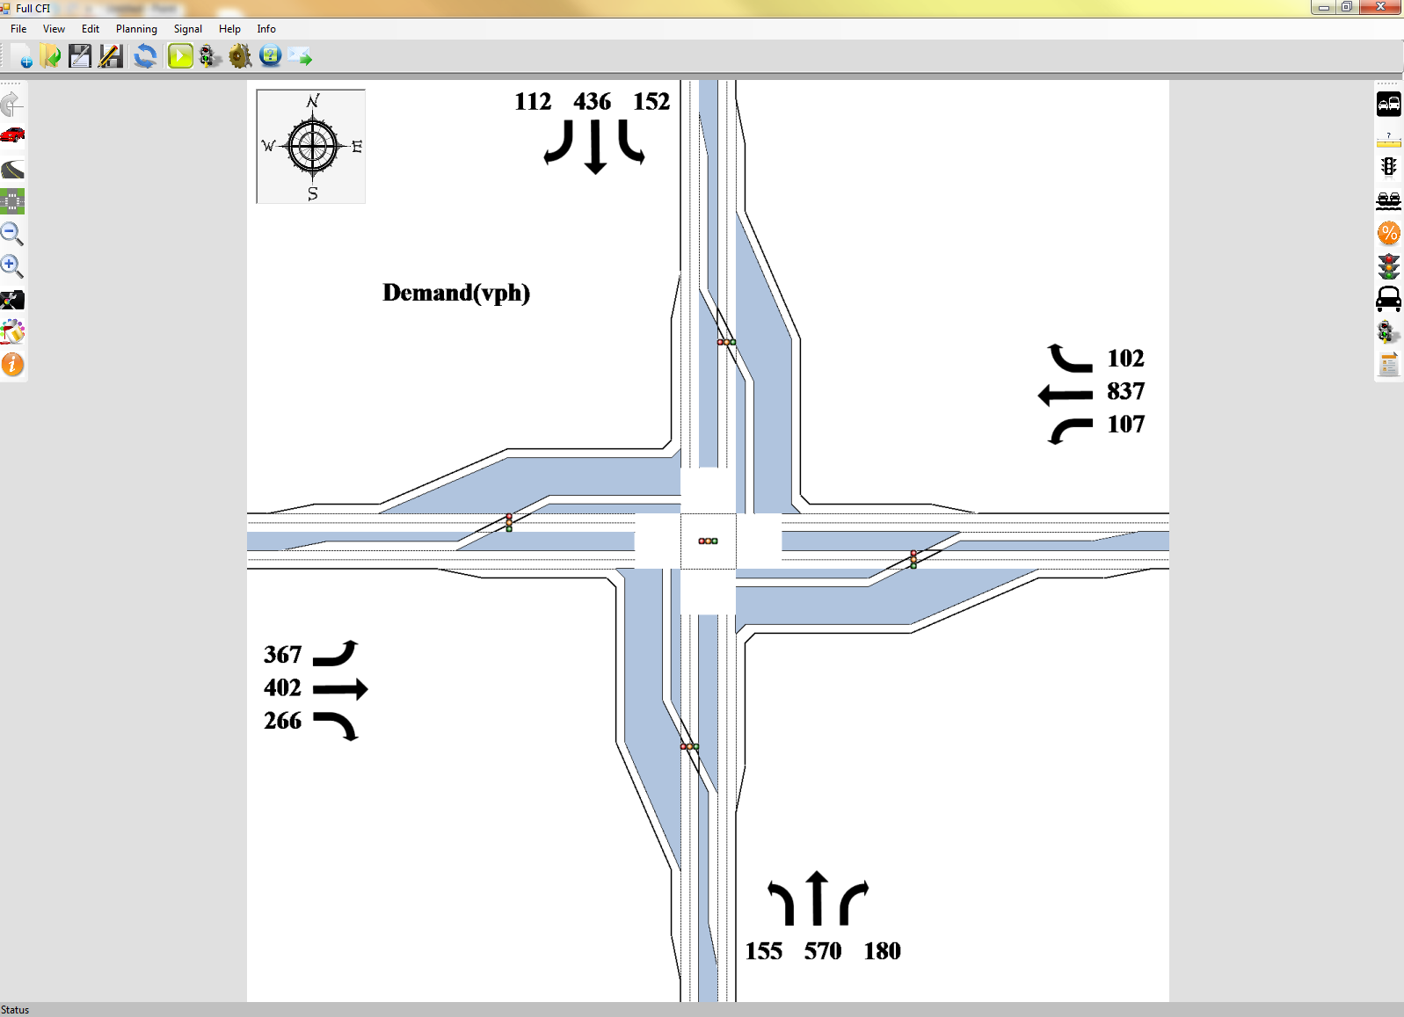
OUTPUT
Show demand

Slide 42
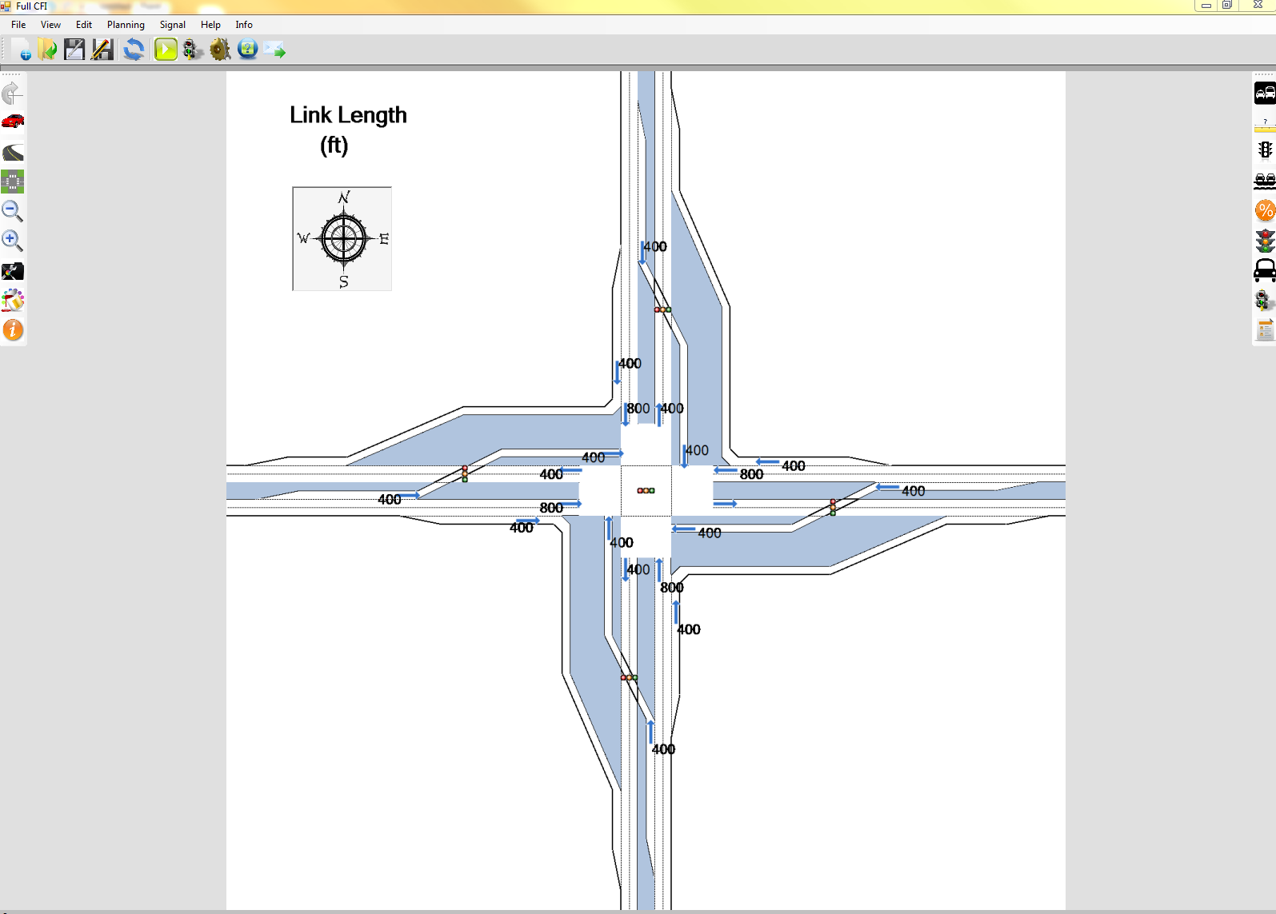
OUTPUT
Show link length

Slide 43
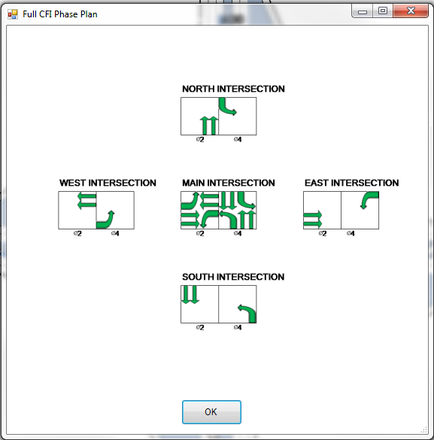
OUTPUT
Show phase plan

Slide 44
OUTPUT
Show Queue length

Slide 45
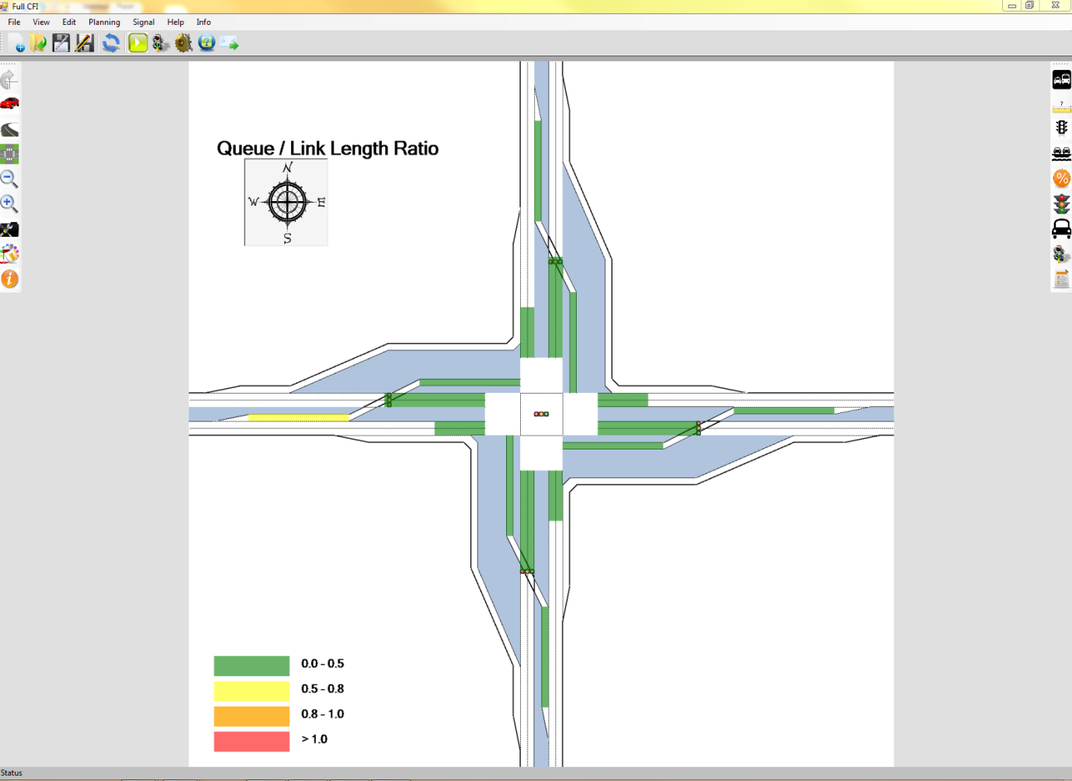
OUTPUT
Show Queue/Link length ratio

Slide 46
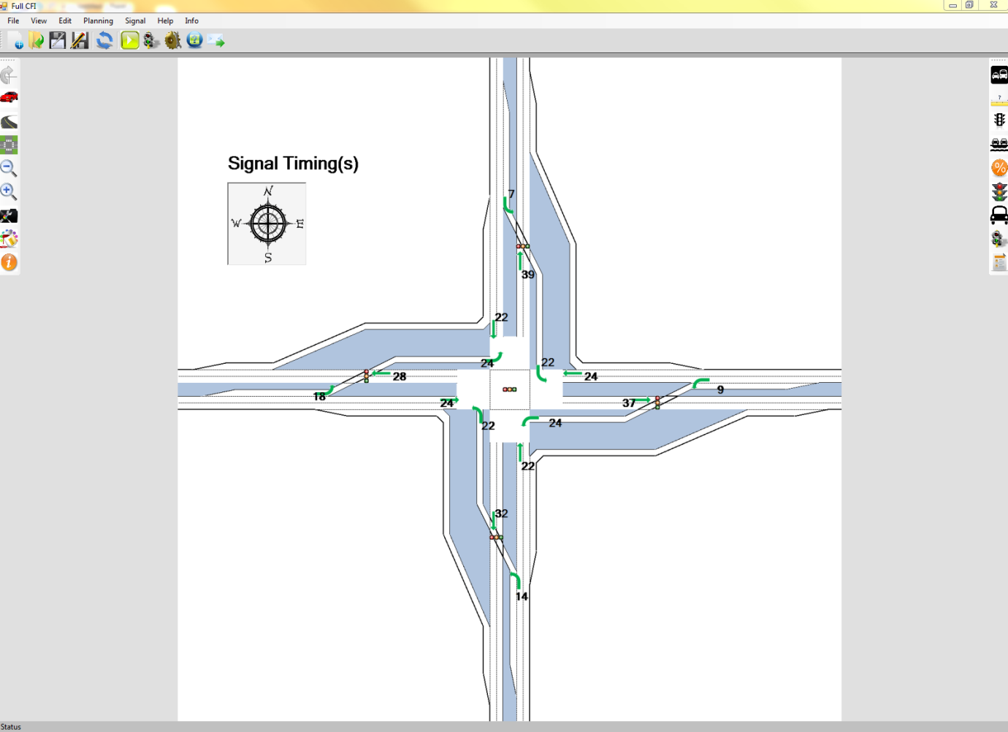
OUTPUT
Show signal timing(s)

Slide 47
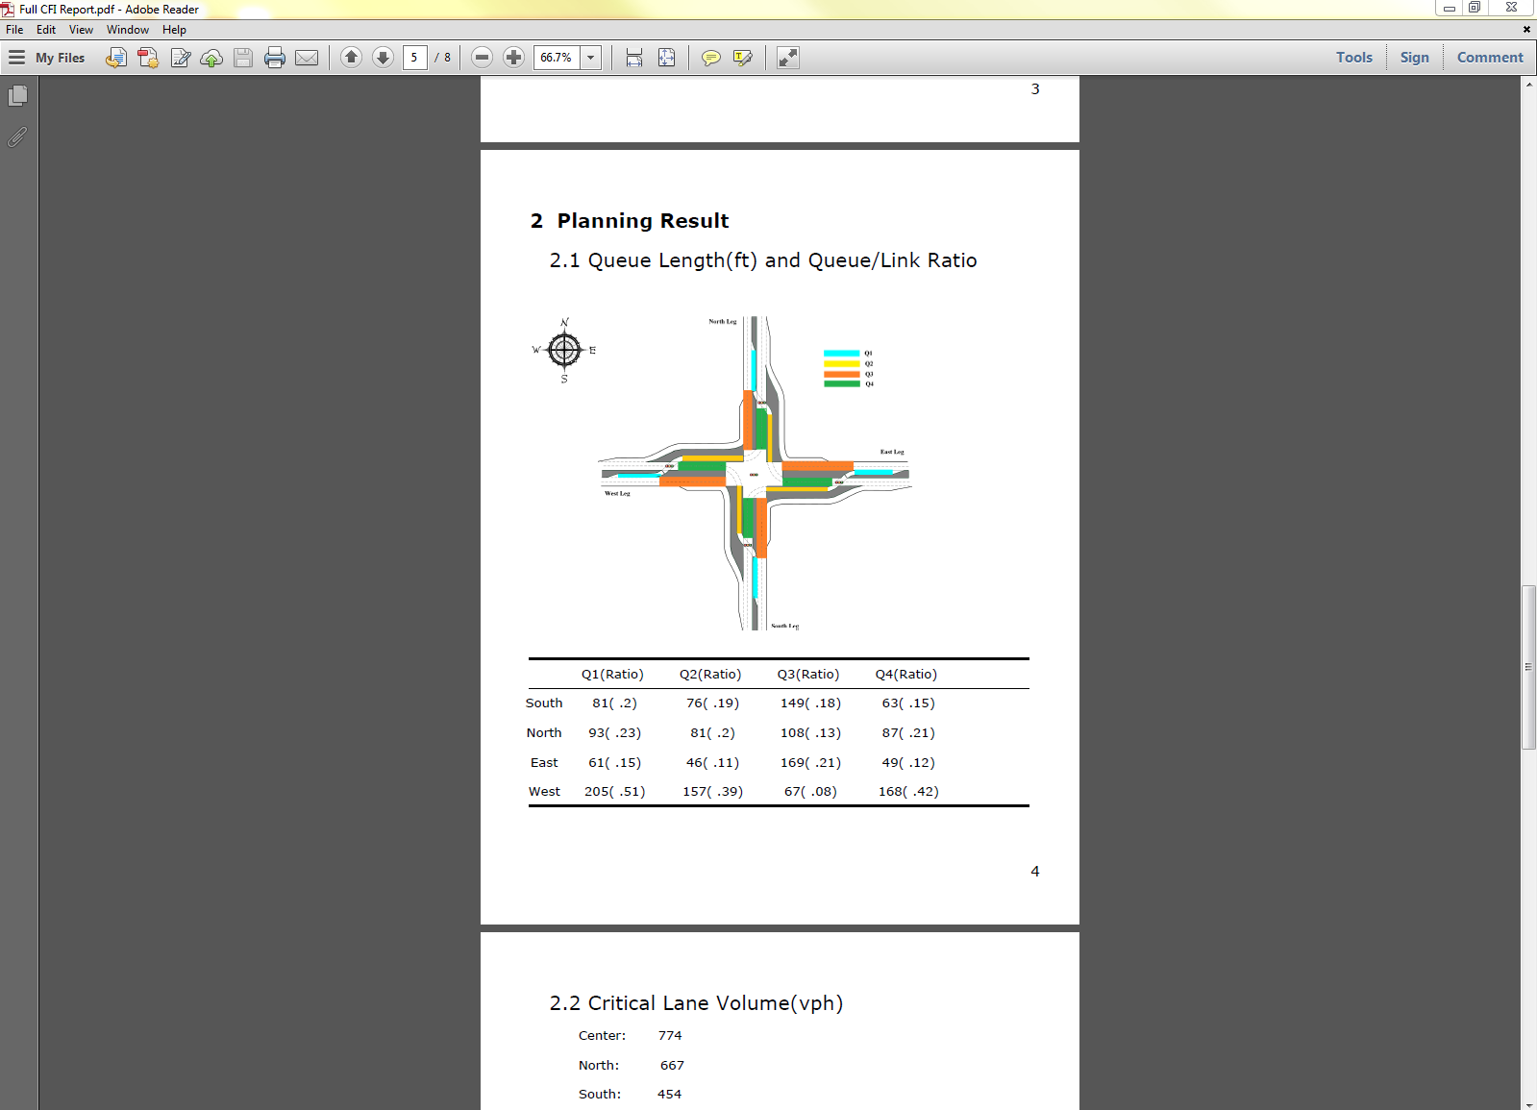
OUTPUT
Generate a report with input and module output
Notes:
Generate a comprehensive report containing all the input and output of the intersection

Slide 48
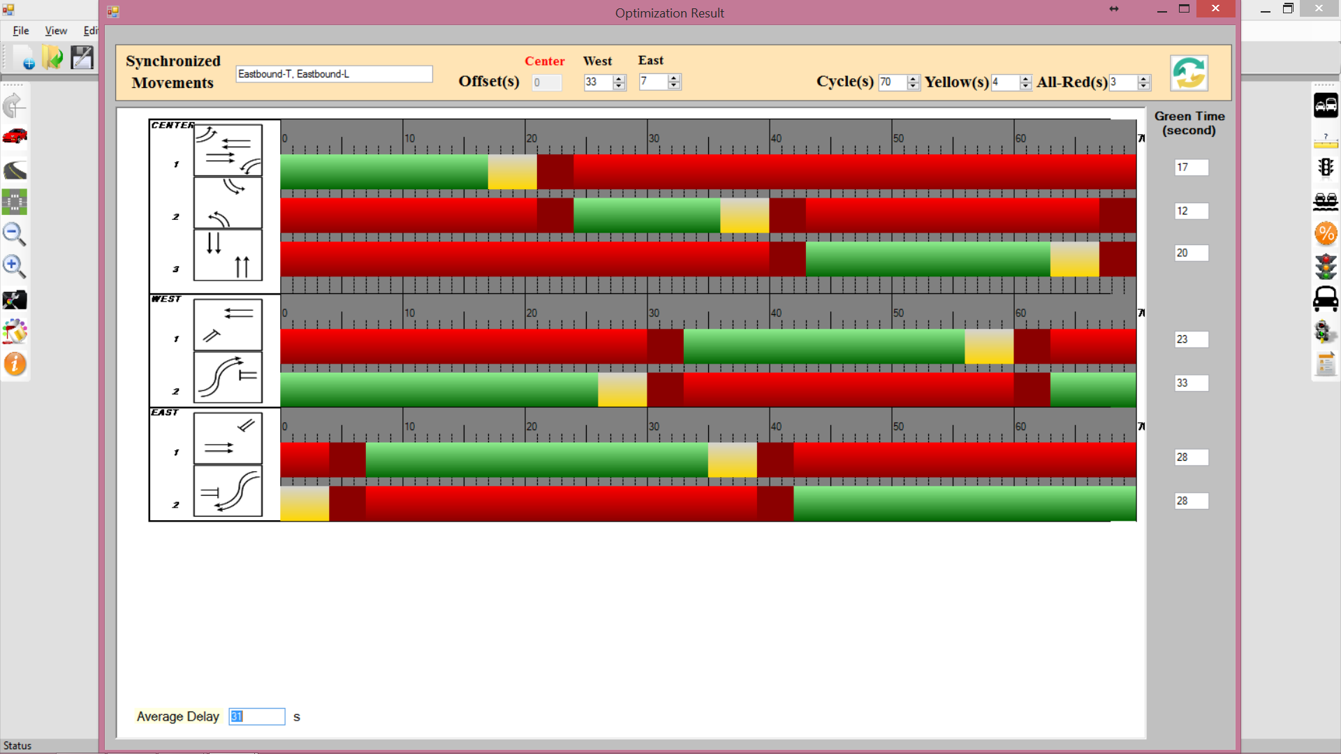
Step 5: Signal Optimization
Optimization for cycle length, green split and offset

Slide 49
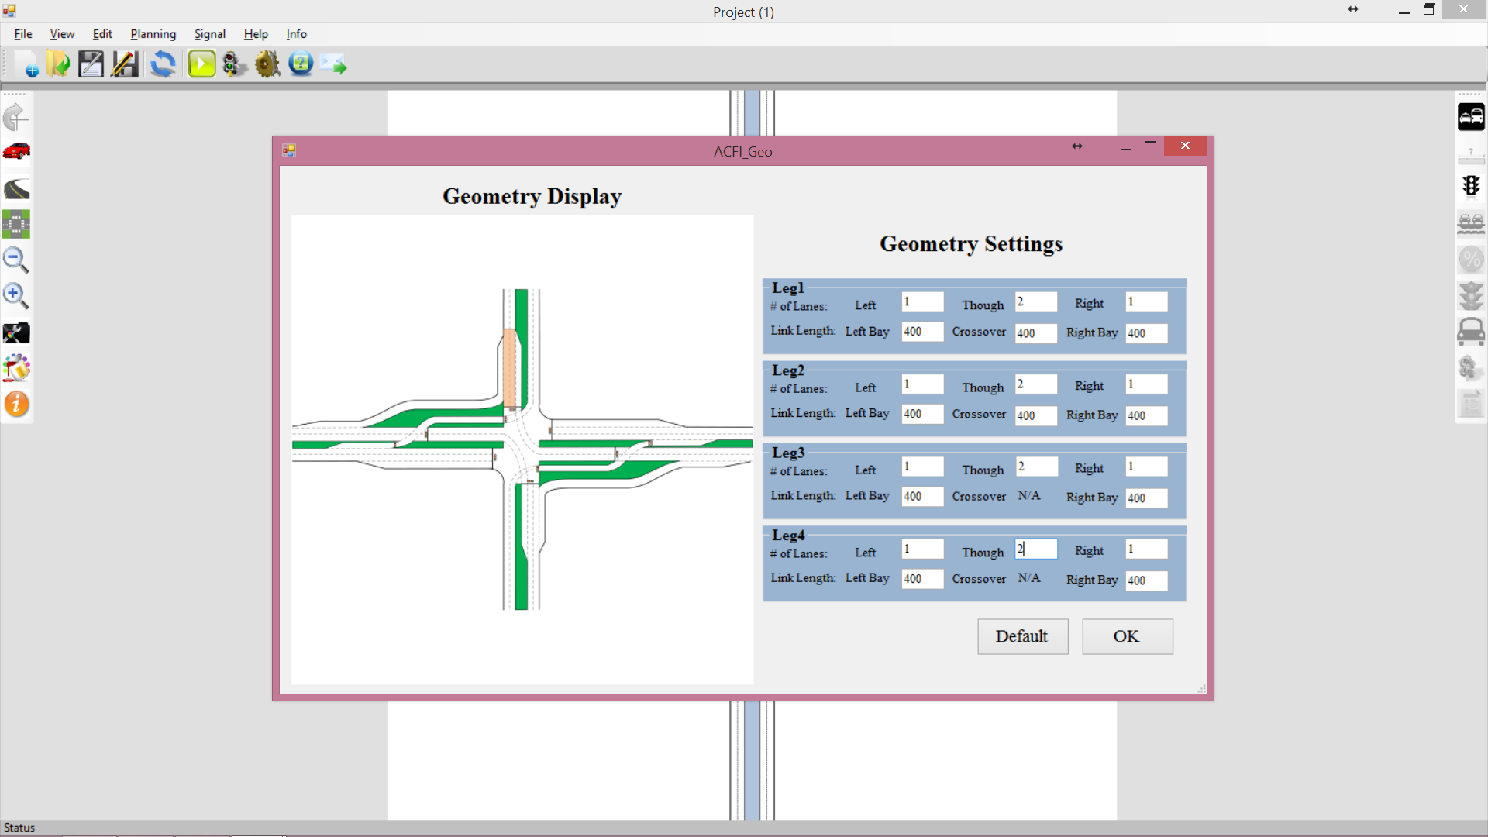
Step 3: Edit Geometric Parameters
Change # of lanes and link Length
The selected link will be colored for convenience

