Slide 1





Department of Civil & Environmental Engineering
University of Maryland
Integrating of Arterial Signal and Freeway Off-ramp Controls for Commuting Corridors
Xianfeng Yang, Ph.D. Candidate
Department of Civil & Environmental Engineering
University of Maryland, College Park

Slide 2
Outline
1
Research Background & Literature Review
2
Primary Tasks & System Framework
3
Model Formulations
4
Conclusions and Future Research Directions
Department of Civil & Environmental Engineering
University of Maryland

Slide 3
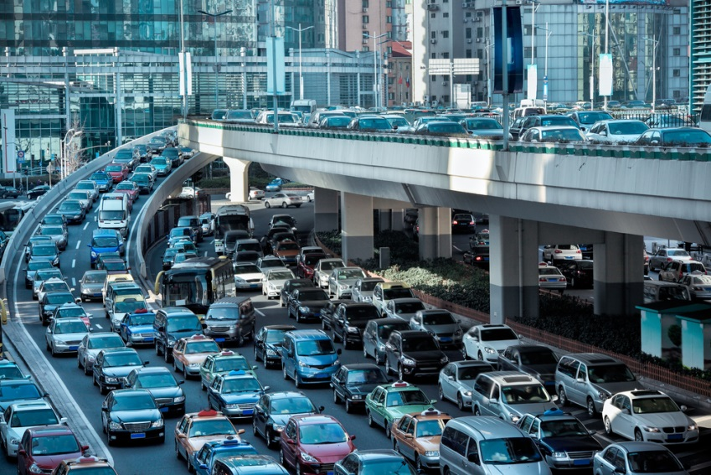
Congestion at Off-ramp Interchanged Area
Bottleneck
Department of Civil & Environmental Engineering
University of Maryland

Slide 4
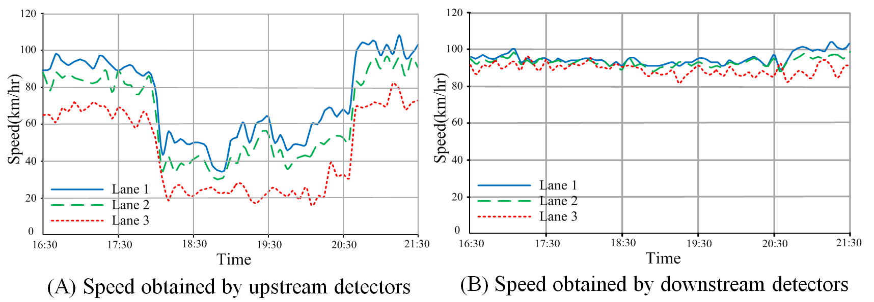
Field Observations
(National Highway No. 1, Chupei, Taiwan)
Department of Civil & Environmental Engineering
University of Maryland

Slide 5
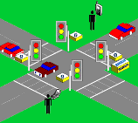
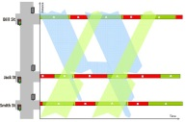
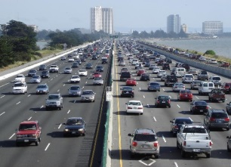
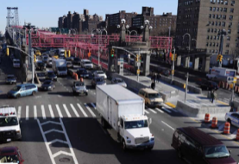
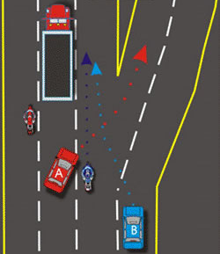

Integrated Off-Ramp Controls
Intersection Signal Control
Signal Coordination Control
Freeway
Off-Ramp Interchange
Arterial
Off- Ramp Queue Spillover Prevention
Integrated Off-ramp Traffic Control
Department of Civil & Environmental Engineering
University of Maryland

Slide 6
Literature Reviews
Pre-timed Signal Optimization Models
Existing Studies
Real-time Signal Control Models
Integrated Control Models
Department of Civil & Environmental Engineering
University of Maryland

Slide 7
Literature Reviews
Pre-timed Signal Optimization Models
Signal optimization at isolated intersections
Delay Minimization Model | Mathematical Programming Model
Matson et al. (1955), Webster (1958), Miller (1963), Robertson, (1969), Allsop (1971, 1972, 1975, 1981), Tully (1976) and Burrow (1987), Chang and Lin (2000) | Silcock, (1997,) Wong et al., (2003), Lan (2004), Yang et al., (2014)
Department of Civil & Environmental Engineering
University of Maryland

Slide 8
Literature Reviews
Pre-timed Signal Optimization Models
Signal optimization at arterial level
Minimizing Total Traffic Delay | Maximizing Progression Efficiency
TRANSYT (Robertson, 1969); TRANSYT 7-F (Wallace et al., 1988); Simulation-based (Yun and Park ,2006, Stevanovic et al., 2007); CTM-based (Lo, 1999; Lo et al., 2001; and Lo and Chow 2004); Others (Aboudolas et al., 2010; Zhang and Yin 2010, Li, 2012, Liu and Chang, 2011) | Morgan and Litter (1964), Litter (1966), Little et al., (1981), Gartner et al. (1991), Chaudhary et al. (2002), Tian and Urbanik (2007), Li (2014)
Department of Civil & Environmental Engineering
University of Maryland

Slide 9
Literature Reviews
Real-time Signal Control Models
Actuated Signal Control | Adaptive Signal Control
System Introduction (Boillot et al. 1992; ITE, 1997) Min green time selection (Kell and Fullerton, 1998) Max green time selection (Lin, 1985; Courage et al., 1989; Orcutt , 1993; Kell and Fullerton, 1998; Courage , 2003; Zhang and Wang, 2011) | SCOOT (Hunt et al. 1982; Ian et al., 1998; Dennis et al., 1991; Bretherton et al., 2005) SCATS (Luke, 1984, Gross, 2000, Gao, 2011) OPAC (Gartner et al., 1979; Gartner, 1983; Gartner et al., 1995; Gartner et al., 2001) RHODES (Mirchandani et al., 1995, 2000, 2001, 2004)
Department of Civil & Environmental Engineering
University of Maryland

Slide 10
Literature Reviews
Integrated Control Models
Integrated Corridor Control | Off-ramp Control
Integration of multiple strategies such as: traffic diversion on-ramp metering speed limit control signal timing controls (Cremer and Schoof , 1989; Zhang and Hobeika, 1997; Wu and Chang, 1999; Chang et al., 1993; Papageorgiou, 1995; Berg et al., 2001; Li, 2010; Haddad et al. , 2013) | Eliminating the lane changing maneuvers (Daganzo et al., 2002; Rudjanakanoknad, 2012; Di et al., 2013) Detouring the flows to other non-congested areas (Gunther et al., 2012; Spiliopoulou et al., 2013, 2014) Optimizing signal timing at neighboring intersections (Messer, 1998; Tian et al., 2002; Li et al., 2009; Lim et al., 2011; Yang et al., 2014)

Slide 11
Findings of Literature
Signal controls at arterial level (pre-timed & real-time):
may fall short of providing efficiency control at the off-ramp interchanged area;
Integrated corridor control:
may not be able to find the optimal solution for system control variables;
Off-ramp control with restricting lane changing or detouring flows:
may not be applicable in practice;
Off-ramp control with signal optimization at neighboring intersections:
more practical but many critical issues remain to be solved!
Department of Civil & Environmental Engineering
University of Maryland

Slide 12
Outline
1
Research Background & Literature Review
2
Primary Tasks & System Framework
3
Model Formulations
3
Conclusions and Future Research Directions
Department of Civil & Environmental Engineering
University of Maryland

Slide 13
Critical Research Issues
I – How to facilitate traffic flows to reach their destinations?
II – How to analyze the demand pattern at the interchanged area?
I – How to facilitate traffic flows to reach their destinations?
II – How to analyze the demand pattern at the interchanged area?
III – How to optimize the signal plans to prevent the off-ramp queue spillover?
V – How to deal with the uncertainty of vehicles’ arrivals using real-time control functions?
III – How to optimize the signal plans to prevent the off-ramp queue spillover?
V – How to deal with the uncertainty of vehicles’ arrivals using real-time control functions?
Department of Civil & Environmental Engineering
University of Maryland

Slide 14
Critical Research Issues
I – How to facilitate traffic flows to reach their destinations?
II – How to analyze the demand pattern at the interchanged area?
III – How to optimize the signal plans to prevent the off-ramp queue spillover?
V – How to deal with the uncertainty of vehicles’ arrivals using real-time control functions?
Department of Civil & Environmental Engineering
University of Maryland

Slide 15
Critical Research Issues
I – How to facilitate traffic flows to reach their destinations?
II – How to analyze the demand pattern at the interchanged area?
Identify traffic flows’ origins and destinations
O-D Estimation Model
III – How to optimize the signal plans to prevent the off-ramp queue spillover?
V – How to deal with the uncertainty of vehicles’ arrivals using real-time control functions?
Identify Critical Path
Department of Civil & Environmental Engineering
University of Maryland

Slide 16
Critical Research Issues
I – How to facilitate traffic flows to reach their destinations?
II – How to analyze the demand pattern at the interchanged area?
III – How to optimize the signal plans to prevent the off-ramp queue spillover?
V – How to deal with the uncertainty of vehicles’ arrivals using real-time control functions?
Department of Civil & Environmental Engineering
University of Maryland

Slide 17
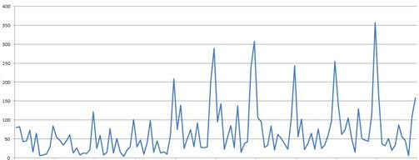
Critical Research Issues
I – How to facilitate traffic flows to reach their destinations?
II – How to analyze the demand pattern at the interchanged area?
III – How to optimize the signal plans to prevent the off-ramp queue spillover?
V – How to deal with the uncertainty of vehicles’ arrivals using real-time control functions?
Department of Civil & Environmental Engineering
University of Maryland

Slide 18
System Framework
Historical Traffic Data
OD Estimation Model
Signal Optimization Model
Traffic Detectors
OD flow pattern
Multi-path Progression Model
Critical Traffic Paths
Pre-timed Signal Plan
Real-time signal Control
Department of Civil & Environmental Engineering
University of Maryland

Slide 19
Outline
1
Research Background & Literature Review
2
Primary Tasks & System Framework
3
Model Formulations
4
Conclusions and Future Research Directions
Department of Civil & Environmental Engineering
University of Maryland

Slide 20
Model Development
Historical Traffic Data
OD Estimation Model
Signal Optimization Model
Traffic Detectors
OD flow pattern
Multi-path Progression Model
Critical Traffic Paths
Pre-timed Signal Plan
Real-time signal Control
Department of Civil & Environmental Engineering
University of Maryland

Slide 21
Origin-Destination Estimation
In the literature, the main purpose of most O-D estimation models is providing essential information for traffic assignment or network simulation.
However, designing of signal plan at the off-ramp interchanged area have also raised the need of using O-D estimation for identifying critical traffic paths.
Static
O-D Estimation
Underdetermined system
Dynamic
Department of Civil & Environmental Engineering
University of Maryland

Slide 22
Origin-Destination Estimation
Based on the dynamic O-D estimation technique, this study proposed three models with different measurement inputs:
Model I: only the link count data are available;
Model II: turning volumes at each intersection are available;
Model III: both intersection turning flows and real-time queue information are obtainable for model estimation.
Department of Civil & Environmental Engineering
University of Maryland

Slide 23
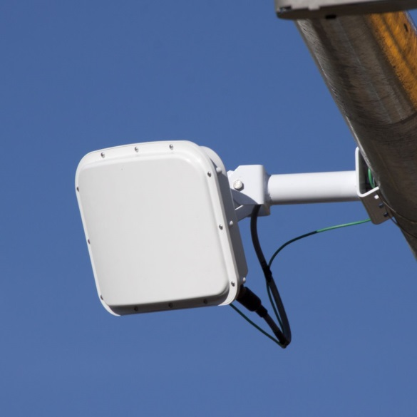
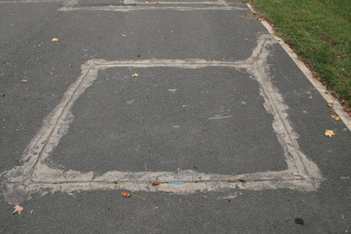
O-D Estimation: Model I
Only the link count data are available
Loop Detector
Radar Sensor
Department of Civil & Environmental Engineering
University of Maryland

Slide 24


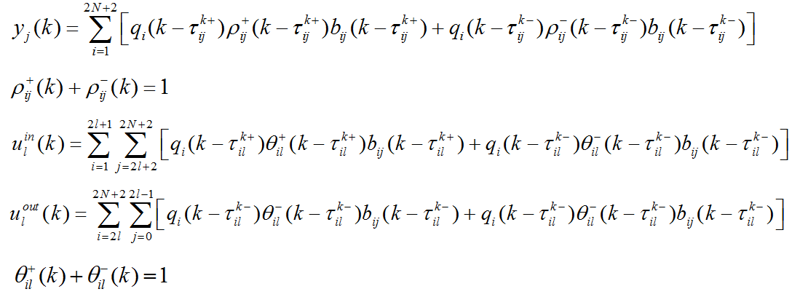






O-D Estimation: Model I
O-D flows and link travel time
Flow conservations and diversions
Flow conservations and diversions
Department of Civil & Environmental Engineering
University of Maryland

Slide 25
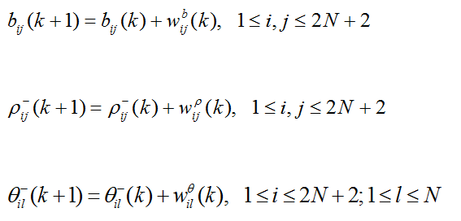
Estimation Algorithm
The dynamic O-D variables are assumed to follow the random walk process between successive time intervals:
Department of Civil & Environmental Engineering
University of Maryland

Slide 26
Estimation Algorithm
Initialization
Compute the mean link travel time
Compute the linearized transformation matrix H(k)
Update the estimation with extended Kalman filter
Department of Civil & Environmental Engineering
University of Maryland

Slide 27
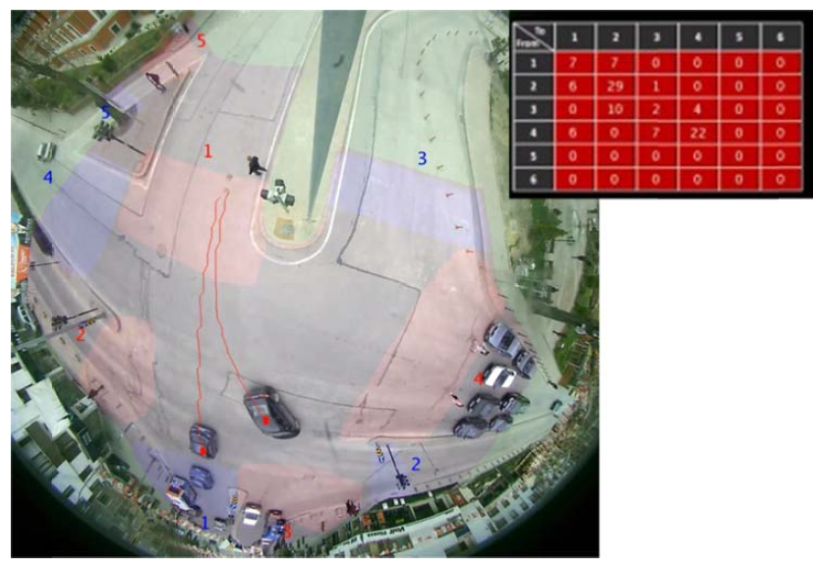
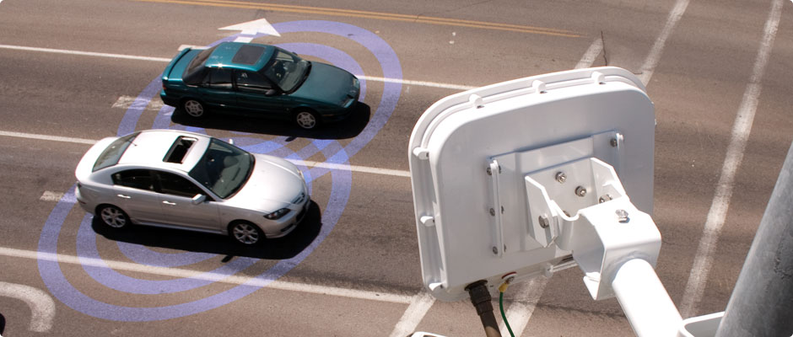
O-D Estimation: Model II
Turning volumes at each intersection are available
Lane-based Radar Sensor
Fisheye camera
Department of Civil & Environmental Engineering
University of Maryland

Slide 28
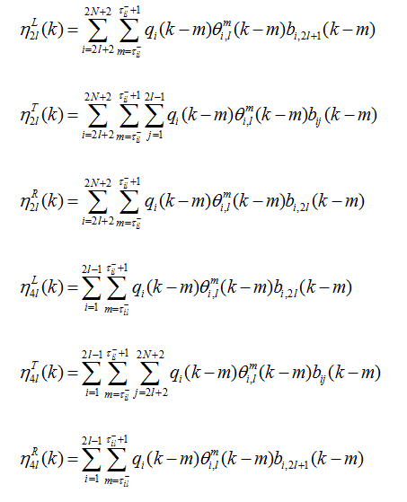
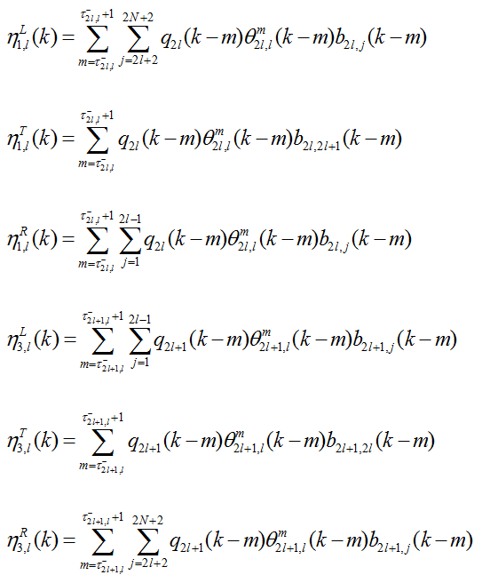
O-D Estimation: Model II
Flow conservations and diversions
Flow conservations and diversions
For approach 1 and 3:
For approach 2 and 4:
Turning flows at intersection l
Department of Civil & Environmental Engineering
University of Maryland

Slide 29

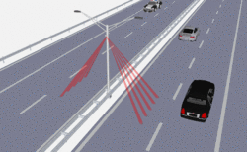

O-D Estimation: Model III
Both intersection turning flows and real-time queue information are obtainable for model estimation
R
T
T
T
L
Signal progression
Camera Sensors
Radar Sensors
Department of Civil & Environmental Engineering
University of Maryland

Slide 30
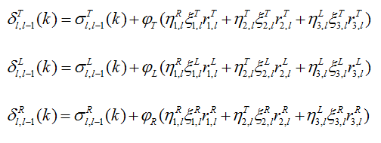
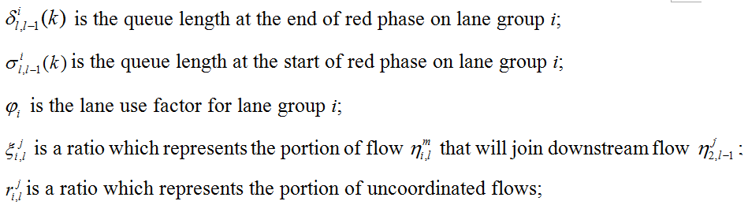
O-D Estimation: Model III
Queue Length Estimation
Department of Civil & Environmental Engineering
University of Maryland

Slide 31
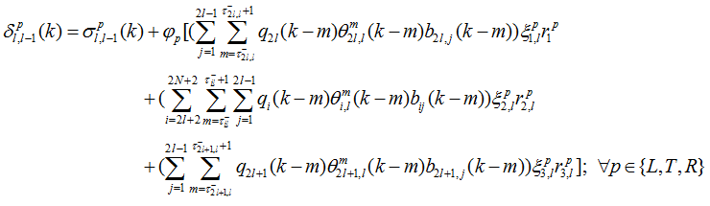
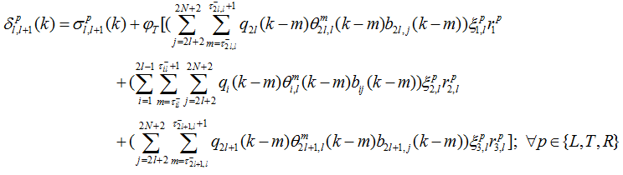
O-D Estimation: Model III
Queue Length Estimation
For outbound direction:
For inbound direction:
Department of Civil & Environmental Engineering
University of Maryland

Slide 32
Model Evaluation
Arterial Topology of the Study Site
Models | Model I |  |  | Model II |  |  | Model III
 | MAE | MAPE | RMSE | MAE | MAPE | RMSE | MAE | MAPE | RMSE
Link flows | 4.54 | 18.56% | 5.48 | 4.10 | 16.31% | 5.21 | 3.99 | 15.92% | 4.99
Turning flows | 4.02 | 42.39% | 5.54 | 2.75 | 18.27% | 4.07 | 2.70 | 17.46% | 3.92
OD flows | 1.885 | 42.02% | 3.075 | 1.473 | 33.20% | 2.512 | 1.251 | 28.11% | 1.979
Department of Civil & Environmental Engineering
University of Maryland

Slide 33
Model Evaluation
Ground Truth |  | Model I |  | Model II |  | Model III
OD Pair | Total Flows | OD Pair | Total Flows | OD Pair | Total Flows | OD Pair | Total Flows
9→12 | 1390 | 9→12 | 1658 | 9→12 | 1372 | 9→12 | 1480
6→12 | 765 | 6→12 | 985 | 6→12 | 860 | 6→12 | 784
9→1 | 756 | 9→4 | 649 | 9→4 | 727 | 9→1 | 722
6→4 | 729 | 4→7 | 497 | 4→7 | 571 | 6→4 | 642
12→7 | 553 | 4→8 | 465 | 12→6 | 544 | 12→7 | 540
12→1 | 472 | 9→1 | 427 | 9→1 | 531 | 12→1 | 452
Department of Civil & Environmental Engineering
University of Maryland

Slide 34
Pre-timed Signal Design
Historical Traffic Data
OD Estimation Model
Signal Optimization Model
Traffic Detectors
OD flow pattern
Multi-path Progression Model
Critical Traffic Paths
Pre-timed Signal Plan
Real-time signal Control
Department of Civil & Environmental Engineering
University of Maryland

Slide 35
Pre-timed Signal Design
Objective:
maximizing intersection capacity
Control Variables:
common cycle length, green split
Signal Optimization Model
Objective:
maximizing progression efficiency
Control Variables:
offsets; phase sequences
Multi-path Progression Model
Department of Civil & Environmental Engineering
University of Maryland

Slide 36
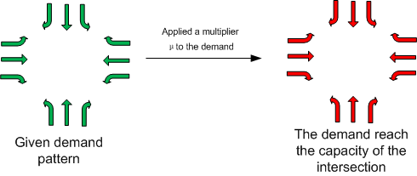
Signal Timing Optimization
Objective function: Maximization of Intersection capacity
Apply a multiplier μ to the demand pattern

Slide 37
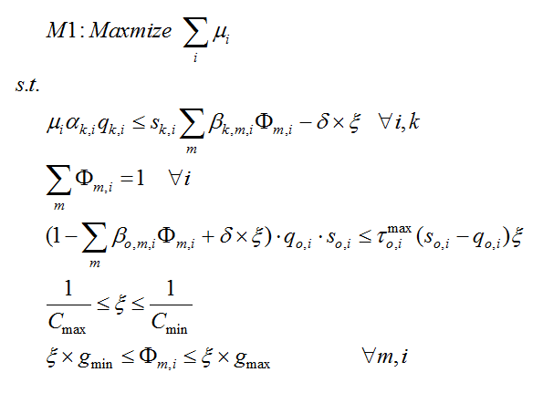
Signal Timing Optimization
Maximization of intersection capacities
Flow <= Link Capacity
Sum of green = cycle length
Off-ramp queue constraint:
Queue < Link Length
Min & Max cycle length
Min & Max green time
Department of Civil & Environmental Engineering
University of Maryland

Slide 38
Pre-timed Signal Design
Objective:
maximizing intersection capacity
Control Variables:
common cycle length, green split
Signal Optimization Model
Objective:
maximizing progression efficiency
Control Variables:
offsets; phase sequences
Multi-path Progression Model
Department of Civil & Environmental Engineering
University of Maryland

Slide 39
Review of Two-way Progression
outbound
inbound
Within the green band, vehicles can pass the intersections without any stops.
Department of Civil & Environmental Engineering
University of Maryland

Slide 40
What is Multi-Path Progression?
Department of Civil & Environmental Engineering
University of Maryland

Slide 41
Critical Issues in Multi-Path Progression
1
How to formulate the optimization model to accommodate multiple traffic paths?
3
How to effectively eliminate some paths so as to produce the maximal progression benefit?
2
How to concurrently optimize the phase sequences?
Department of Civil & Environmental Engineering
University of Maryland

Slide 42
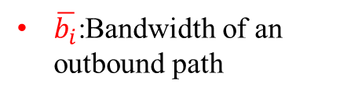
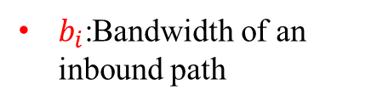
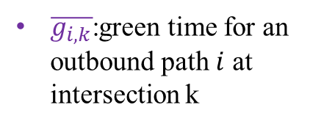
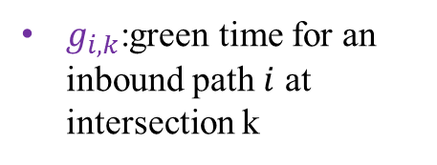

Model I
$b_{i}$:Bandwidth of an inbound path
Control Objective:
Interference Constraints:
$\overline{b_{i}}$:Bandwidth of an outbound path
$φ_{i}, \overline{φ_{i}}$:weighting factors
$g_{i,k}$:green time for an inbound path $i$ at intersection k
$\overline{g_{i,k}}$:green time for an outbound path $i$ at intersection k
$w_{i,k}$:part of green time that is before the band for an inbound path $i$ at intersection $k$
$\overline{w_{i,k}}$:part of green time that is after the band for an outbound path $i$ at intersection $k$
Department of Civil & Environmental Engineering
University of Maryland

Slide 43
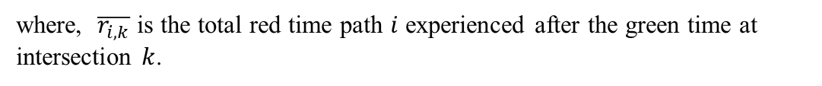



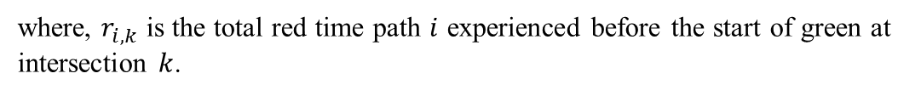









Model I
Progression Constraints:
For inbound directions:
outbound
$${\overline{w}}_{k+2}$$
$${\overline{r}}_{k+2}$$
Inbound
$${\overline{t}}_{k+1}$$
$${\overline{w}}_{k+1}=0$$
$${\overline{r}}_{k+1}$$
where, $r_{i,k}$ is the total red time path $i$ experienced before the start of green at intersection $k$.
$$r_{k+1}$$
$$θ_{k+2}−θ_{k+1}$$
$$w_{k+1}$$
For outbound directions:
$$r_{k}=0$$
$$w_{k}$$
$$t_{k,}$$
$$θ_{k}$$
where, $\overline{r_{i,k}}$ is the total red time path $i$ experienced after the green time at intersection $k$.
Department of Civil & Environmental Engineering
University of Maryland

Slide 44
Model II
Model 2: To optimize the phase sequence in the multi-path progression model.
To facilitate the phase sequence optimization, a set of binary variables are defined as follows:
Department of Civil & Environmental Engineering
University of Maryland

Slide 45

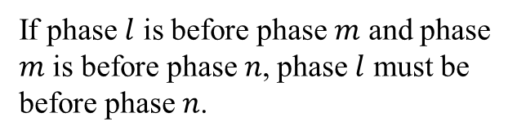
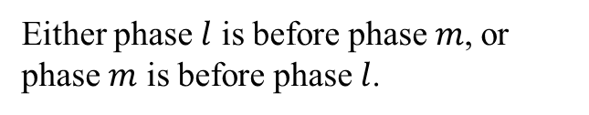
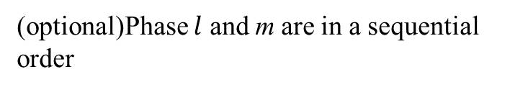
Model II
To ensure the feasibility of the generated phase sequence, a set of constraints are defined as follows:
A phase is never before itself.
Either phase $l$ is before phase $m$, or phase $m$ is before phase $l$.
If phase $l$ is before phase $m$ and phase $m$ is before phase $n$, phase $l$ must be before phase $n$.
(optional)Phase $l$ and m are in a sequential order
(optional)Phase $l$ must be before phase $m$
Department of Civil & Environmental Engineering
University of Maryland

Slide 46
Model II
The interference constraints must be re-written as follows:
A set of binary parameters are defined to represent the phasing design:
Department of Civil & Environmental Engineering
University of Maryland

Slide 47
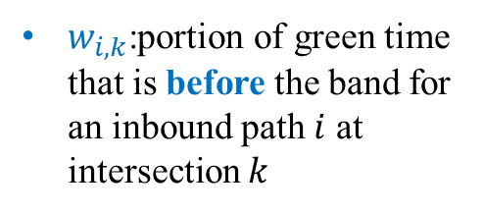
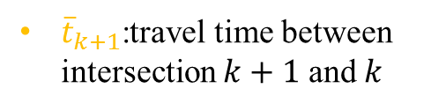
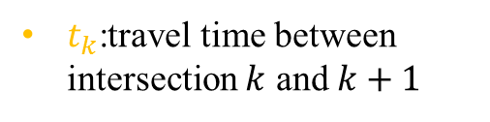
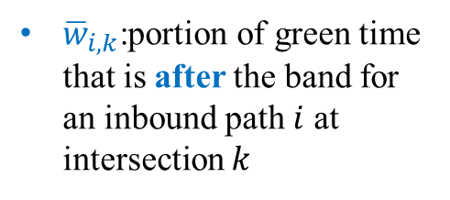
Model II
Similarly, the progression constraints are given as follows:
$w_{i,k}$:portion of green time that is before the band for an inbound path $i$ at intersection $k$
For inbound directions:
?
?
${\overline{w}}_{i,k}$:portion of green time that is after the band for an inbound path $i$ at intersection $k$
For outbound directions:
?
?
$t_{k}$:travel time between intersection $k$ and $k+1$
${\overline{t}}_{k+1}$:travel time between intersection $k+1$ and $k$
Department of Civil & Environmental Engineering
University of Maryland

Slide 48
Model III
Progression competition between different critical paths
  In practice, the identified critical paths may compete for the progression band.
  Thus, it might be infeasible or ineffective to find a synchronization plan which can offer reasonable bandwidths for all the critical paths.
  Hence, it is essential to eliminate some infeasible paths when designing signal progression.
Department of Civil & Environmental Engineering
University of Maryland

Slide 49
Model III
To deal with the progression conflicts between critical paths, another set of constraints are introduced as follows to the model:
For inbound directions:
It is similar for outbound directions.
Department of Civil & Environmental Engineering
University of Maryland

Slide 50
Model Summary
Model III
Model II
Model I
Department of Civil & Environmental Engineering
University of Maryland

Slide 51
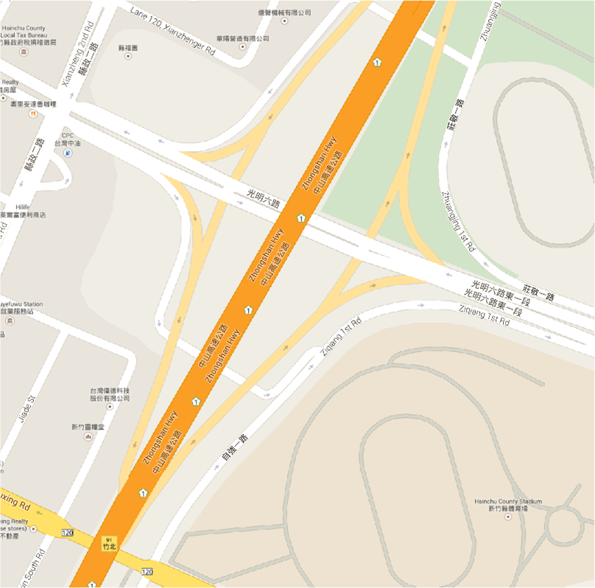
Numerical Test
Bottleneck

Slide 52
Numerical Test
Three models are compared:
Model 1: TRANSYT-7F optimization Model;
Model 2: Proposed signal optimization model with MAXBAND for progression design;
Model 3: Proposed model;
Model | Intersection | CL | Φ1 | Φ2 | Φ3 | Φ4 | offset
Model-1 | 1 | 160 | 91 | 69 | / | / | 152
 | 2 | 160 | 41 | 32 | 60 | 27 | 0
 | 3 | 160 | 75 | 35 | 50 | / | 115
 | 4 | 160 | 92 | 37 | 31 | / | 76
Model-2 | 1 | 155 | 108 | 47 | / | / | 55
 | 2 | 155 | 39 | 27 | 63 | 26 | 85
 | 3 | 155 | 48 | 50 | 57 | / | 40
 | 4 | 155 | 95 | 32 | 28 | / | 0
Model-3 | 1 | 155 | 108 | 47 | / | / | 35
 | 2 | 155 | 39 | 27 | 63 | 26 | 47
 | 3 | 155 | 48 | 50 | 57 | / | 0
 | 4 | 155 | 95 | 32 | 28 | / | 138
Department of Civil & Environmental Engineering
University of Maryland

Slide 53
Numerical Test
To evaluate the signal plans produced by different models, a simulation network is developed with VISSIM.
Also, the VISSIM network has been well-calibrated with field data.
Percentage difference between simulated and field volume data
Intersection No. | Approach
 | WB | NB | EB | SB
1 | 1% | 0.6% | 2% | N/A
2 | 0.9% | N/A | 2% | 0.2%
3 | 2% | 3% | 0.6% | 1%
Netowork performance under the control of different models
MOEs | Model 1 TRANSYT 7-F | Model 2 MAXBAND | Model 3 Proposed
Average Delay | 54.3 secs | 55.4 secs | 47.6 secs
Average # of Stops | 0.972 | 1.047 | 0.884
Average Speed | 34.7 km/h | 31.3 km/h | 40.5 km/h
Department of Civil & Environmental Engineering
University of Maryland

Slide 54
Numerical Test
The time-dependent travel time on freeway mainline
Department of Civil & Environmental Engineering
University of Maryland

Slide 55
Real-Time Signal Control
Historical Traffic Data
OD Estimation Model
Signal Optimization Model
Traffic Detectors
OD flow pattern
Multi-path Progression Model
Critical Traffic Paths
Pre-timed Signal Plan
Real-time signal Control

Slide 56
Real-Time Signal Control
Off-ramp Queue Estimation
Traffic Detection System
Potential Freeway Breakdown?
No
Yes
Arterial Adaptive Signal Control
Dynamic Off-ramp Priority Control

Slide 57
Off-ramp Queue Estimation Model
Location of dual-zone detectors on the target off-ramp
Short Detection Zone: collect traffic flow information;
Long Detection Zone: identify the presence of queue

Slide 58
Off-ramp Queue Estimation Model
This study proposed two models in response to different congestion levels at the off-ramp:
Model I: off-ramp queue can be cleared during the green phase;
Model II: off-ramp queue cannot be cleared during the green phase.

Slide 59
Model I
equals the number of vehicles passed the upstream detector during time period [ε – t_{off} , ε]
At time ε:
plus # of arrivals and minus # of departures
At time goff:
At time c:
plus # of arrivals

Slide 60
Model II
Two additional scenarios might be encountered:
Scenario 1: residual queue cannot reach the downstream detector;
Scenario 2: residual queue can reach the downstream detector;

Slide 61
Scenario 1
At time c:
equals the number of vehicles passed the upstream detector during time period [η – t_{off} , c]

Slide 62
Scenario 2
If the residual queues have exceeded the downstream detector, the queue length at the end of a cycle can be approximated with :
Last cycle queue
Total Arrivals
Total Departures

Slide 63
Real-Time Signal Control
Off-ramp Queue Estimation
Traffic Detection System
Potential Freeway Breakdown?
No
Yes
Arterial Adaptive Signal Control
Dynamic Off-ramp Priority Control

Slide 64
Arterial Adaptive Signal Control
Intersection Signal Timing Adjustment
Adaptive Signal Progression Design
Objective
Minimization of intersection Delays
Objective
Maximization of Progression Efficiency
Solution Algorithm
Gradient Search
Solution Algorithm
Dynamic Programming
Department of Civil & Environmental Engineering
University of Maryland

Slide 65
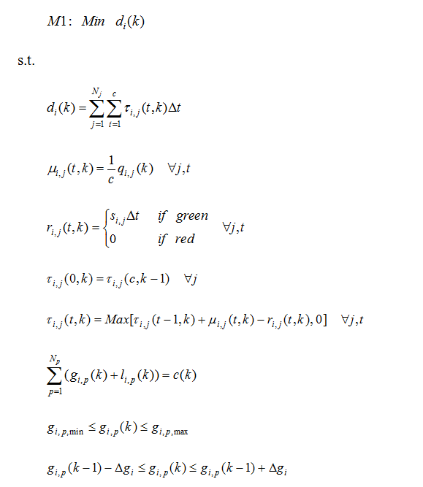
Intersection Signal Timing Adjustment
Minimization of intersection total delay
Step 1: Intersection Signal Timings Adjustment
Total delay estimation with queue
Arrival rate calculation
Departure rate estimation
Queue Estimation
Common cycle length constraint
Min & Max green time constraint
Max green time adjustment constraint

Slide 66
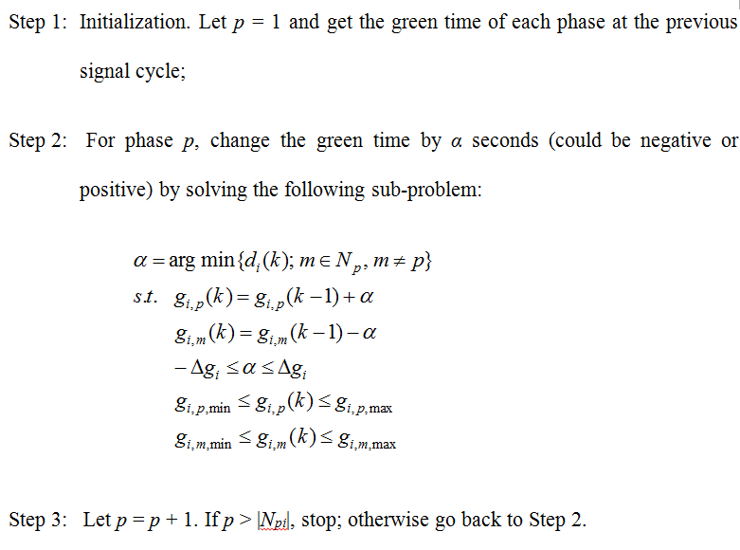
Solution Algorithm
Gradient Search Algorithm:
Step 0: compute the intersection total delay if no green time adjustment is applied;
Step 1: for each phase p; find the adjustment direction (increase or reduce green time) based on the intersection total delay;
Step 1.1: increase the green time of phase p by 1 second and reduce the green time of another phase (the one can produce the minimal delay) by 1 second;
Step 1.2: decrease the green time of phase p by 1 second and increase the green time of another phase (the one can produce the minimal delay) by 1 second;
Step 1.3: compare the obtained delay from Step 1.1 &1.2 with the one from Step 0; find the green time adjustment direction;
Step 2: keep increasing or decreasing green time for phase p until no delay improvement is found or the green time constraint is violated.

Slide 67
Adaptive Signal Progression Control
Green band of an outbound path between two intersections
Green band of an inbound path between two intersections

Slide 68
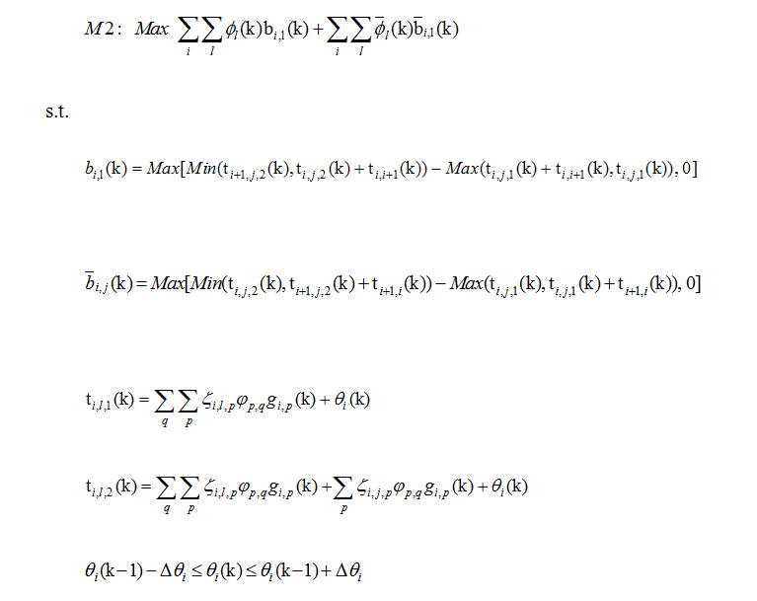
Adaptive Signal Progression Control
Maximization of total green bandwidths
Estimation of green bandwidth for an outbound path
Estimation of green bandwidth for an inbound path
Identification of start of green for path i
Identification of end of green for path i
Max allowed offset adjustment constraint

Slide 69
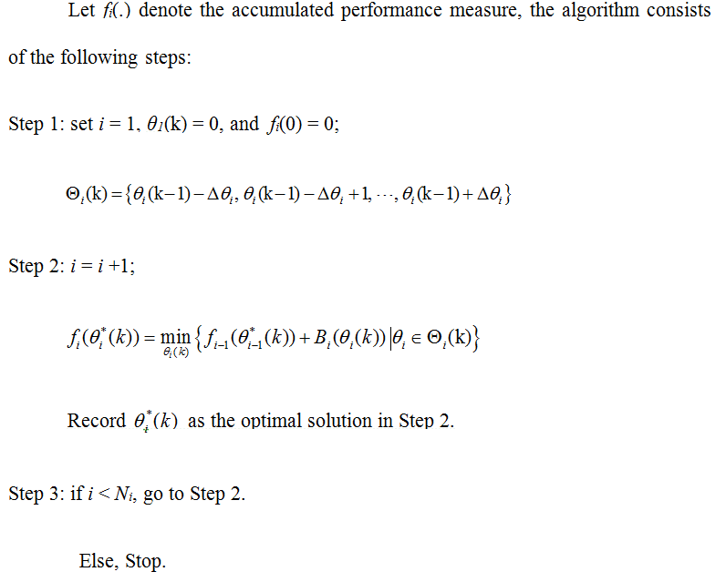
Solution Algorithm
Dynamic Programming:

Slide 70
Solution Algorithm
Dynamic Programming:
Intersection 1
Intersection 2
…
Intersection j
…
Intersection n

Slide 71
Real-Time Signal Control
Off-ramp Queue Estimation
Traffic Detection System
Potential Freeway Breakdown?
No
Yes
Arterial Adaptive Signal Control
Dynamic Off-ramp Priority Control

Slide 72
Dynamic Off-ramp Priority Control
Intersection Signal Timing Adjustment
Adaptive Signal Progression Design
Objective
Minimization of intersection Delays
Objective
Maximization of Coordination Efficiency
Solution Algorithm
gradient search
Solution Algorithm
Dynamic programming

Slide 73
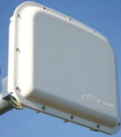
Control Logic
Data Collection
Breakdown!
Data
Analysis
Priority Control
increasing the green time for the off-ramp flows;
providing signal progression priority to those path-flows from the target off-ramp.

Slide 74
Intersection Signal Timing Adjustment with Off-ramp Priority
Step 1: computation of the minimum green extension to off-ramp flows
The minimal green extension will ensure the prevention of queue spillover until the end of the following signal cycle.

Slide 75
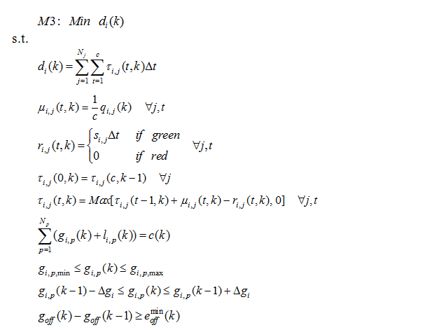
Intersection Signal Timing Adjustment with Off-ramp Priority
Step 2: adaptive signal control with off-ramp priority
Green extension constraint

Slide 76
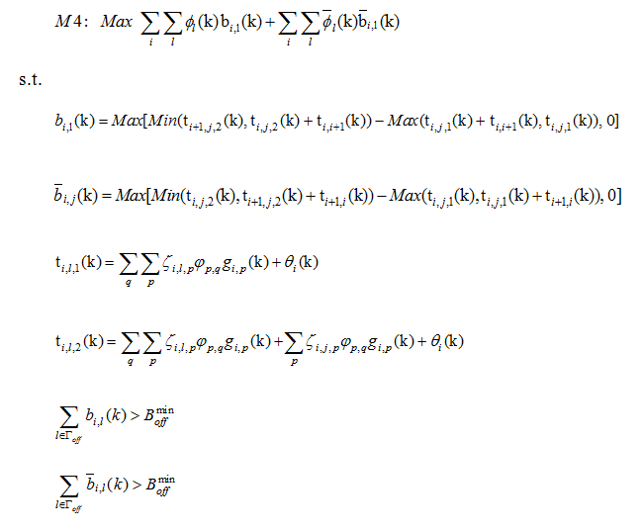
Adaptive Signal Progression Control with Off-ramp Priority
Min bandwidth constraint for off-ramp path-flows

Slide 77
Numerical Test

Slide 78
Numerical Test
Queue Estimation Accuracy
Comparison of estimated and actual queue length at the off-ramp
The estimation errors of the off-ramp queue estimation model

Slide 79
Numerical Test
Activation of off-ramp priority control function
Green extension time granted to the off-ramp flows

Slide 80
Numerical Test
System Evaluation
The following three systems are tested for comparison:
Pre-timed Control System: using the proposed pre-timed models to generate the signal plans;
Adaptive Control System: only the proposed adaptive signal control model and dynamic signal progression model are implemented;
Proposed System: including the off-ramp queue estimation, arterial signal adaptive control, and off-ramp priority control.

Slide 81
Numerical Test
The time-dependent travel time along the freeway mainline

Slide 82
Numerical Test
Network Performance
Performance Index | Pre-timed System | Adaptive System | Proposed System
Ave number of stops | 2.391 | 1.711 (-28.4%) | 1.621 (-32.2%)
Ave speed (km/h) | 36.116 | 38.633 (+7.0%) | 39.25 (+8.7%)
Ave Network delay (s) | 89.065 | 73.77 (-13.7%) | 68.209 (-19.6%)

Slide 83
Outline
1
Research Background & Literature Review
2
Primary Tasks & Modeling Framework
3
System Framework & Model Formulations
4
Conclusions and Future Research Directions
Department of Civil & Environmental Engineering
University of Maryland

Slide 84
Conclusions
Summary of Contributions:
Developed an effective operational framework for the integrated traffic control at the off-ramp interchanged area;
Constructed a new O-D estimation model with real-time queue information;
Formulated a signal optimization model to prevent the off-ramp queue spillover;
Proposed a multi-path progression model to facilitate traffic flows to reach their destinations;
Advanced all key control models for real-time operations, in response to traffic fluctuations in practice.
Department of Civil & Environmental Engineering
University of Maryland

Slide 85
Conclusions
Future Research Directions:
Development of an optimal traffic control model to concurrently account for the delay of traffic flows on the freeway and local arterial;
Integration of both on-ramp and off-ramp control strategies (ramp metering, variable speed limit, off-ramp priority, local signal adaptive control) for a large-scale corridor traffic management;
Enhancement of the current real-time signal control system with advanced information/communication technologies (e.g., connected vehicles).
Department of Civil & Environmental Engineering
University of Maryland

Slide 86

Department of Civil & Environmental Engineering
University of Maryland
THANKS & Questions?

